Slide 1
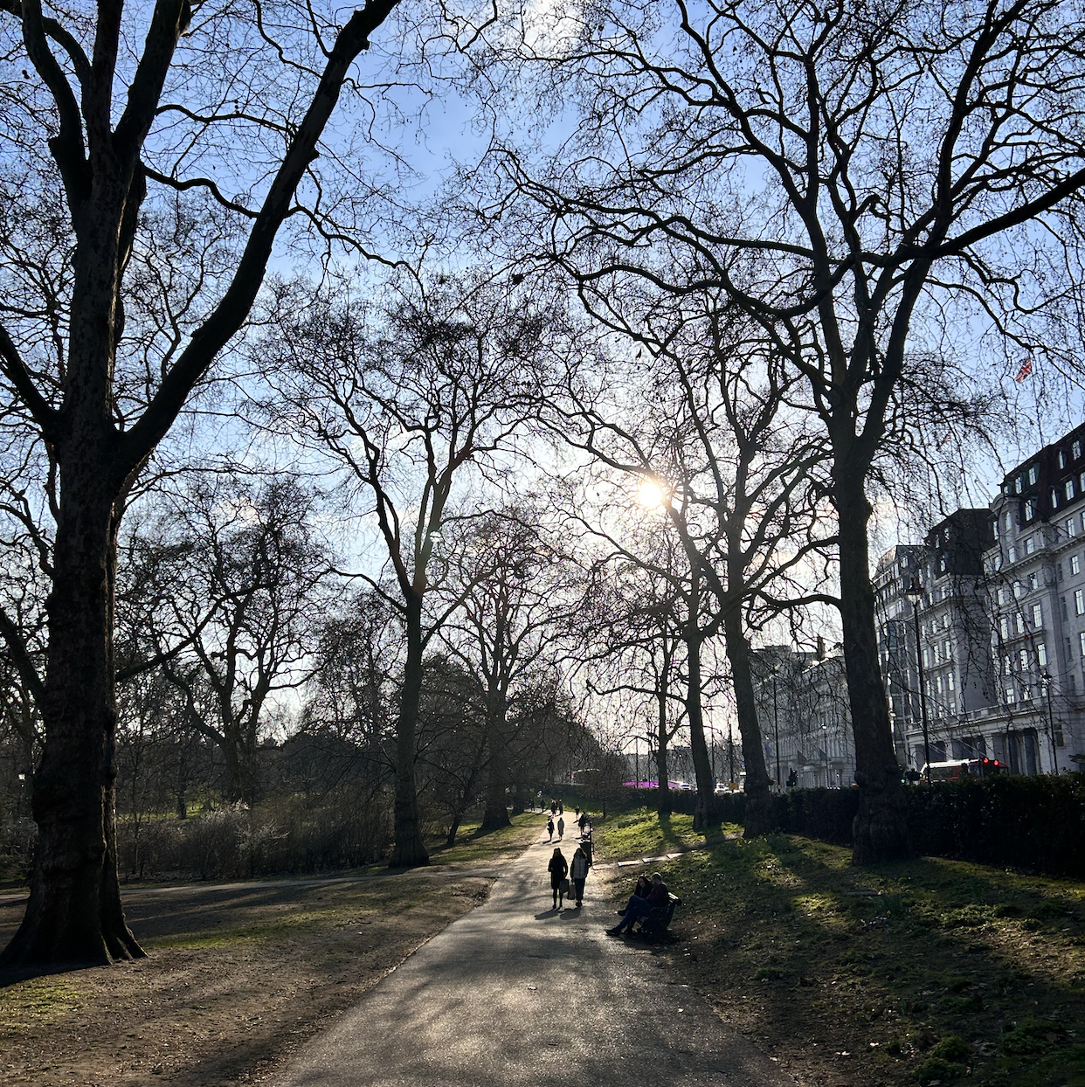
Biodiversity & Ecosystem functioning under anthropogenic stressors
Marc W Cadotte
University of Toronto
Session 1.1: The history of BEF research, motivations, questions, conflicts

Slide 2
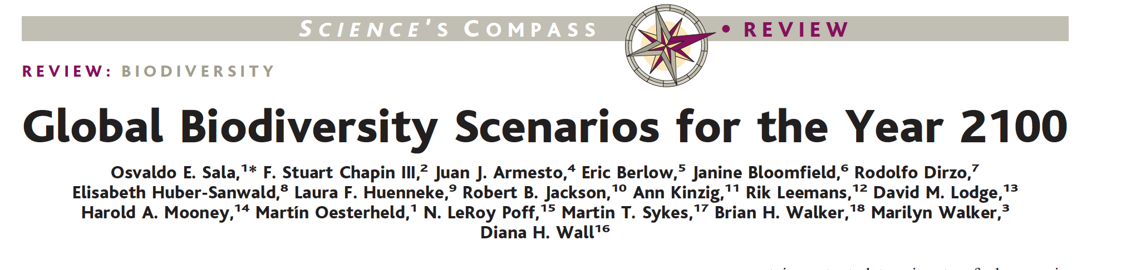
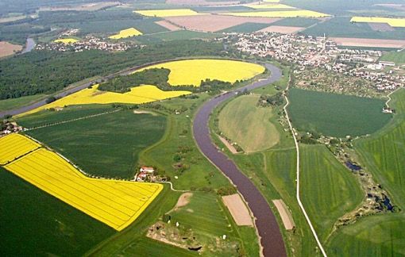
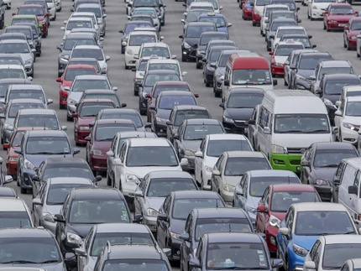
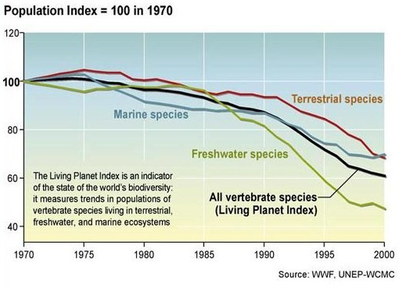


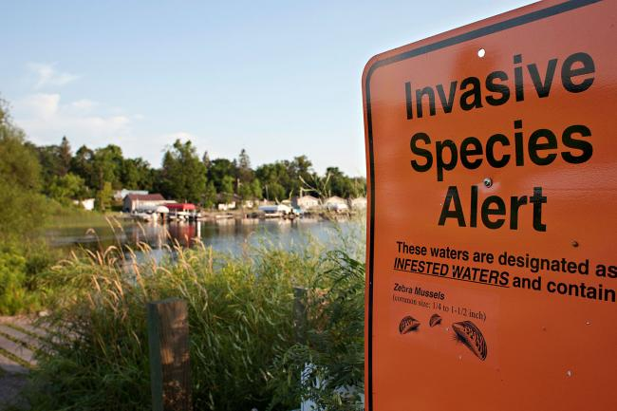
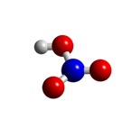
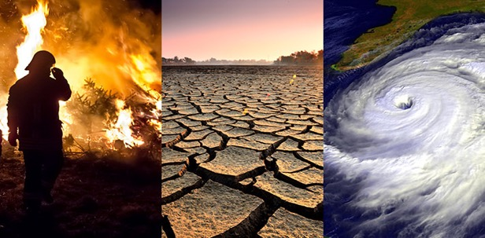
Biodiversity is changing
Land use change
Carbon pollution
Nitrogen
deposition
Species invasion
Climate change

Slide 3
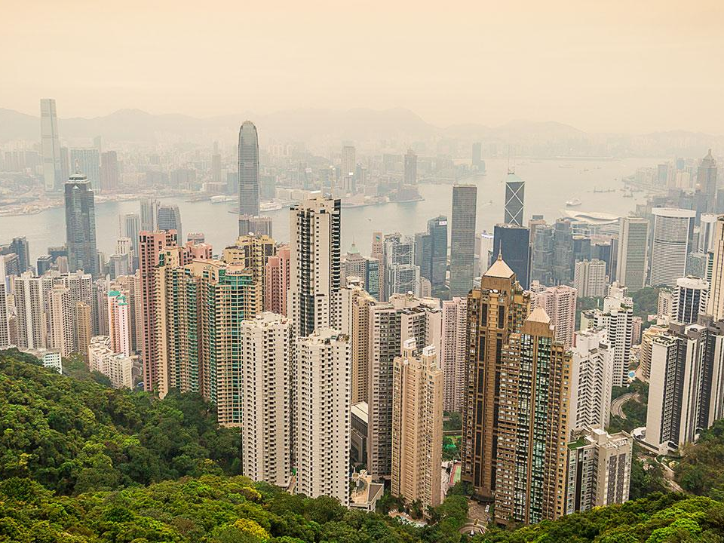
City: the most novel of habitats

Slide 4
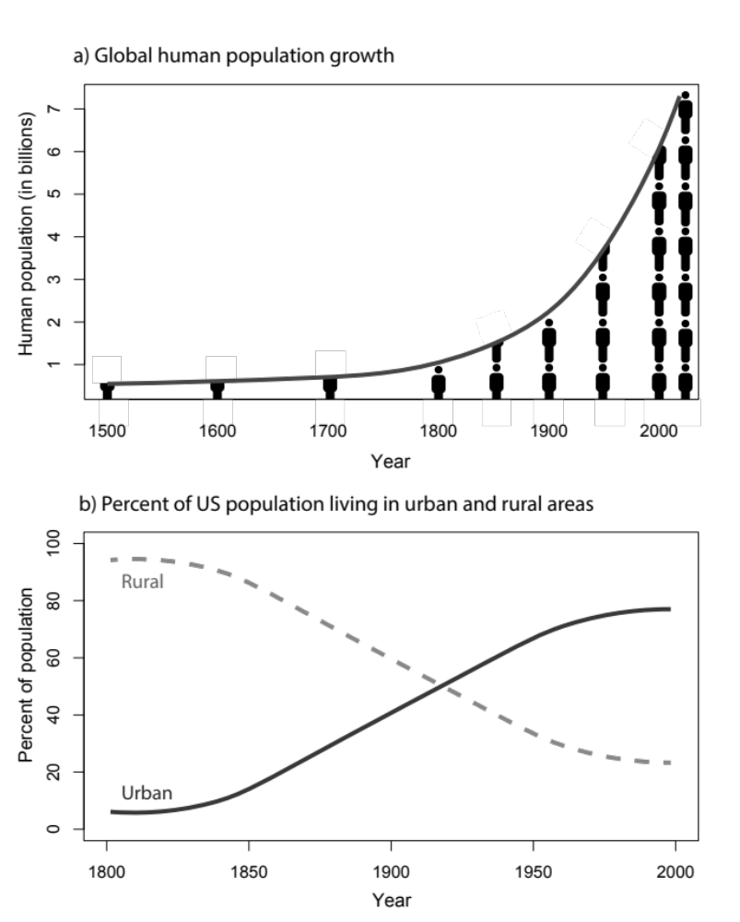
The growth of human populations

Slide 5
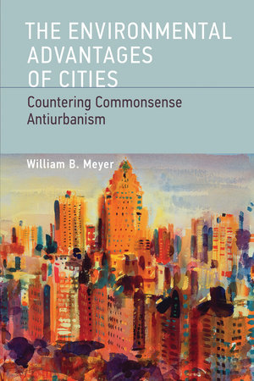
Are cities good for the environment?
At a global scale, cities are more efficient –that’s why they emerged.
Efficient transportation, energy &resource use
Cities have a lower environmental impact than if the same number of people were distributed evenly across the globe.
Cities concentrate human activity so land can be spared elsewhere.
But…

Slide 6

None of this really matters is this is your reality
Taipei,
Taiwan

Slide 7
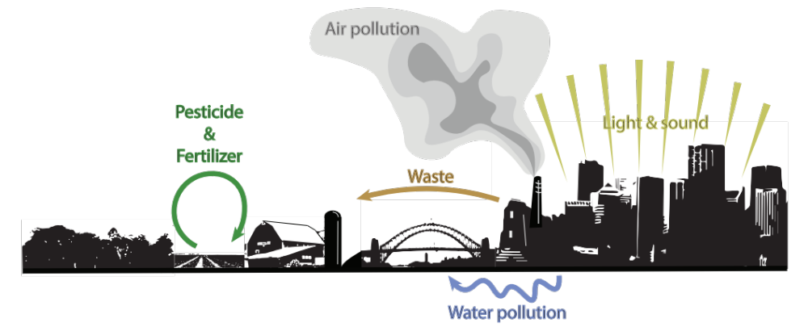
Human activities generate a complex suite of environmental impacts
The effects of all these impacts are not well understood, but have consequences for human and ecosystem health

Slide 8
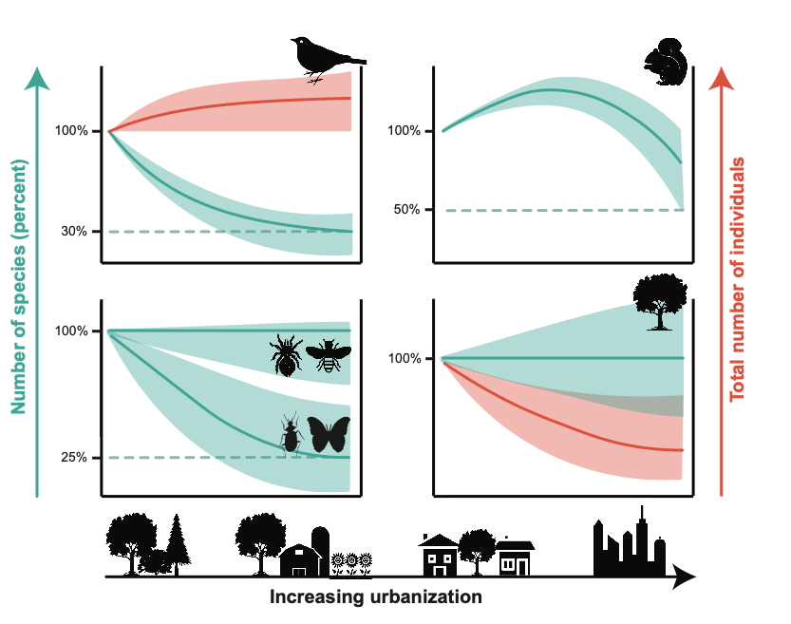
Urbanisation effects on biodiversity

Slide 9
Changes in biodiversity result in changes to functioning
Functioning (biomass)
Species diversity

Slide 10
Stressors, Biodiversity & Ecosystem Functioning Short course
4 + 1 days of instruction.
Three sessions per day for everyone, and an additional afternoon meeting for people working on additional project :
1) 9:30-11:00; 2) 11:30-13:00; 3) 14:00 – 15:00; 4) 15:30 – 17:00 (for subgroup working on project)
With such a large group, the course will be lecture based, with opportunities for group discussion and question & answer.
A subgroup of 20 students will be selected for participate in final session each day and on the fifth day.

Slide 11
Schedule
Day 3: Data synthesis
Synthesizing stressors: Reviews and meta-analyses
Synthesizing BEF: Reviews and meta-analyses
Building conceptual models/frameworks for stressor effects on BEF
iv) Refine search strings, collect evidence (subgroup)
Day 1: The basics of biodiversity and ecosystem functioning (BEF) and anthropogenic stressors
The history of BEF research, motivations, questions, conflicts
Background of stressor impacts on biodiversity
Systematic review design
Develop questions and key words (subgroup).
Day 4: How stressors impact BEF
Stressor impacts on BEF relationships: theory and evidence
Building conceptual models/frameworks for stressor effects on BEF
Why BEF research might not be valuable
Refine search strings, collect evidence (subgroup)
Day 2: BEF analyses and meta-analyses
Measuring biodiversity
Analyzing BEF experiments: measuring selection and complementarity
BEF experiments: design and outcomes; How do different biodiversity measures compare?
Further develop questions and review strategies (subgroup)
Day 5 (subgroup): Groups wanting to push forward with review meta-analysis will meet to carry out tasks and develop plan.

Slide 12
Source for readings and links
https://cubes-labs.com/sbef-short-course-material/

Slide 13
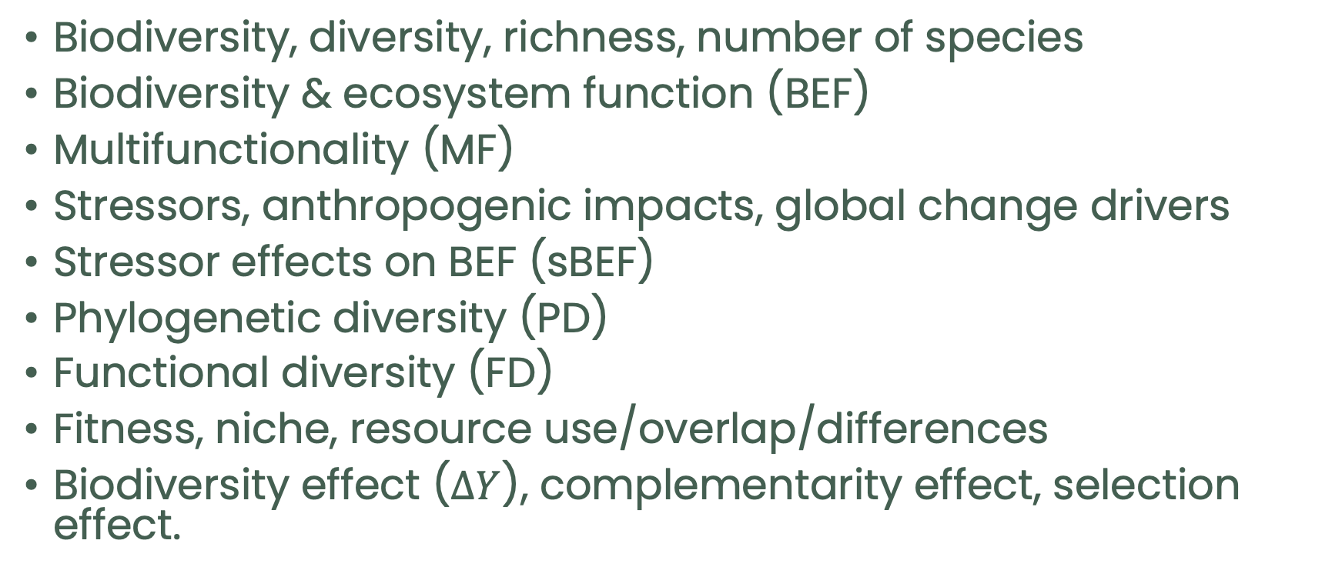
Common terms
Biodiversity, diversity, richness, number of species
Biodiversity & ecosystem function (BEF)
Multifunctionality (MF)
Stressors, anthropogenic impacts, global change drivers
Stressor effects on BEF (sBEF)
Phylogenetic diversity (PD)
Functional diversity (FD)
Fitness, niche, resource use/overlap/differences
Biodiversity effect ($∆Y$), complementarity effect, selection effect.

Slide 14
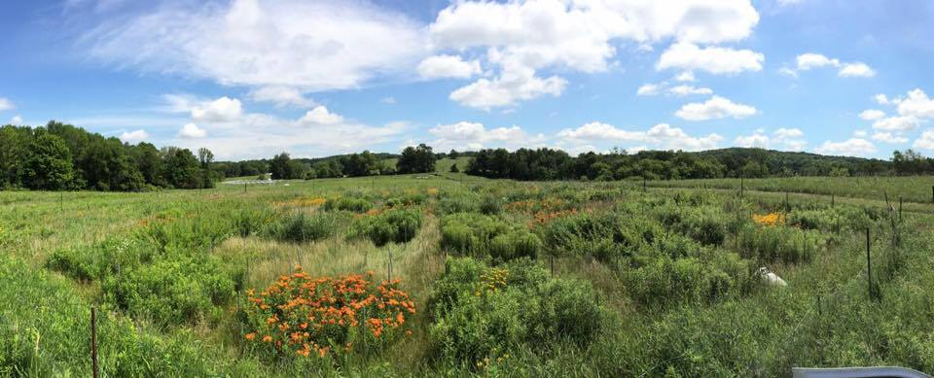
From causes to consequences of diversity

Slide 15

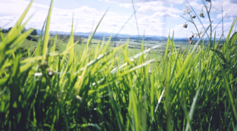


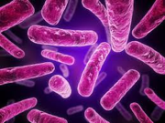
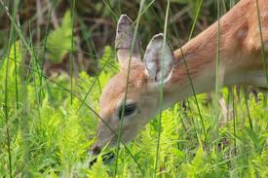


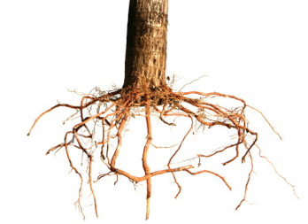
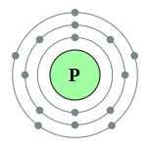
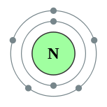
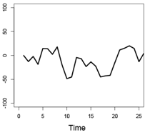
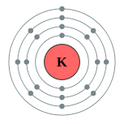
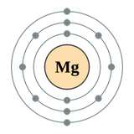
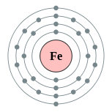
From causes to consequences of diversity
CO₂
Credit: Simone Yasui

Slide 16
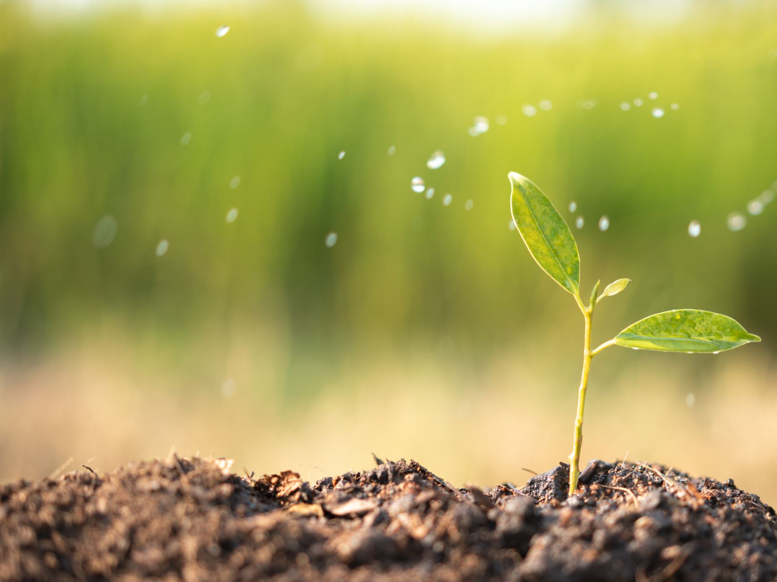
What exactly is an ecosystem function?
Definitions are actually a bit vague
at a minimum we can say that ecosystem functions are community or ecosystem-level processes that contribute to the amount and flow of energy and nutrients and that contribute to the maintenance and expansion of the ecosystem.

Slide 17
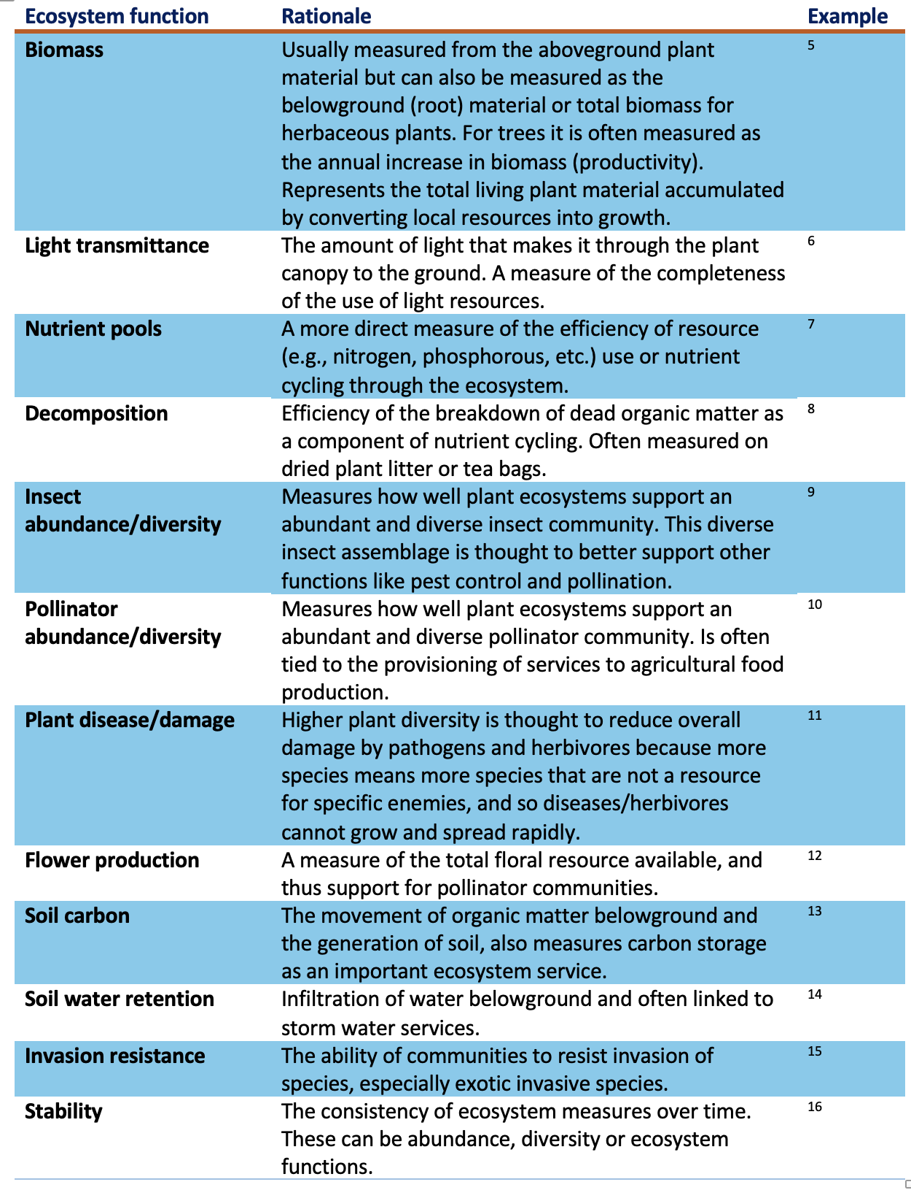
Types of functions

Slide 18
Why are these functions?
All of these ecosystem functions capture different facets of how real ecosystems function but are in essence representing three important processes:
1- The efficiency of resource use and the ability to turn inert resources like water, sunlight and nutrients into organic material;
2- The generation of greater complexity by supporting other trophic levels and creating rich soil and nutrient pools; and
3- Ensuring long-term stability in the delivery of functions and the resistance to detrimental change

Slide 19
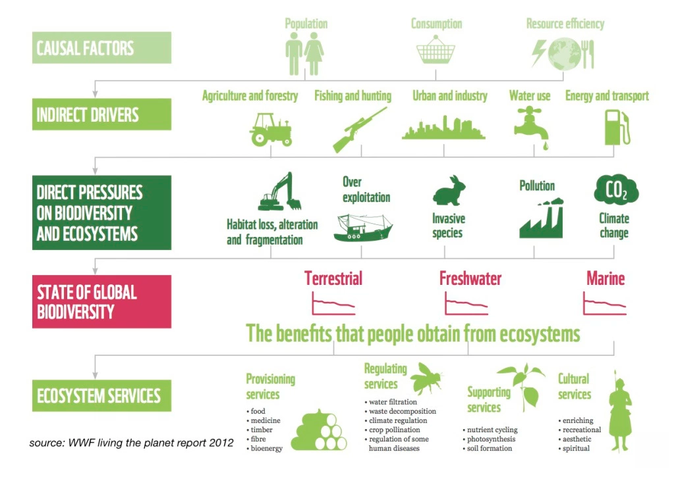

Slide 20

We can mitigate some of the negative impacts of cities by providing places for green spaces.
1) Healthy ecosystems (regulating services)
2) Environmental benefits (supporting services)
Basic functioning: stocks & flows of nutrients & energy; home for biodiversity; processes that ensure stability of ecosystem
Providing nourishing environments: cooling on hot days; intercepting heavy rains; filtering pollutants from water; removing air pollution
3) Provisioning services
4) Experiential benefits (cultural services)
Providing goods to people: Edible plants, animals, fungi; opportunities for urban agriculture; artistic & building material
Immersive values to people: cultural, religious, & artistic benefits; opportunities for learning; mental health wellbeing; child development

Slide 21

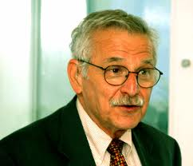

The history of BEF research
1991 meeting in Mitwitz, Germany on biodiversity and ecosystems (Detlef Schulze and Hal Mooney) (Schulze and Mooney 1994).
Does ecosystem function depend on biodiversity?

Slide 22

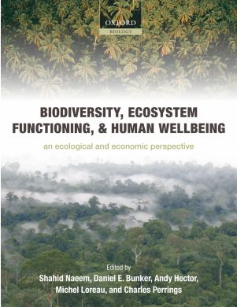
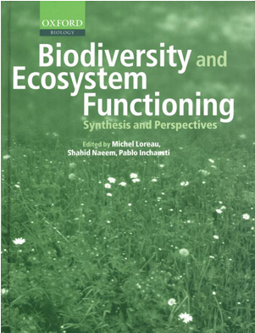
2009
1994
2002

Slide 23
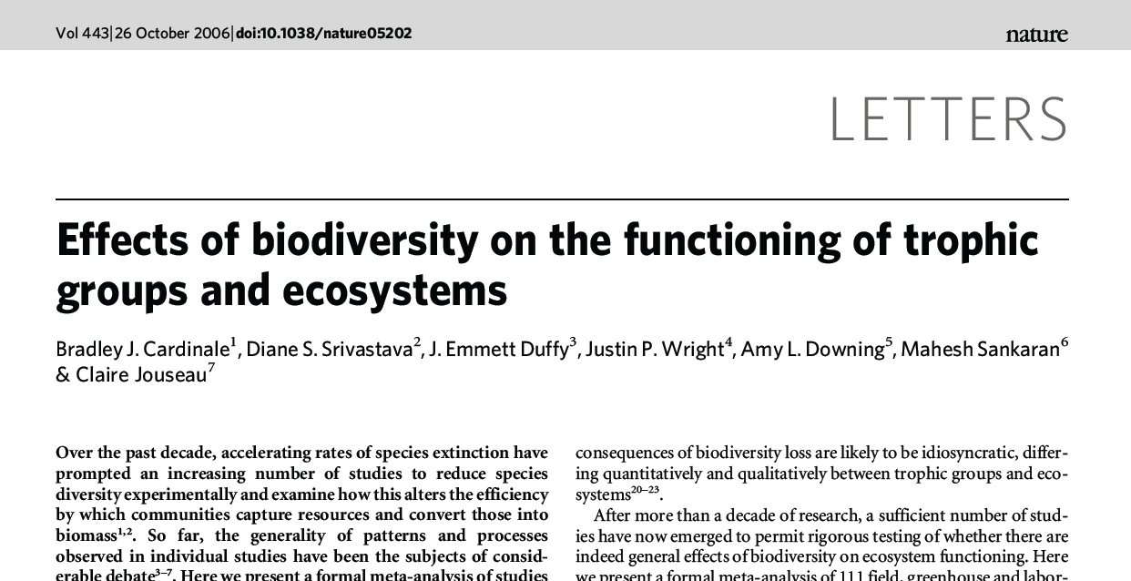
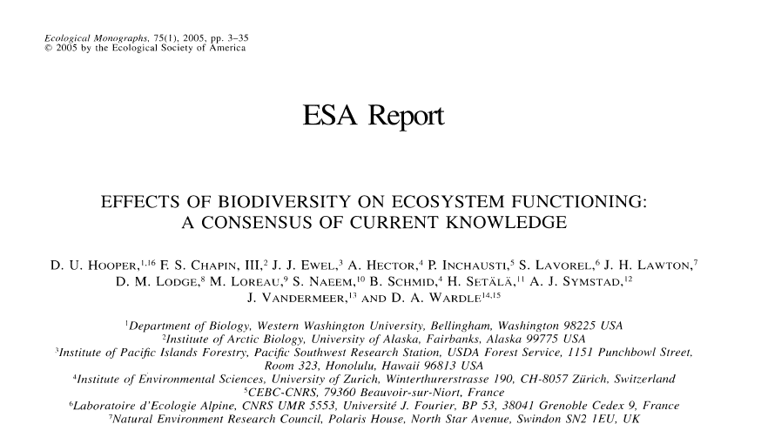
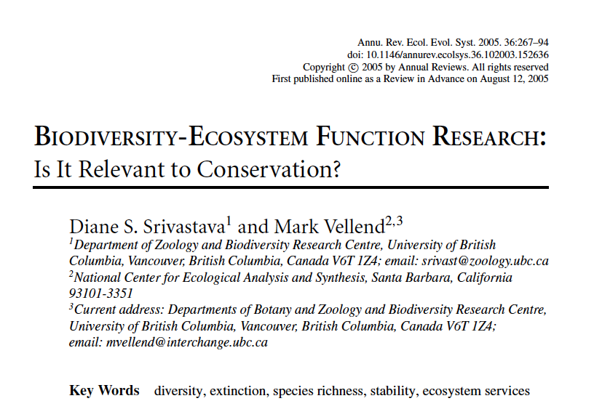
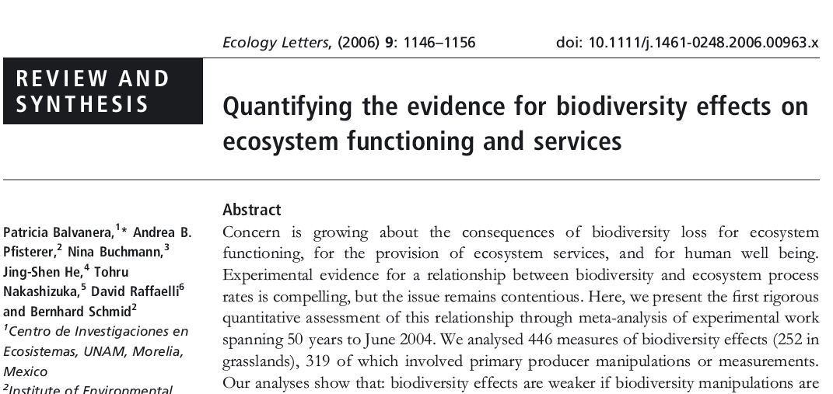

Slide 24
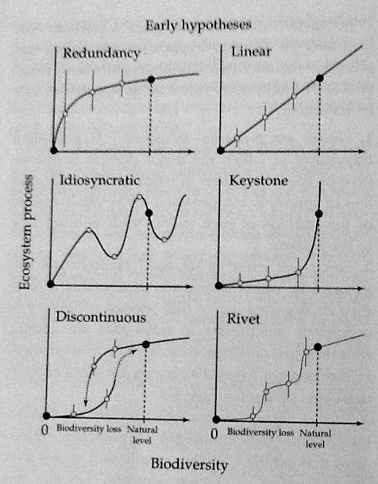


Early arguments why biodiversity matters for functioning?
Heuristic hypotheses
Argument from analogy
Naeem et al. 2002

Slide 25
Experiments needed to test hypothesis that function was related to diversity

Slide 26
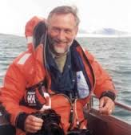

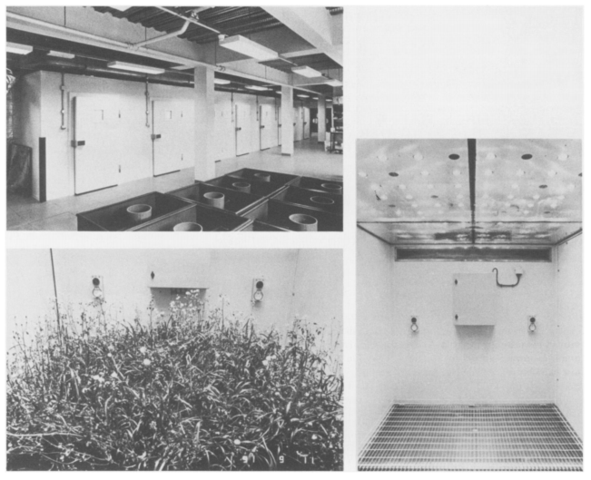
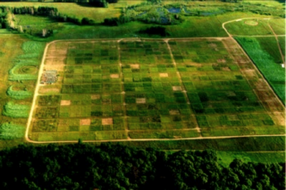
Two classic experiments
Lawton
Tilman
Cedar Creek
Ecotron
Lawton et al. 1993. Phil. Trans. Biology. 341: 181-194
Experiment 120 (‘Big Bio’); 1994

Slide 27







Why this expectation? coexistence & complementarity
Ecosystem function
Number of species

Slide 28
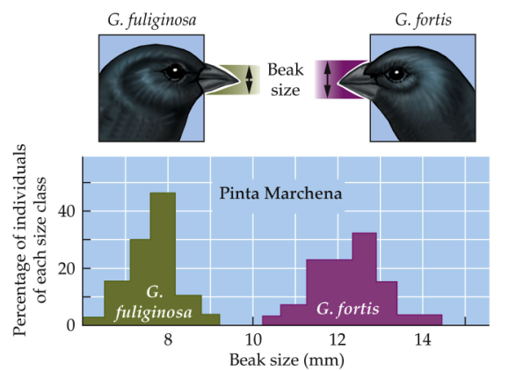
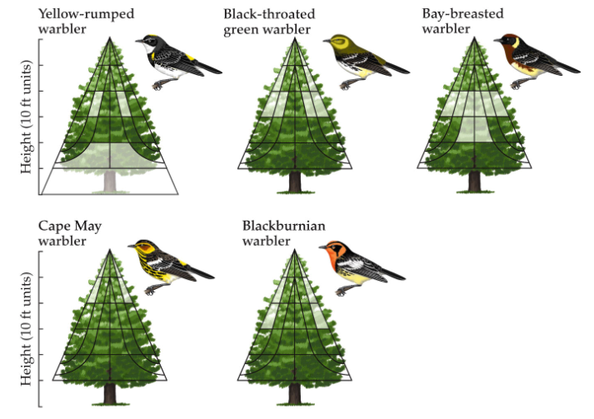
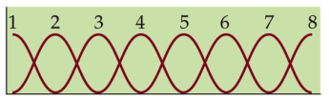
Coexistence is key
Fitness
Resource axis

Slide 29
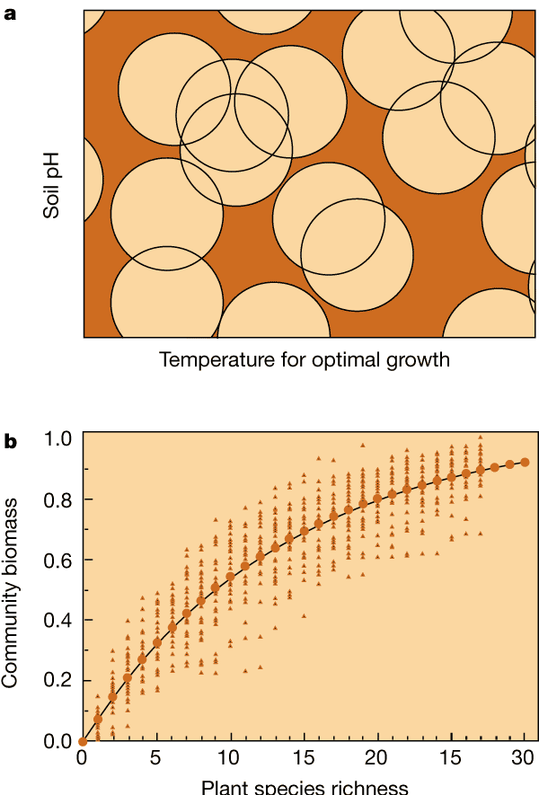
Niche differentiation and productivity. a, A simple model — the 'snowballs on the barn' model — of niche differentiation and coexistence. The range of conditions in which each species can exist is shown with a circle, the position of which is defined by its centre. By randomly choosing locations for various numbers of circles (species), it is possible to calculate the effect of diversity on the 'coverage' of the heterogeneous habitat. The amount of such coverage is proportional to community biomass. b, Results of simulations (triangles) and of an analytical solution (solid curve) to the effects of diversity on community productivity for the snowballs on the barn model
From: Tilman (2000), Nature.

Slide 30
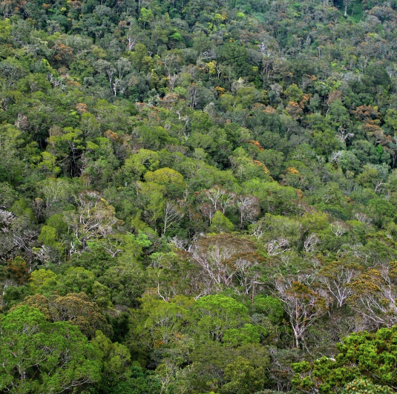
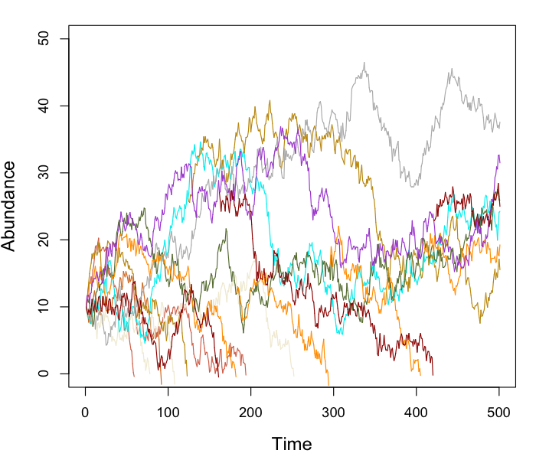
Neutral theory

Slide 31

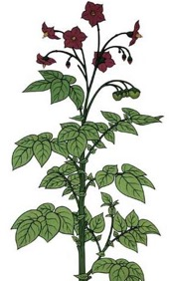


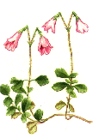
Why coexistence matters
Biomass
1 2 3 4
Species richness

Slide 32
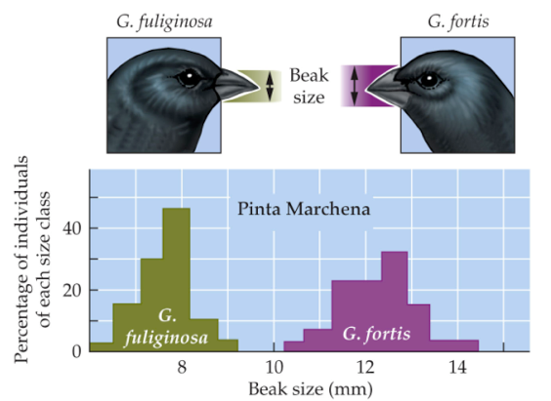
Why coexistence matters
Biomass
1 2 3 4
Species richness

Slide 33
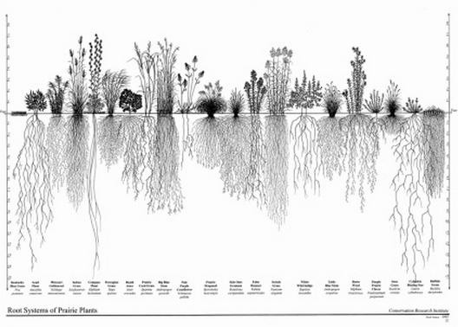
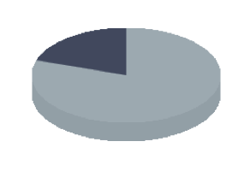
Why niche partitioning?
Species A
Available
Resources that can be converted to biomass

Slide 34

Chesson coexistence
Where would species maximally increase function?
Chesson, P. 2000. Mechanisms of maintenance of species diversity. Annual Review of Ecology and Systematics 31:343-366

Slide 35
Three key studies set the tone for two decades of research

Slide 36


Study # 1: Naeem et al. 1994
Naeem
Ecotron

Slide 37



Study # 1: Naeem et al. 1994
Naeem
What is the treatment changing?

Slide 38


Study #2: Tilman et al. 1997
Tilman
Experiment 120 (‘Big Bio’); 1994
1, 2, 4, 8, 16 species from a pool of 18.
Weeded regularly
28-35 replicates.
Biomass harvested from sub plots.
Sampled 1996-present.

Slide 39







Study #3: BIODEPTH 2005
Andy
Hector
Bernhard
Schmid
Jasmin
Joshi
Lawton
Great Britain
Germany

Slide 40

Study #3: BIODEPTH 2005
Andy
Hector
Bernhard
Schmid
Jasmin
Joshi
Lawton

Slide 41

Study #3: BIODEPTH 2005
Andy
Hector
Bernhard
Schmid
Jasmin
Joshi
Lawton

Slide 42

Study #3: BIODEPTH 2005
Andy
Hector
Bernhard
Schmid
Jasmin
Joshi
Lawton

Slide 43



Slide 44

The criticisms
Grime (MacGillivray et al. 1995, Grime 1997) argued that it is the characteristics of the dominant species that drives ecosystem function, not the number of species.
He finds this in responses to stress, and succession.
Phil Grime

Slide 45


The criticisms
Lonnie Aarssen
Hypothesized that there is a higher probability of including productive species in high diversity plots.

Slide 46

The criticisms
Lonnie Aarssen
Phil Grime
Michael Huston
Experimental treatments often include other factors (e.g., changes in nutrient dynamics), and might influence results.
Non-random species assemblages that may increase the effect of diversity.
Increased probability of including productive species in high diversity treatments.

