Slide 1

Biodiversity & Ecosystem functioning under anthropogenic stressors
Marc W Cadotte
University of Toronto
Session 1.3: Systematically summarizing literature

Slide 2
Reviews are extremely important
Reviews define the state of understanding on a topic.
They should be timely overviews of an area of research or question.
They should also guide future research.
Also, for your career…
They establish your reputation as someone pushing an area forward.
And they are cited more than other types of papers.

Slide 3
Steps for conducting a review
Question Formation
1
Protocol Formation
2
Search Strategy / Literature Searching
3
Article Screening / Relevance Assessment
4
Critical Appraisal / Data Extraction
5
Evidence Synthesis
6
Reporting / Dissemination
7

Slide 4

Question formation
Things to keep in mind when developing a research question:
  It must be answerable using scientific methodology and have policy implications
  It should be currently unanswered and add something new to the literature
  It should be generated in collaboration with relevant stakeholders/decision-makers
  It may need to be unbiased/worded neutrally for involved stakeholders
  It should guide the generation of search terms and determine relevance criteria

Slide 5
Question formation
Consider the following research question:
“How can we reduce the impact of alien invasive species on native biodiversity?”
Do you see any problems with this research question?
How would you change it?

Slide 6
Question formation
What did you come up with?
Some problems:
  Too broad!
  Poorly defines the species and element(s) of biodiversity being studied
  Does not include specific interventions against invasive species
How could we improve this research question?

Slide 7
Question formation
Refined research question:
“Is poison-baiting effective at eradicating rats from islands?”
Outcome
Intervention
Population

Slide 8
PICO formula
Use the PICO formula to help build effective research questions:
Population, Intervention/Exposure, Comparison/Control, Outcome
P: rat populations on islands
I/E: poison-baiting methods
C: no baiting (or other methods)
O: eradication of rat populations

Slide 9
Protocol Formation
Before beginning the full search, a research protocol must be developed:
  Acts as an a priori guide for conducting the systematic review
  Has a clearly laid out methodology and is finalized based on agreement between a research team and stakeholders
  Research protocol are often openly shared and made available for public scrutiny → transparency!
Key Components:
  Formal presentation of the research question
  Background information (i.e. the “real world” context)
  Search strategy to be used + relevance criteria for article screening
  Methods to be used for critical appraisal, data extraction, and data synthesis
Examples: Collaboration for Environmental Evidence (CCE) – Systematic Review & Protocol Library

Slide 10
Searching for studies
Where can we look for studies / information?
Key Sources of Information:
  Online literature databases and catalogues (interdisciplinary and subject-specific)
  Organizational websites and professional networks (grey literature)
  The internet / world-wide web (grey literature)
  Key individuals / subject experts in the field
  Bibliographies of key articles / reviews
  Citation searches for key papers
Why is it important to look in more than one place?

Slide 11
Literature searching
Remember: Documentation is key! Each step of your search must be transparent and repeatable.
A record for each source should include:
  Full list of search terms used and how they were combined
  Name of the resources used and date(s) the search was carried out
  Any changes to the default search settings of the source used
  Nature of the search (e.g. keywords, topics, or full texts) and other search options (e.g. lemmatization & stemming)
  Removal of duplicates if automatically carried out when downloading results
  All the results returned by each search (i.e. retrieval)

Slide 12
Screening articles
Citation managers can help with the screening process!
Examples:
  Eliminate duplicates among imported references
  Keep a record of studies included/excluded for further analysis (based upon relevance criteria)
Recommended filters:
  A 1st reading of article titles and abstracts to remove spurious hits (be conservative)
  Assessment of the full text - *Note that full-text may or may not be readily available
Is good practice to have two reviewers to undertake the same process on a random sub-sample of articles from the original list (50-200 references)

Slide 13
Need help? Use the “craap” test
Currency – the timeliness of the information
Relevance – the importance of the information for your needs
Authority – the source of the information
Accuracy – the reliability, truthfulness, and correctness of the information
Purpose – the reason the information exists
Sample Worksheet:
http://legacy.juniata.edu/services/library/instruction/handouts/craap_worksheet.pdf

Slide 14
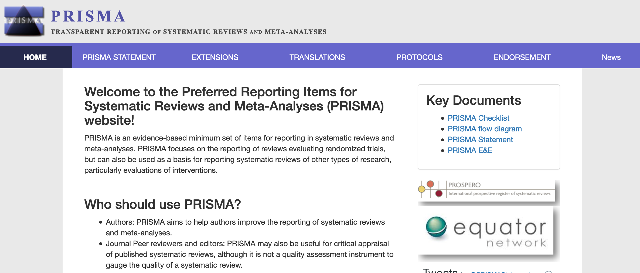
Use existing tools to assess papers!
A number of tools and checklists exist for checking the quality of studies in a review
  Sample Tool: PRISMA Checklist

Slide 15
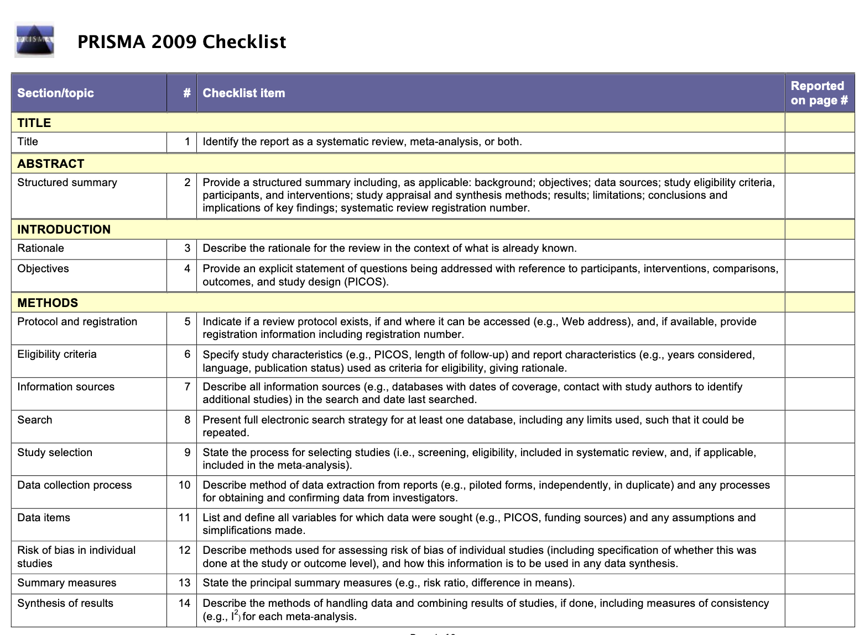
PRISMA

Slide 16
Data extraction
Data extraction is a process of extracting and collating relevant data generated by each study
  Often occurs in conjunction with critical appraisal of study quality
  Requires careful documentation on designated spreadsheets
Good practice for data extraction:
  Presents the primary data as reported in the primary study; any corrections/modifications are presented additionally
  Notation of the location of data within each article + means of extraction if data are in figures
  Description of any pre-analysis calculations or data transformations (e.g. standard deviations, effect sizes, etc.)
  Details of a pre-tested data extraction form (example on p. 53 of CEE guidelines)
  Inclusion of appendices of extracted information
  Any contact made with authors to request missing data

Slide 17
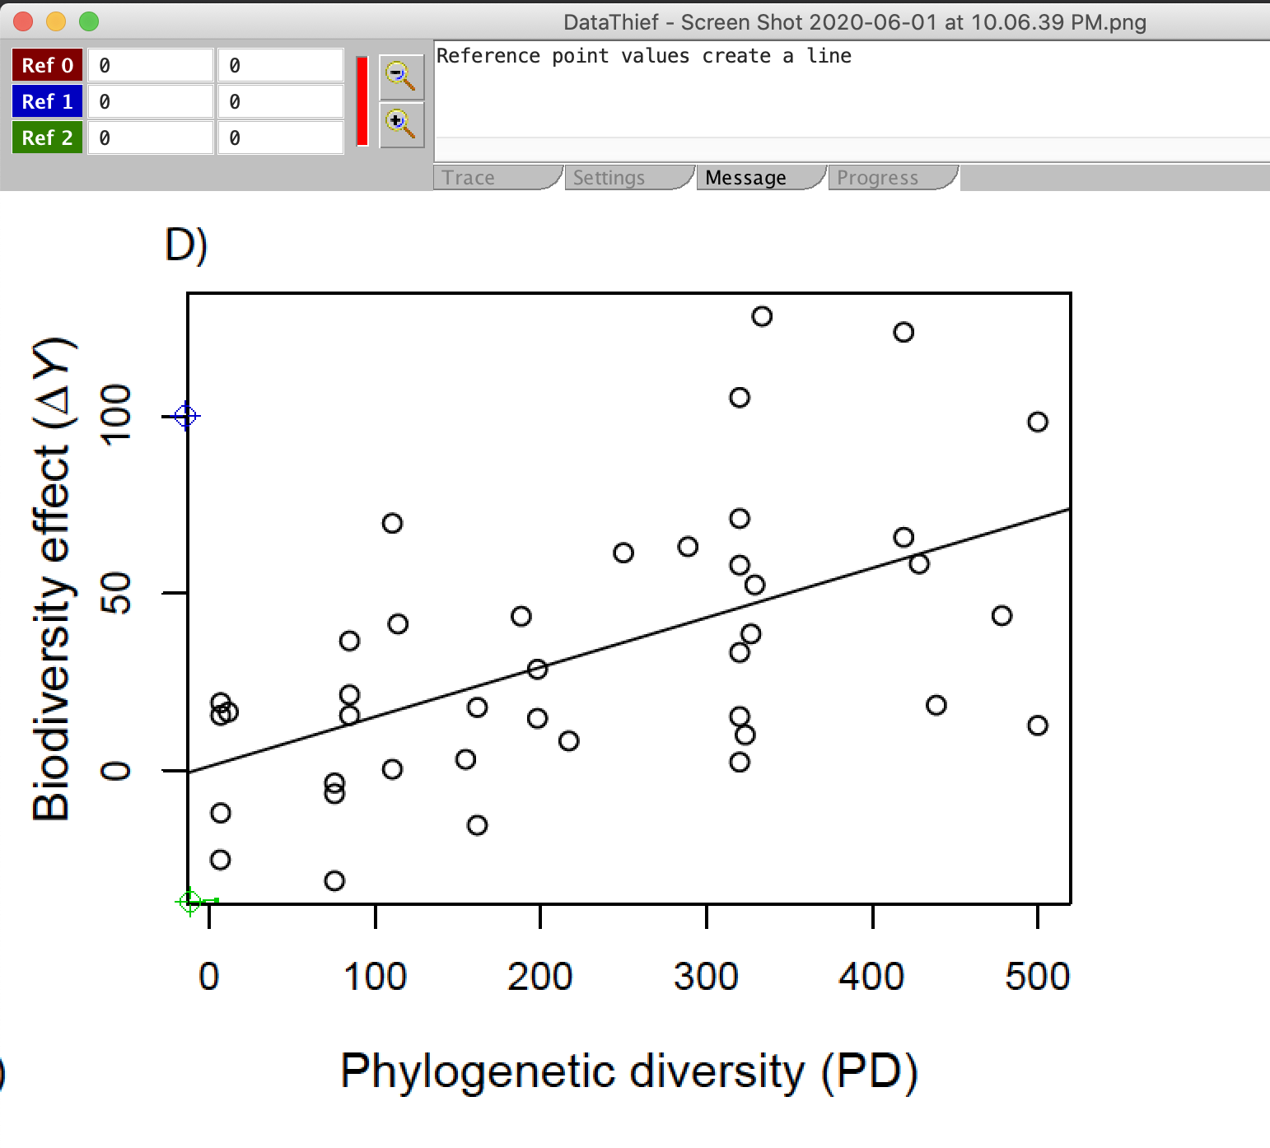
Data thief (Java) metaDigitise (R)

Slide 18
Evidence synthesis
3 types of synthesis:
  Narrative Synthesis – present the context and overview of the evidence; requires the construction of tables that provide details of the study or population characteristics, data quality, and relevant outcomes
    Should be present in any form of systematic review
  Quantitative Synthesis – usually desirable when attempting to measure the effect of an intervention or exposure
    Examples: meta-analyses, fixed-effects statistical models, random-effects statistical models, etc.
  Qualitative Synthesis – used when views of individual people are recorded in relation to a question (e.g. open-ended questions with complex answers)
    Can be used with qualitative data for a mixed method approach
  *Refer to CEE guidelines (pp. 55-57) for additional details and resources on evidence synthesis

Slide 19

Reporting / Dissemination
Reporting involves the interpretation of systematic review evidence
  Aim is to inform rather than to advise
  Avoid drawing forced conclusions due to inconclusive evidence
Always be aware of bias!
  Publication, citation, and duplication bias of studies with statistical significance
  Language bias for acceptance and publication of English studies
  Availability and cost bias based on time and resources on hand
  Familiarity bias for one’s own subject area or discipline
  Confidentiality bias may limit availability of sensitive/secured data

Slide 20
Reporting / dissemination
Elements to include in report conclusions:
  The reliability / quality of the studies included
  The relevance / external validity of the studies included
  The size and statistical significance of observed effects
  The consistency of effects across studies or sites + the extent to which this can be explained by other variables (effect modifiers)
  The clarity of the relationship between the intensity of the intervention and outcome
  The existence of any indirect evidence that supports or refutes the inference
  The lack of other plausible competing explanations of the observed effects (bias or confound)

Slide 21
And finally writing a review
Unlike research articles, the format of a review is more flexible.
Some are written like a research paper with methods, results and discussion sections.
More often they are like an essay format where they might informally state what they did if at all.
More of a move recently to make reviews more transparent, which means including search terms, databases used, exclusion rules, etc.
They should always have a strong introduction with hypotheses.

Slide 22

Commitment to open and transparent scholarship
Transparent processes:
store code on github,
make database available, eg., on Dryad
Publish in open access journal.
Publish methodology prior to completing research.

Slide 23
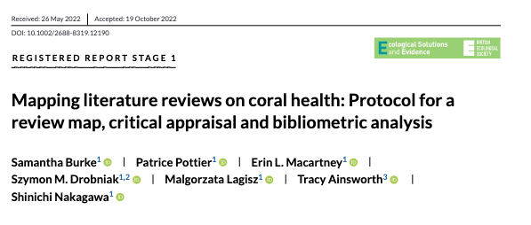
Registered report (stage 1)
Ecological Solutions and Evidence; Ecology and Evolution; Environmental Evidence

Slide 24
Registered report (stage 1)
Manuscript has introduction for questions/hypotheses; proposed methods; anticipated findings.
Goes through regular review process.
Gets published as standalone article.
Final paper (stage 2) will be published regardless of findings as long as methodology followed.

Slide 25
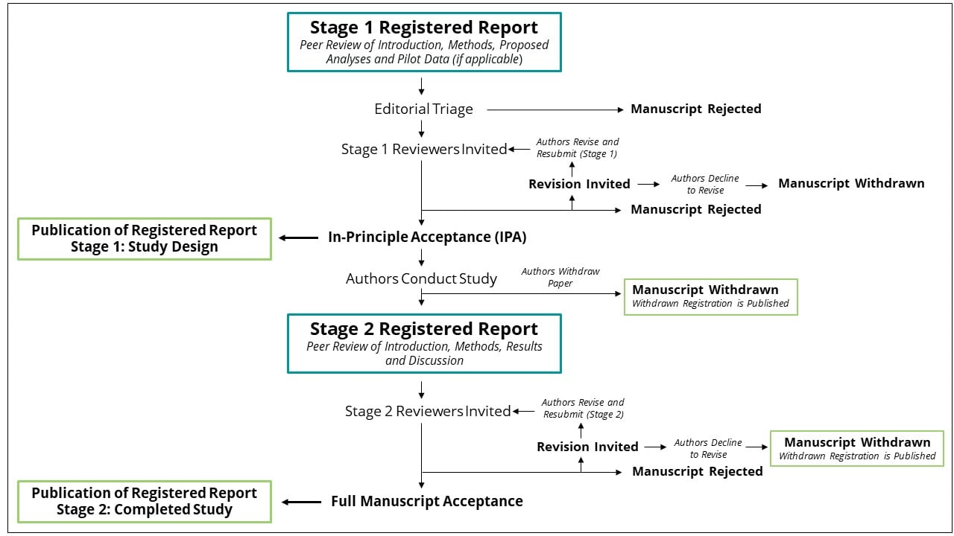

Slide 26

Group activity
Get into your groups and download the two data review forms. These are for medical sciences.
Look at it and decide on which kinds of information need to included if you were examining an ecological study (use example paper).
Add columns to group spreadsheet for which kinds of information should be assessed.
https://cubes-labs.com/sbef-short-course-material/

