Slide 1
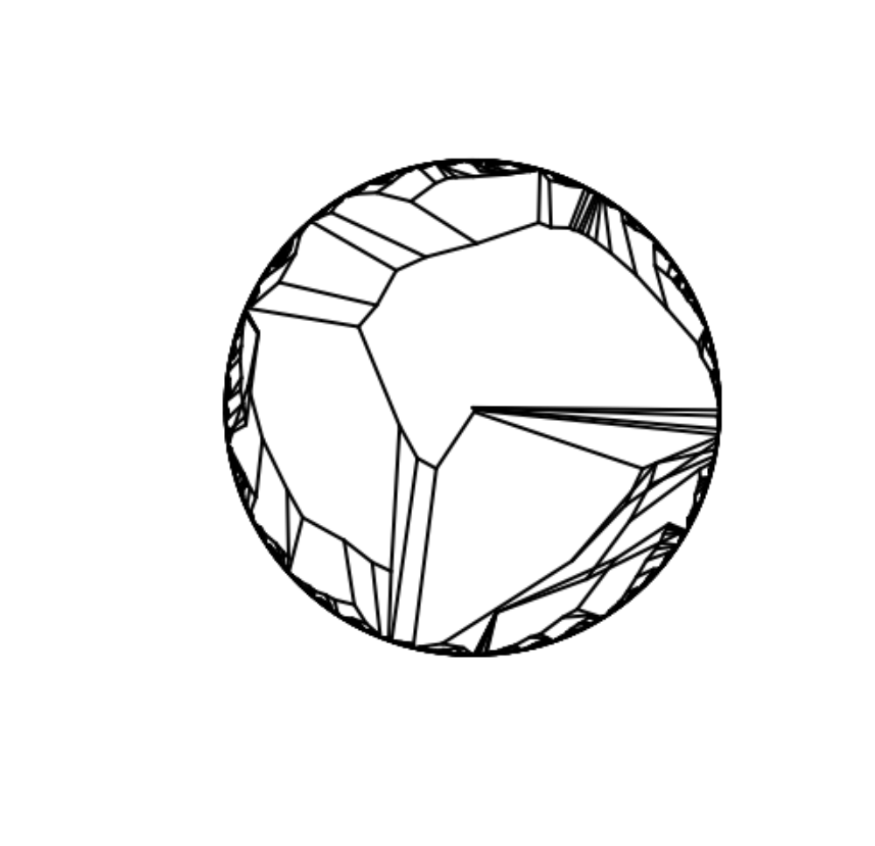
Biodiversity & Ecosystem functioning under anthropogenic stressors
Marc W Cadotte
University of Toronto
Session 2.1: Measuring biodiversity

Slide 2
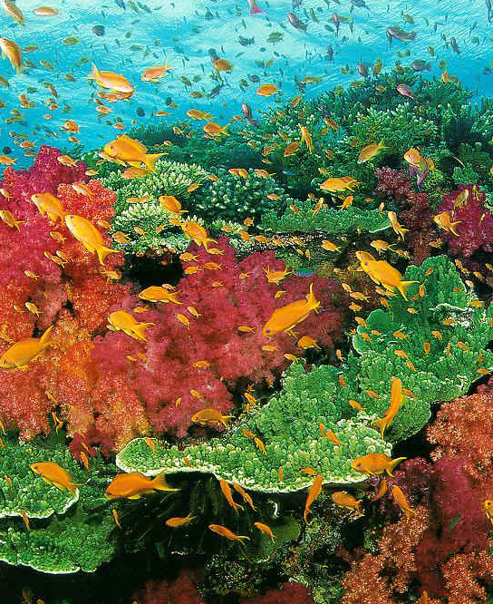
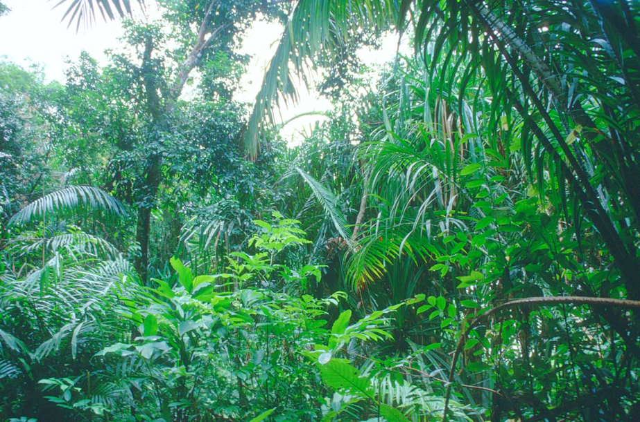
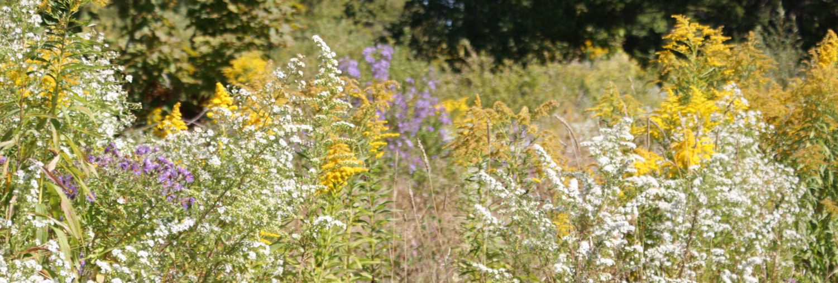

Slide 3

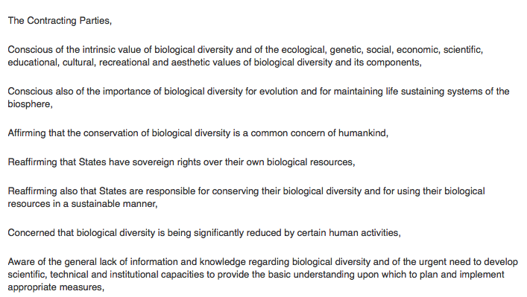

Slide 4
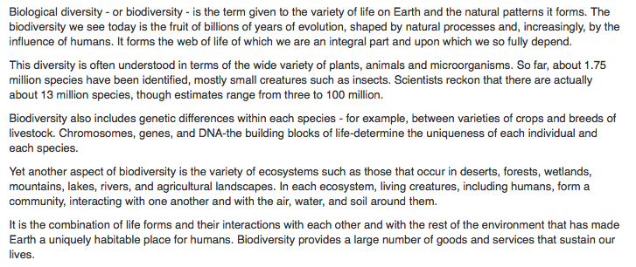

Slide 5
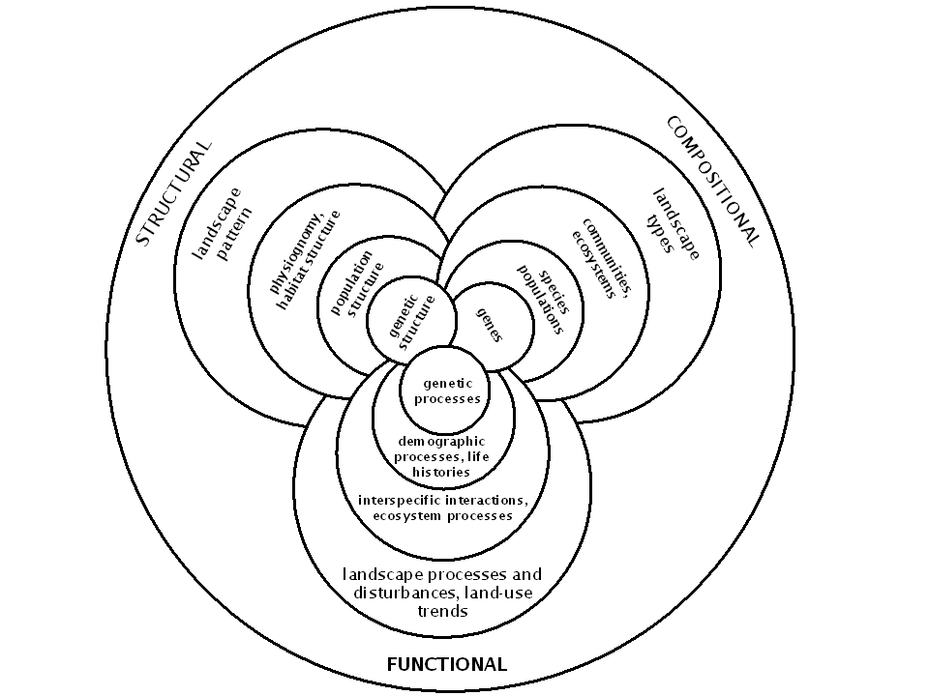
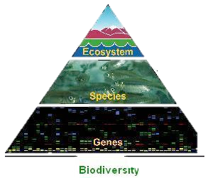

Slide 6
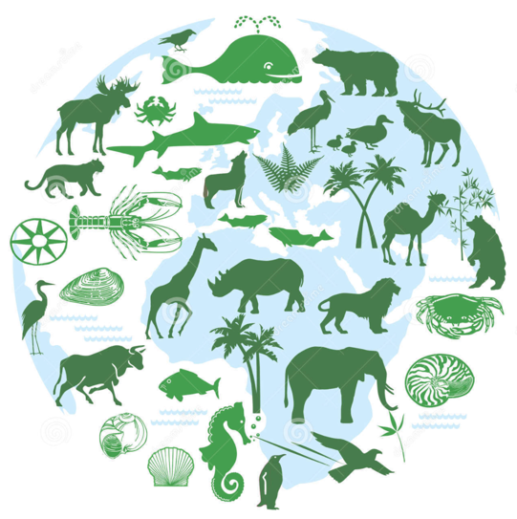
Measures of diversity
What do we wish to measure and why?
Biodiversity is ultimately about the numbers of things and variability in those numbers. If all habitats had the same number of species, then counting species would not be very informative.
Should we be concerned with more than one measure?

Slide 7
Does our measure of diversity change our understanding of Biodiversity-ecosystem function relationships?
Diversity measure 1
Functioning (biomass)
Diversity measure 2
Do different diversity measures reflect different mechanisms?
Functioning (biomass)
Biodiversity

Slide 8
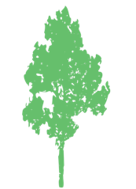






Diversity Scales
$$\text{Alpha} \left(\overline{α}\right)=3$$
$$\text{Gamma} \left(γ\right)=4$$
$$\text{Beta} \left(β\right)=∗$$

Slide 9
Measures of diversity
Species richness: The number of species in some location.
Problem: how do we know that we have accurately sampled species?
Two sites may have different richness simply because we have sampled less in one site.
A diversity of methods exist (rarefaction) to estimate richness from different sampling efforts.

Slide 10




‘Diversity’ metrics
A lot of information is lost when using only species counts
Need measures that capture both numbers of species and relative abundance

Slide 11



‘Diversity’ metrics
$$D_{shan}=−\sum_{i=1}^{S}{p_{i}\text{ln}}p_{i}$$
Shannon diversity:
Simpson diversity:
Diversity numbers:
$$D_{simp}=\frac{1}{\sum_{i=1}^{S}{p_{i}^{2}}}$$
$$D_{Hill}={\left(\sum_{i=1}^{S}{p_{i}^{q}}\right)}^{1/{\left(1−q\right)}}$$
p: is the relative proportion of a species in a community: e.g., a species with p = 0.5 represents 50% of the community.

Slide 12
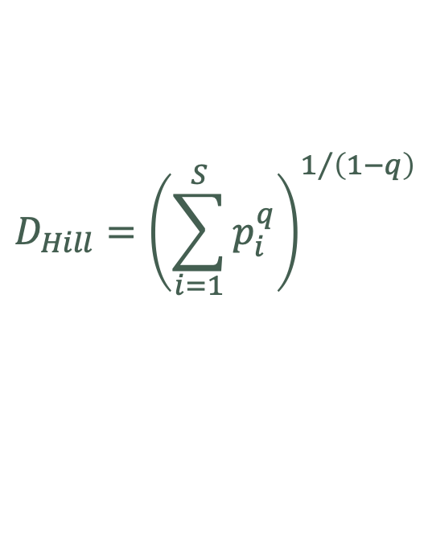
Hill numbers
$$D_{Hill}={\left(\sum_{i=1}^{S}{p_{i}^{q}}\right)}^{1/{\left(1−q\right)}}$$
q = 0; species richness
q = 1; Shannon index
q = 2; Simpson index
q > 0; reduce weighting of rare species.

Slide 13
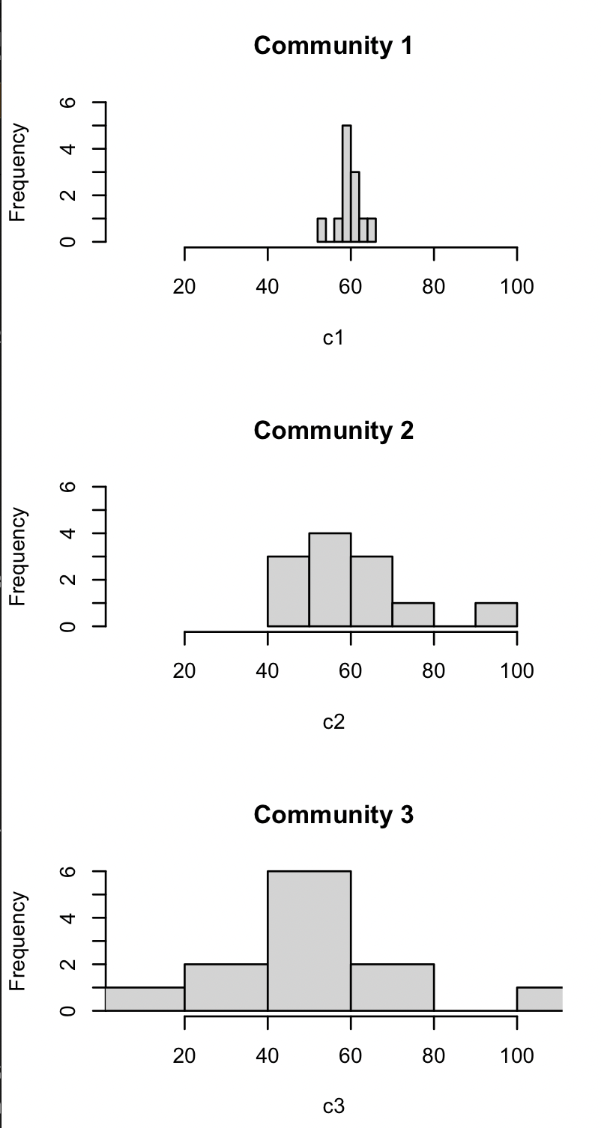
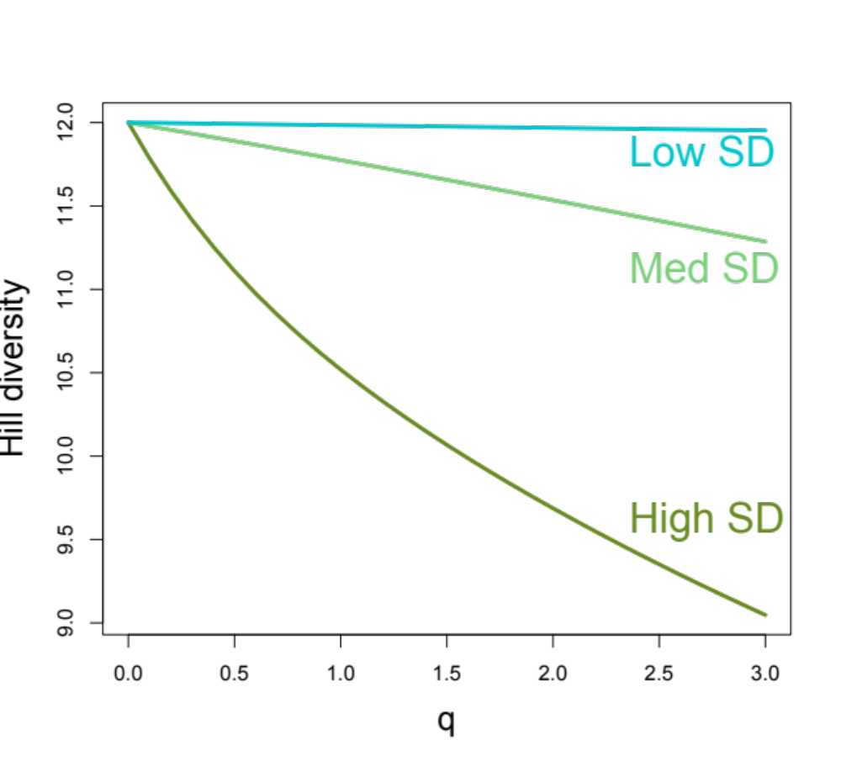
Effect of q on Hill diversity

Slide 14
Diversity depends on evenness
The distribution of abundance has important consequences for these diversity metrics.
The distribution distribution may have other consequences as well: e.g., nutrient cycling, pathogen spread, supporting specialized herbivores and pollinators, etc.

Slide 15
Still missing diversity?
Example:
Com A: D_{shan} = 3.17
Com B: D_{shan} = 3.08
Com C: D_{shan} = 2.43
share 95% of species
only 10% similar species
Which one is least important?
Compositional similarity important

Slide 16
Still other diversities?
All the above measures have one assumption in common: all species are equivalent.
Traditional diversity measures poorly link to theory and mechanisms.
Other diversity metrics attempt to account for species differences and similarities.
Their logic is that communities with more dissimilar species are more diverse than ones with a bunch of very similar species.

Slide 17
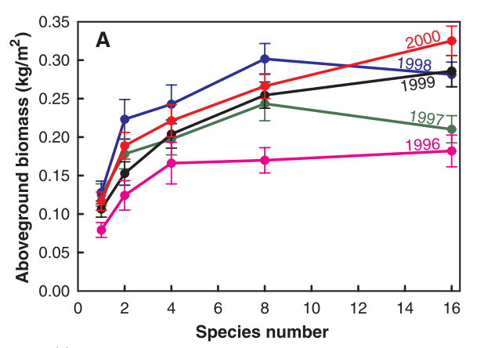
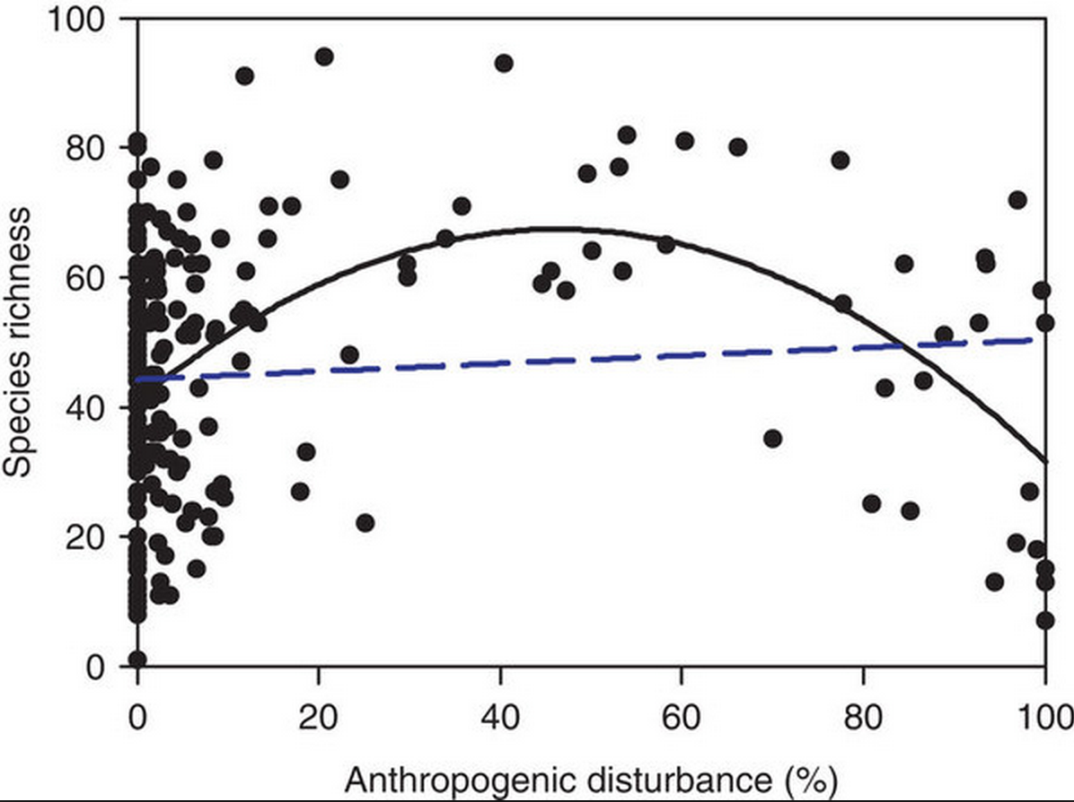
Traditional community ecology: species richness
Tilman et al. 2001, Nature
Mayor et al. 2012, Nat. Comm.

Slide 18
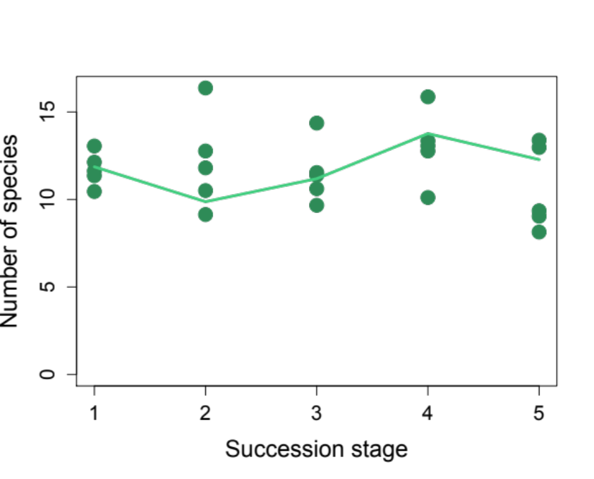
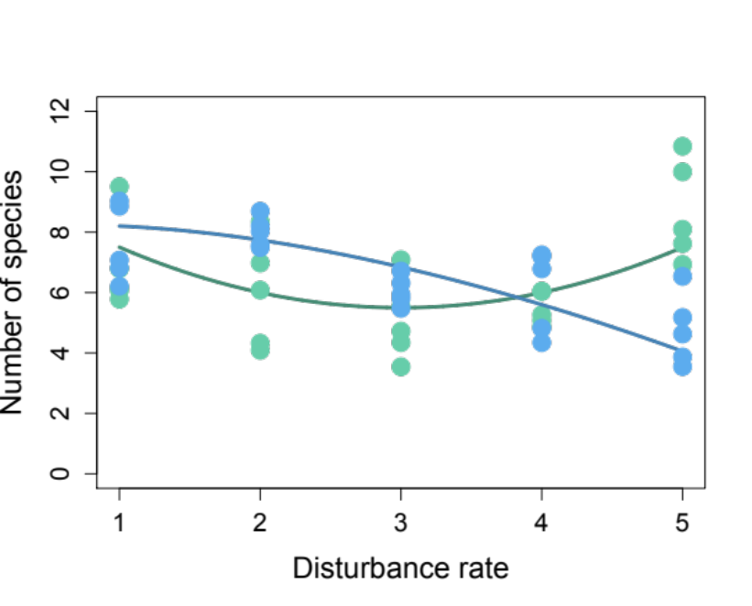
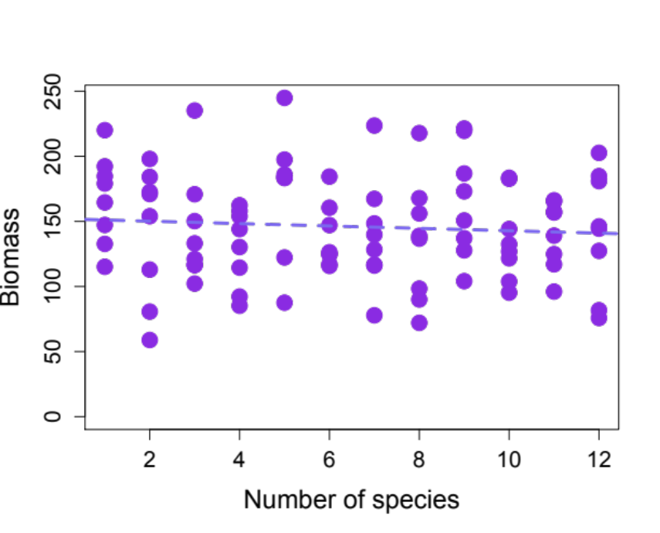
The problem: when richness is not important
Are we to reject the mechanisms we think are important?

Slide 19
Changes in richness tell you about the pool
Intermediate disturbance hypothesis
More early colonists in the pool
More competitors in the pool

Slide 20
The problem: when richness is not important
Late
Trait 2
Early
Trait 1

Slide 21
Similar with ecosystem function
L
H
L
Biomass
H
Species redundancy

Slide 22
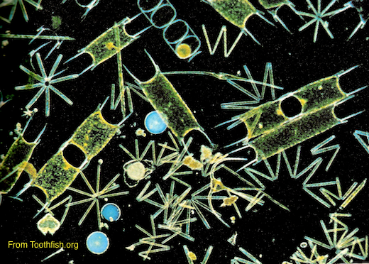
An ecology of differences
From counting species to accounting for species
Total/average phenotypic or niche differences
Number of species
Or

Slide 23







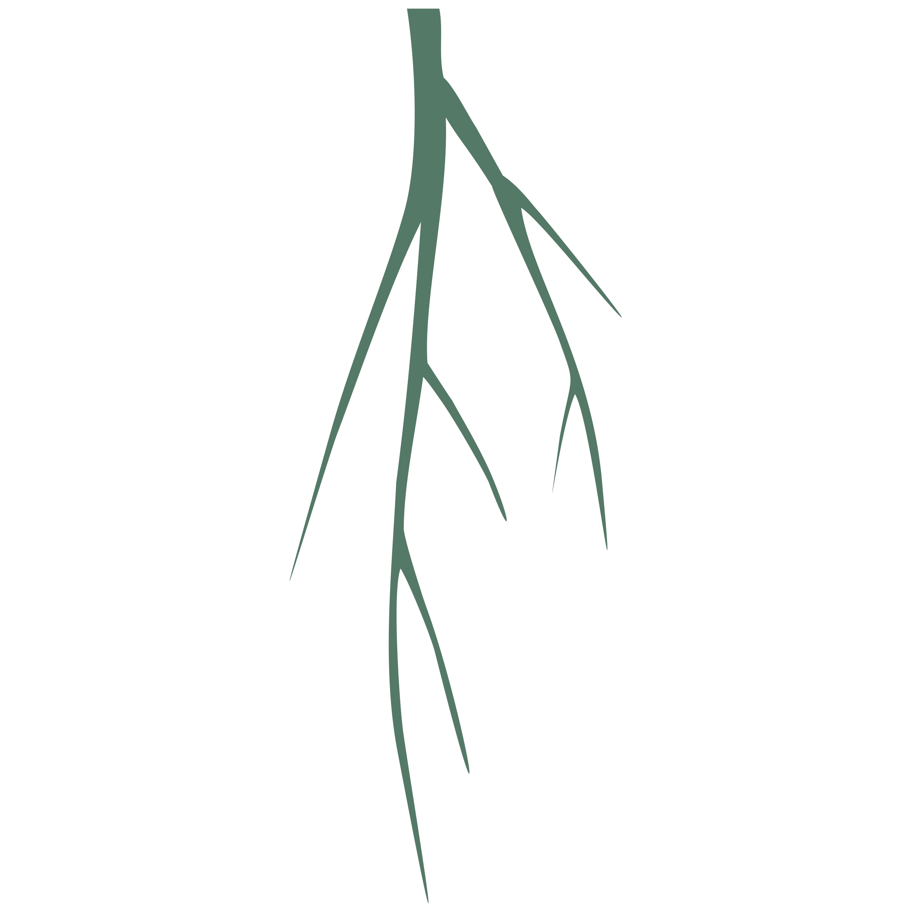

Rethinking diversity –how do we measures a species?
N = 4 species
How can we measure this?
Phylogenetic
diversity
Trait-based functional
diversity

Slide 24
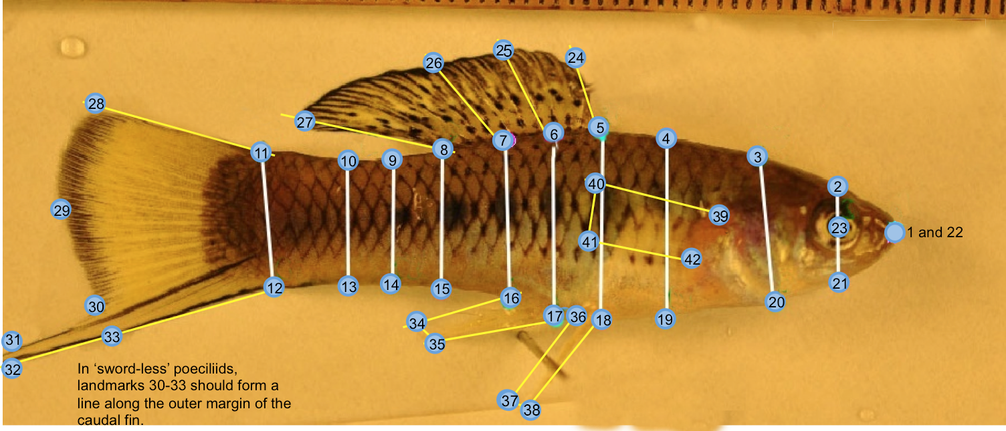
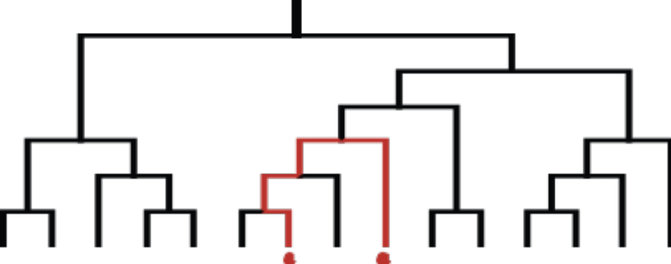
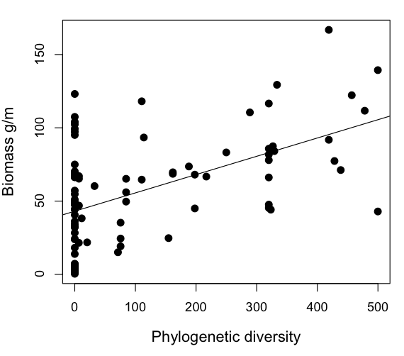
Two methods have emerged
1) Trait/functional approach
2) Evolutionary relationships
Late
Early
Trait 2
Trait 1

Slide 25
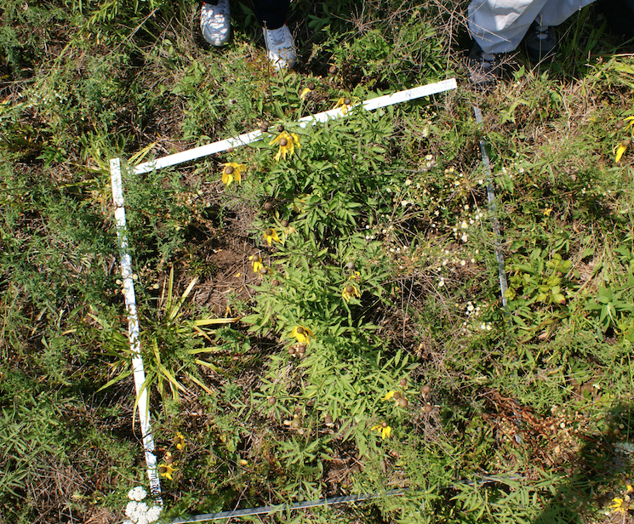
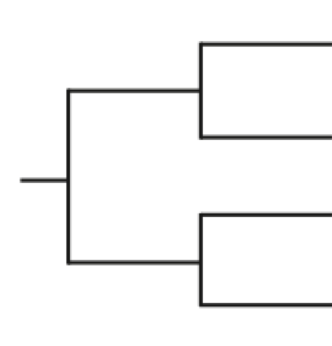
Often asked:
Researchers often ask: “what are the diversity patterns relative to random assembly?”
Regional pool
Trait 2
5 species
Observed
Trait 1
Trait 2
Randomly select 5 species 1000 times
Trait 1

Slide 26
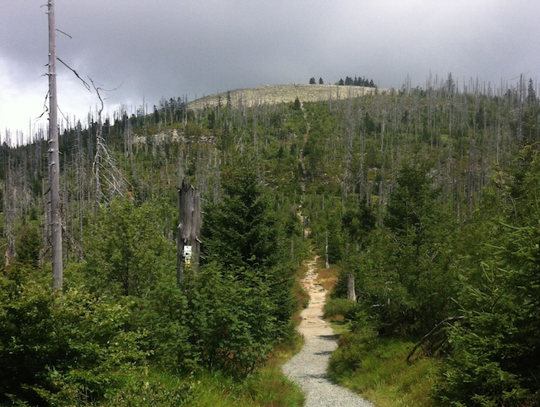
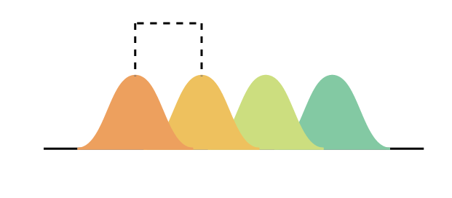
Two non-random patterns
Under-dispersed/clustered
Over-dispersed
X
X
X
Trait 2
Trait 2
X
Trait 1
Trait 1
Potential mechanisms?
Min. distance
Niche axis
Harsh environment/stress

Slide 27
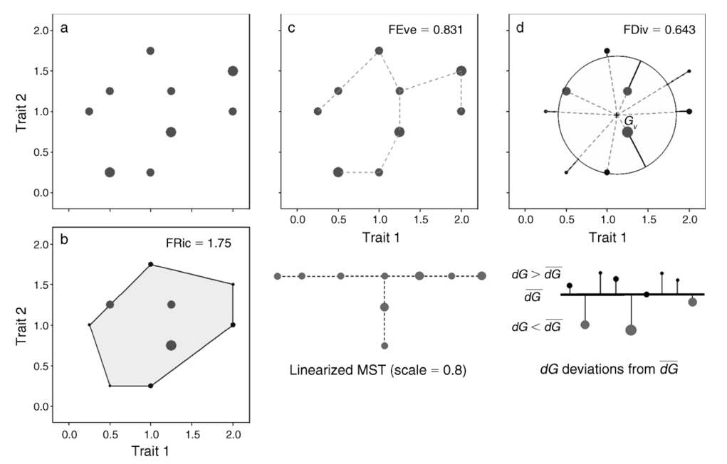




Functional diversity
A relatively small number of statistical methods to quantify the multivariate volume, divergence or evenness of traits.
Villeger et al. 2008 Ecology

Slide 28









What are traits?
examples: leaf size, beak size, seed size, body mass, frost tolerance, metabolic rate, nutrient concentrations, etc.

Slide 29
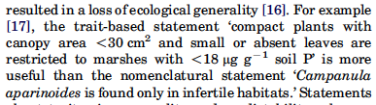
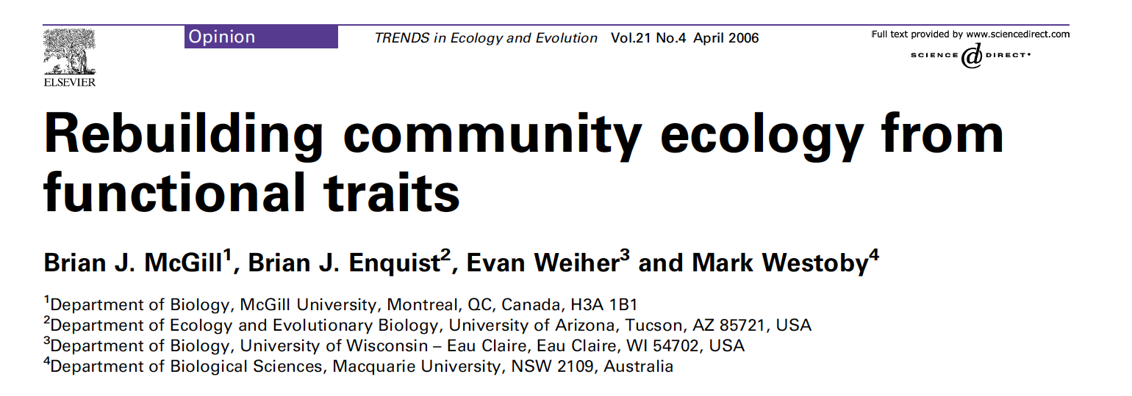
Species differences

Slide 30
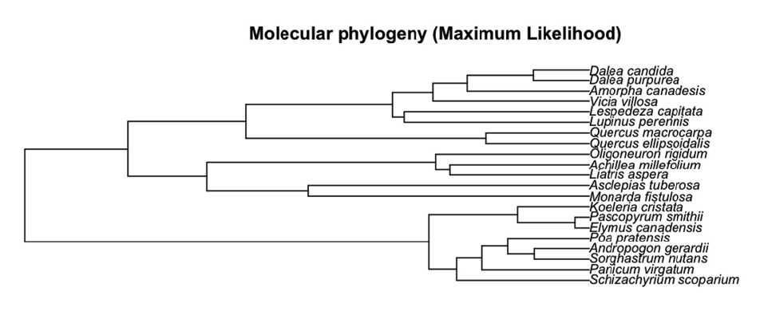
Phylogenies

Slide 31
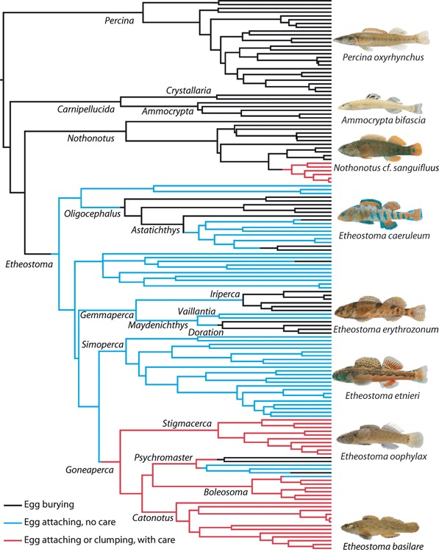
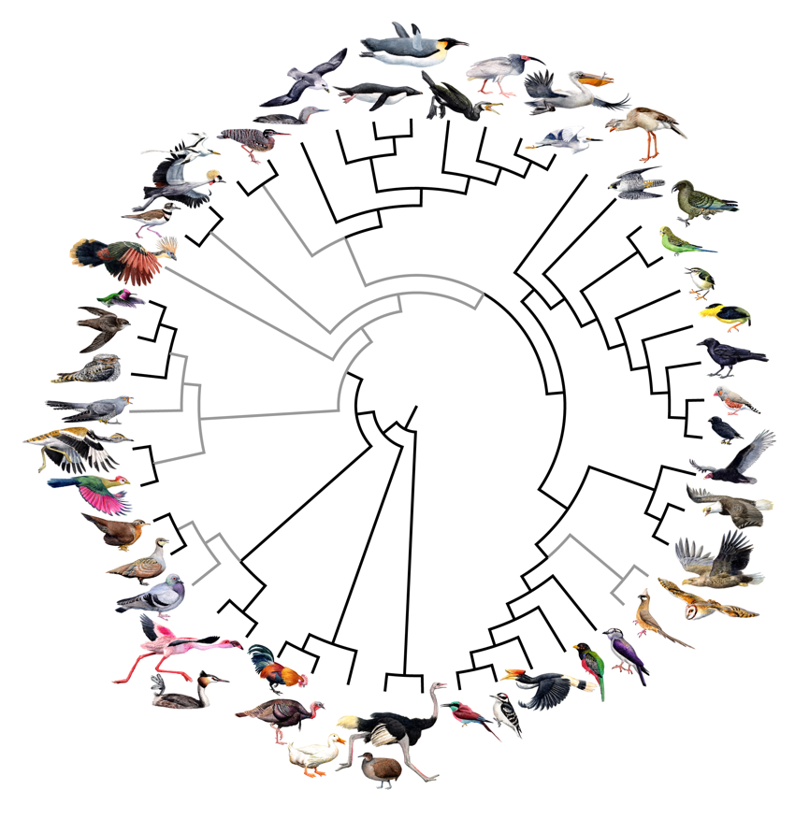
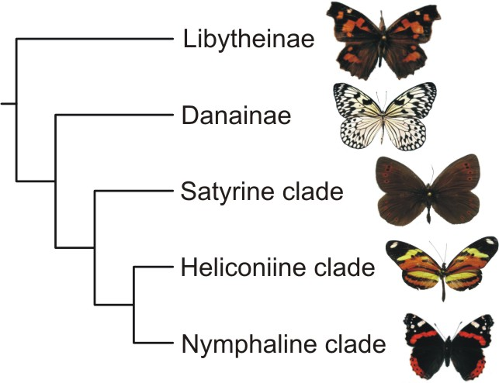
What is a phylogeny?

Slide 32
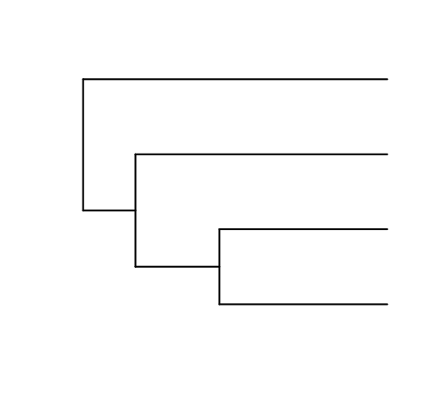
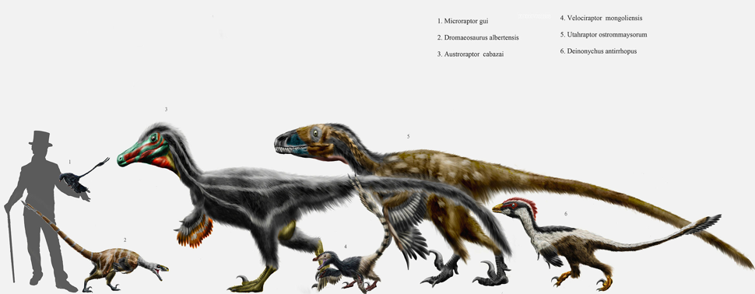
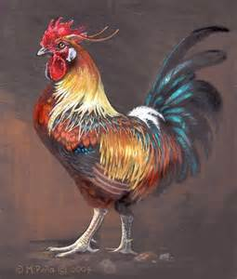
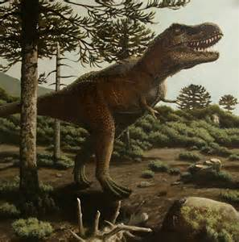
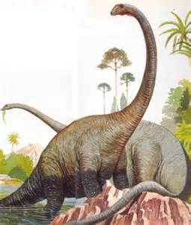
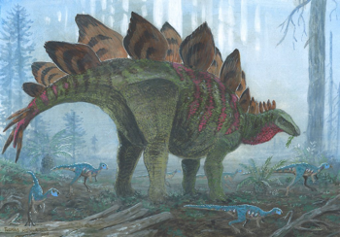
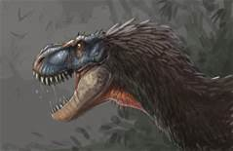
Phylogenies provide information
Dinosauria
Theropoda
Suaropoda
Ornithischia

Slide 33
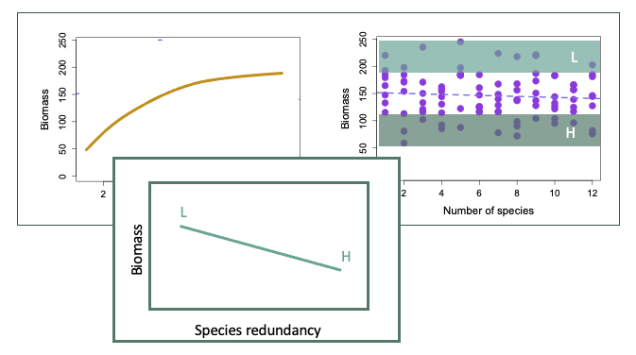
The problem: when richness is not important
Late
Trait 2
Early
Trait 1

Slide 34
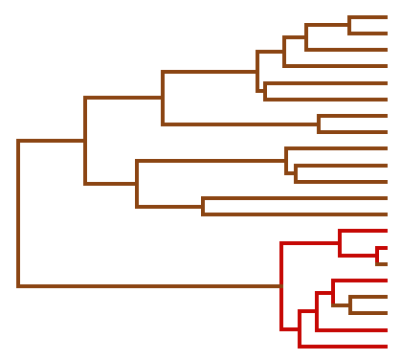
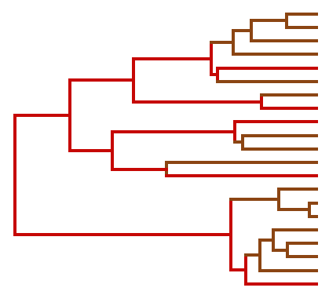
Many measures to quantify dissimilarity, but two broad classes are common.
‘Richness’ measures are summations quantifying total accumulated dissimilarity among species.
Phylogenetic diversity
Functional richness
Late
Trait 2
Early
Trait 1

Slide 35
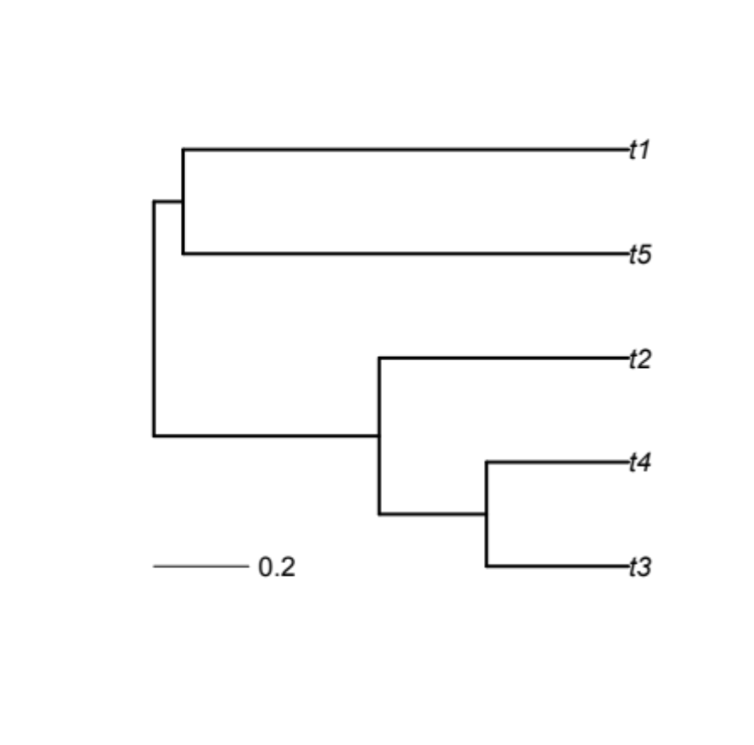
Many measures to quantify dissimilarity, but two broad classes are common.
‘Richness’ measures are summations quantifying total accumulated dissimilarity among species.
Divergence measures quantify the average distances separating species.
Trait 2
+
Trait 1

Slide 36
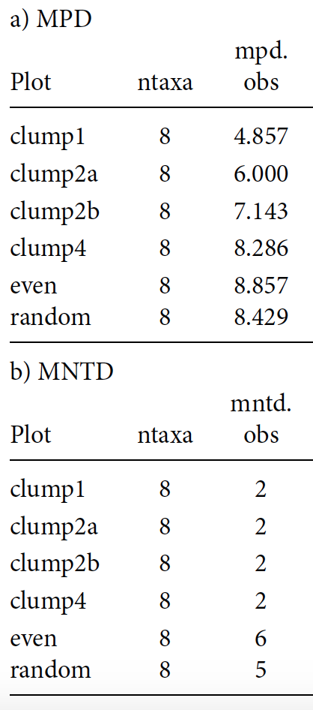
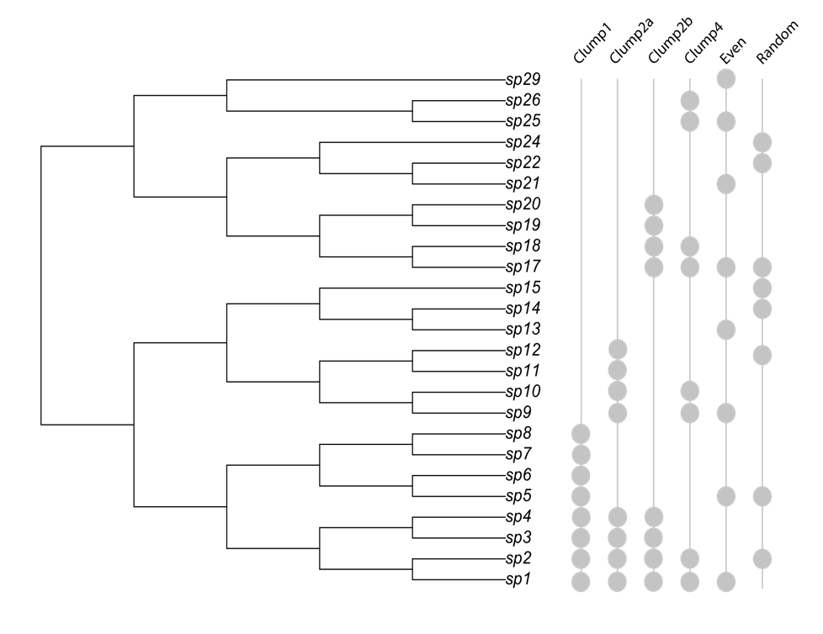
One measure: Mean Pairwise Distance (MPD)

Slide 37
Assessing significance
How do we know if MPD (or other) values are different from random (e.g., clustered)?
No standard statistical tests exist, so we need to use randomizations.
What do we randomized?
  Either the community matrix or the phylogeny.

Slide 38
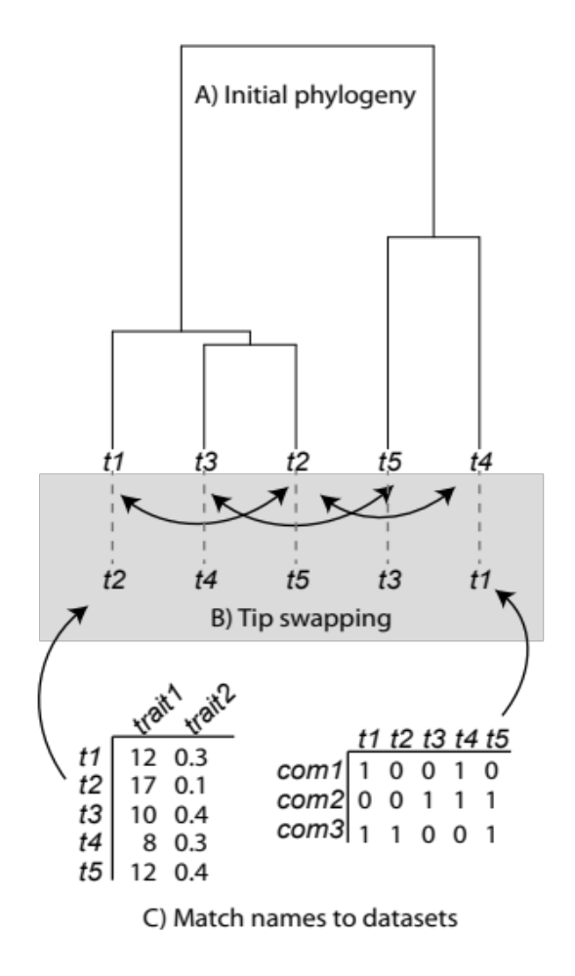
Randomize phylogeny
Simplest way –swap tip labels.

Slide 39
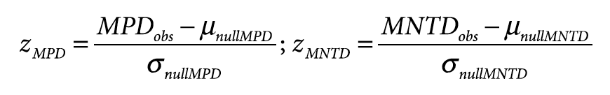
Calculate Standardized Effect Size (SES)
Controls for richness differences among sites.
Z-value can be assessed for significance directly, or from randomized values.
Value of 0; no different than random.
Value > 0; species more dissimilar (over-dispersion).
Value < 0; species more similar (clustered).

Slide 40
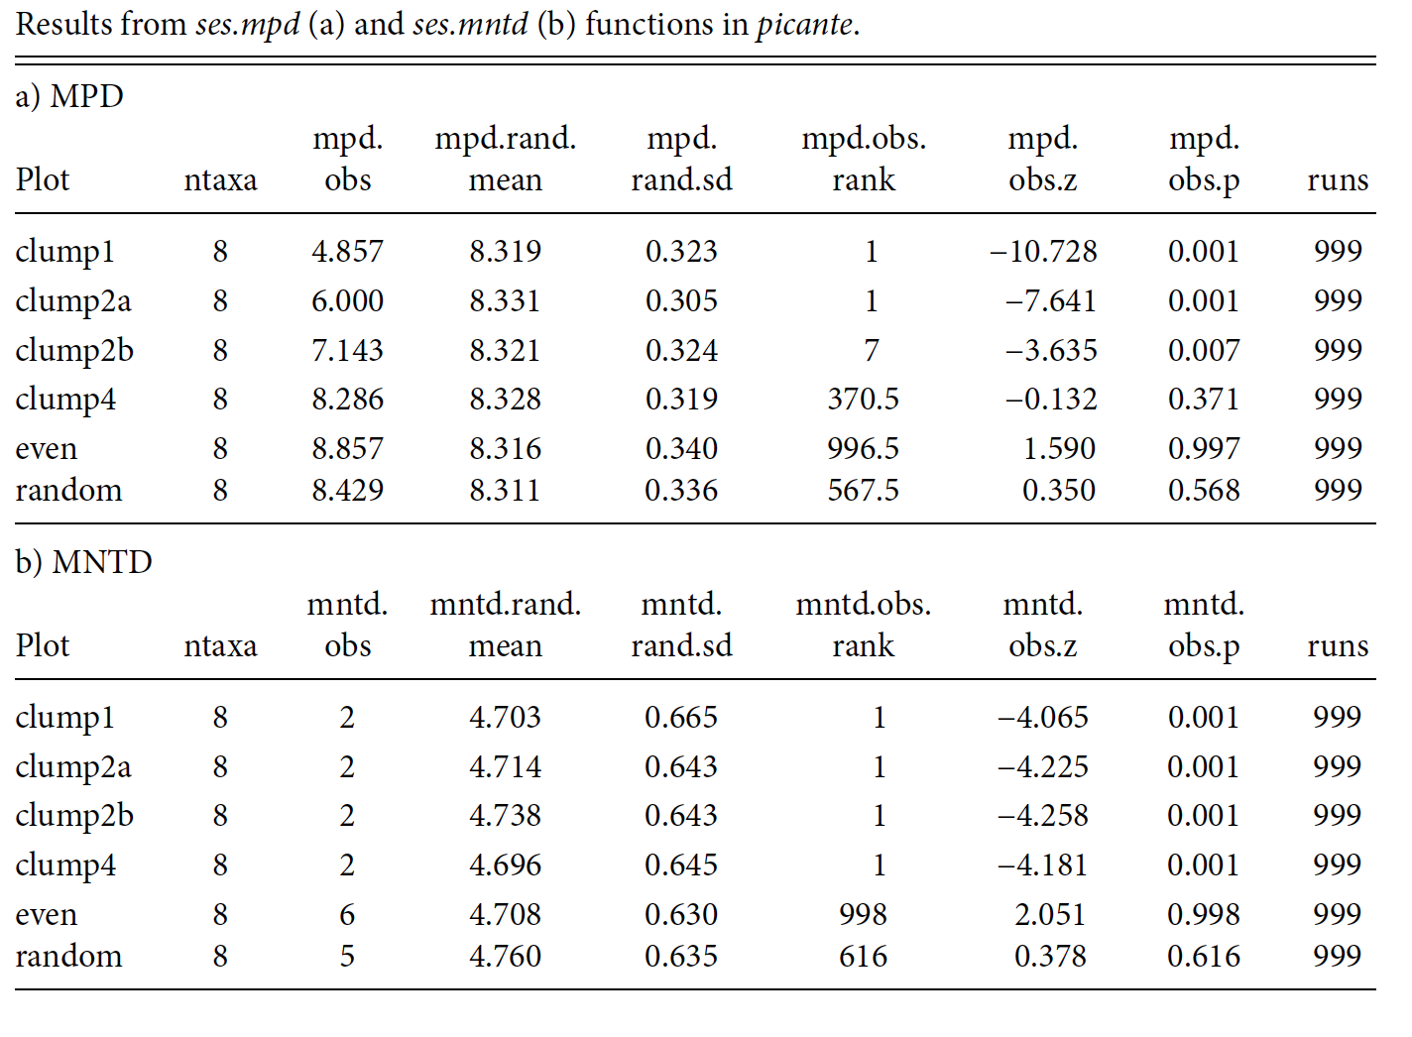


Slide 41








Better insight from traits?
Abundance
Logically, traits should provide better prediction compared with PD.
Traits are how species actually experience the world.
Niche position (soil moisture)

Slide 42

Better insight from traits?

Slide 43










Better insight from traits?
Technically measured as Community Weighted Mean (CWM)
d
Average
Height
d
d
d
Average
Height
Trait 2
+
Many very technical ways, commonly used: Functional Dispersion (FDis)
Trait 1

Slide 44


Reanalyzing BEF relationships
Number of species
Tilman et al. 2001 Science

Slide 45












Diversity facets and mechanisms
BEF relationships much variation.
Lack of concrete mechanisms
Difficult to make restoration/design recommendations
Use of functional traits and phylogenetic relationships

Slide 46

Cedar Creek
1, 2, 4, 8, 16 species from a pool of 18.
28-35 replicates.
Biomass harvested from sub plots.
Sampled 1996-2010.
  abundances 2001-2010

Slide 47


Phylogeny and traits
Leaf area
Specific leaf area
Leaf perimeter/area ratio
Leaf lobedness
Seed weight
Height
Presence of:
  C3
  C4
  Forb
  N-fixer

Slide 48
Functional Diversity
Number of functional groups: FG.
Functional attribute diversity: FAD (Walker et al. 1999).
Functional diversity: FD (Petchey & Gaston 2002).
FD-NMDS.
PD

Slide 49


Slide 50

Single-Variable Models
_{Single trait measures}
Multi-trait functional diversity
_{Phylogenetic diversity}

Slide 51
R exercise (if time)
Go to github and download ‘cedar_e120data2008.csv’ and ‘cedar_example_diversity.R’
Calculate at least four different types of diversity measures using the R script.
Correlate those measures to see which are similar.

Slide 52





Succession & diversity
Classic succession theory predicts that competition increases through time.
Time

Slide 53

Succession & diversity
Classic succession theory predicts that competition increases through time.
From Meiners, Cadotte, et al. 2015. Func. Ecol.

Slide 54


Slide 55

Communities go from clustered to over-dispersed
How do immigration and local extinction drive this pattern?
If competition increases over time –should we see more extinction among close relatives later on?
Overdispersed
Clustered

Slide 56

Colonists are clustered early on
Colonists relative to residents
Overdispersed
Clustered

Slide 57

Extinctions are not clustered
Extinct species relative to residents
Overdispersed
Clustered

Slide 58

Why do we see PD change through time?
Early on: Stressful environment selects for key shared traits.
OR: related species share life-history attributes that give them temporal fitness advantage (e.g., good dispersal, high growth rates, etc.)

Slide 59
Why do we see PD change through time?
Late stages: Dissimilar traits by competition and limiting similarity.
OR: mature communities have greater environmental heterogeneity (e.g., light stratification) allows for divergent species (e.g., trees and epiphytes are often distantly related).

Slide 60
The problem: when richness is not important
Late
Trait 2
Early
Trait 1

