Slide 1
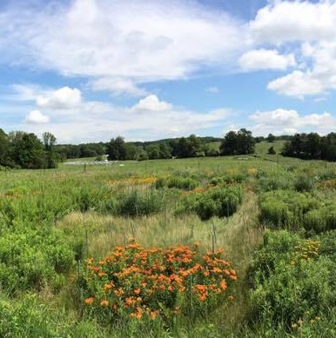
Biodiversity & Ecosystem functioning under anthropogenic stressors
Marc W Cadotte
University of Toronto
Session 2.2: Analyzing BEF experiments: measuring
selection and complementarity

Slide 2
Changes in biodiversity result in changes to functioning
Functioning (biomass)
Species diversity

Slide 3

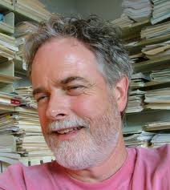

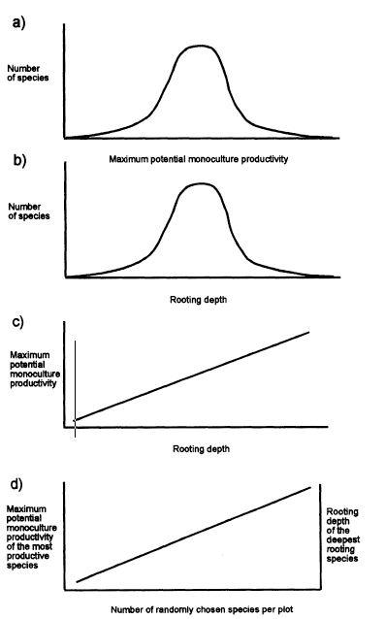
The criticisms
Lonnie Aarssen
Phil Grime
Michael Huston
Experimental treatments often include other factors (e.g., changes in nutrient dynamics), and might influence results.
Non-random species assemblages that may increase the effect of diversity.
Increased probability of including productive species in high diversity treatments.

Slide 4
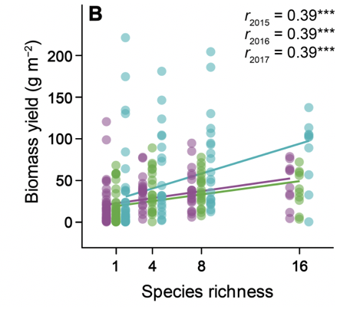
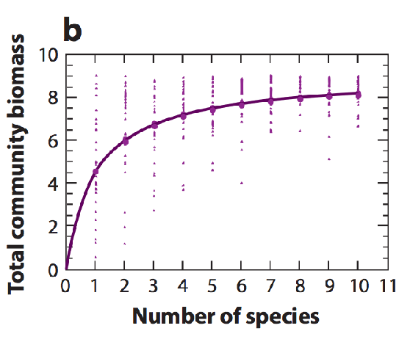
The problem
How do we know that biodiversity is the cause for increasing function?

Slide 5
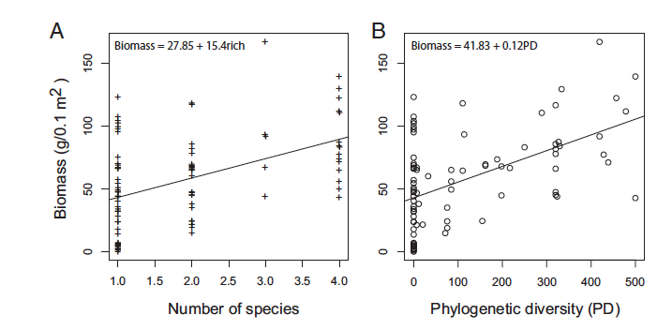
Need to separate effects of species from diversity
M_{MAX}
M

Slide 6
The concept of overyielding
‘Overyielding’ is a term that comes from crop research.
Overyielding: A species mixture (polyculture) produces more biomass than expected from their monocultures.

Slide 7
Overyielding
Transgressive
overyielding
Biomass
Overyielding
Expectation
Species 1
0 25 50 100
Species 2
100 50 25 0
Species proportion in mixture

Slide 8
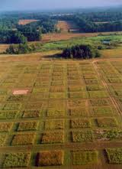
Exercise 1
Use the files on github to analyze the relationship between diversity and function, and to see if there is overyielding.

Slide 9


Population dynamics and species interactions make it difficult to observe this
1
The assumption:
2
The reality:

Slide 10
Population dynamics and species interactions make it difficult to observe this
Species contributions to ecosystem functioning are influenced by important ecological processes.
Competitive interactions influenced by fitness differences will skew contribution to dominant species.
Coexistence influenced by niche differences will allow for overyielding (especially transgressive overyielding).
To understand this more we need to talk about Peter Chesson’s model.

Slide 11


Chesson: coexistence
“Stable coexistence can be quantified by the long-term rates at which community members recover from low density.”
Peter Chesson
Abundance
What is the low density growth rate ( )?
$${\overline{r}}_{i}$$
Time

Slide 12

Chesson: coexistence
If is large, then species is recovering –likely coexisting with other species
If remains small, then the growth rate is affected by environment and not
release from density-dependence.
$${\overline{r}}_{i}$$
$${\overline{r}}_{i}$$
Peter Chesson
Abundance
What is the low density growth rate ( )?
$${\overline{r}}_{i}$$
Time

Slide 13
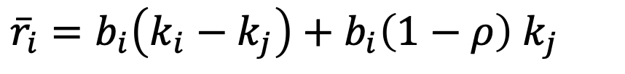
Chesson: coexistence
${\overline{r}}_{i}=b_{i}\left(k_{i}−k_{j}\right)+b_{i}\left(1−ρ\right)$ $k_{j}$
Fitness differences
Niche overlap
k_{i} is the fitness of species i
k_{j} is the fitness of the resident species
b_{i} is the rate at which growth rate declines as resource become depleted.

Slide 14
Chesson: coexistence
${\overline{r}}_{i}=b_{i}\left(k_{i}−k_{j}\right)+b_{i}\left(1−ρ\right)$ $k_{j}$
Neither increasing nor decreasing
Growth rate species i
0
Fitness differences
k_{i} is the fitness of species i
k_{j} is the fitness of the resident species
b_{i} is the rate at which growth rate declines as resource become depleted.
Resident fitness (j)
We equate a higher fitness to better competitive ability
But only when species use the same resources

Slide 15
Chesson: coexistence
(here, k_{j} > k_{i})
${\overline{r}}_{i}=b_{i}\left(k_{i}−k_{j}\right)+b_{i}\left(1−ρ\right)$ $k_{j}$
Neither increasing nor decreasing
Growth rate species i
0
Niche overlap
k_{i} is the fitness of species i
k_{j} is the fitness of the resident species
b_{i} is the rate at which growth rate declines as resource become depleted.
Niche overlap, rho (p)
We equate a higher fitness to better competitive ability
But only when species use the same resources

Slide 16

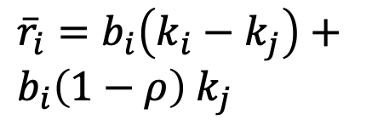
Regions of coexistence
+
Species i invades regardless of niche overlap
${\overline{r}}_{i}=b_{i}\left(k_{i}−k_{j}\right)+b_{i}\left(1−ρ\right)$ $k_{j}$
A
Species i outcompetes species j.
Both species coexist
Species i outcompetes species j.
B
Niche difference
0
Fitness difference (k_{i} – k_{s})
$\left(1−ρ\right)$
B
C
-

Slide 17

What does this mean for ecosystem function?
+
For a community with species i and j:
A:
B:
Species i invades regardless of niche overlap
A
B
Selection effect
Species i outcompetes j and pulls polyculture function to its own monoculture
Niche difference
0
Fitness difference (k_{i} – k_{s})
$\left(1−ρ\right)$
B
Species i coexists with j and polyculture function should be greater than monocultures
C
Complementarity effect
-

Slide 18
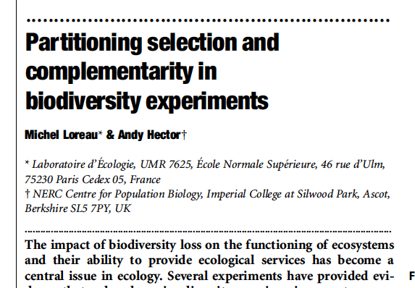
Measuring selection and complementarity
To overcome the criticism that results could be produced by a greater probability of selecting productive species in higher diversity plots, researchers needed statistical measures of species contributions to productivity.
Nature 2001

Slide 19
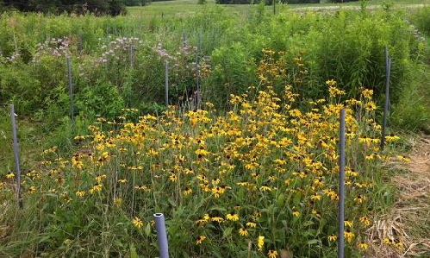



Selection vs. complementarity
Is this polyculture more productive with 2 species than what we expect from monocultures?
Polyculture = 2 species
ΔY = ‘biodiversity effect’
Selection effect:
Complementarity:
$$\}∆Y$$
Dominates
Ecosystem function
Each species produces more than expected from monoculture (50%)
1 2
Number of species

Slide 20
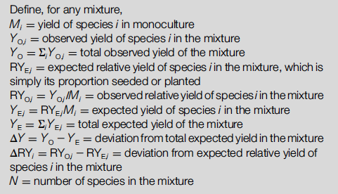
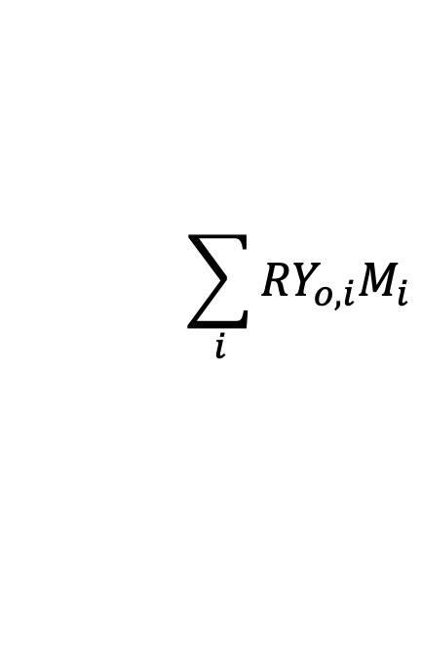
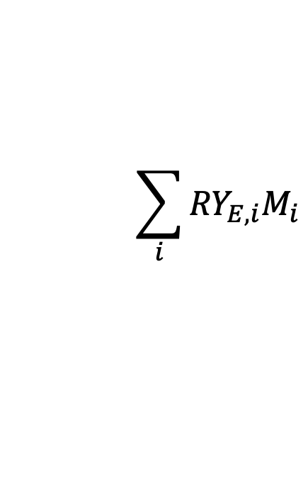
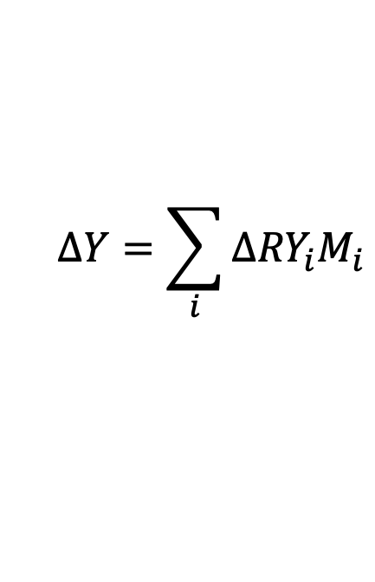

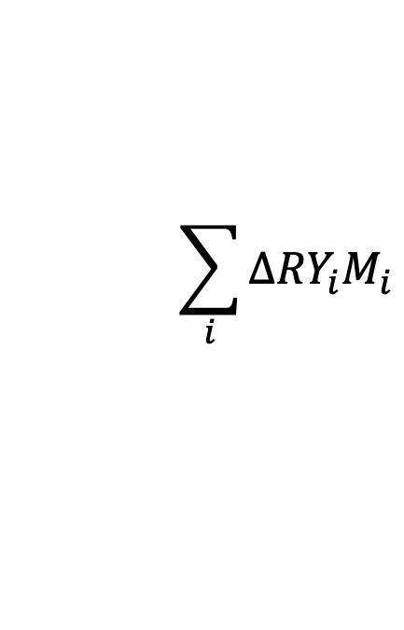
Measuring selection and complementarity
Net biodiversity effect:
$$ΔY=Y_{o}−Y_{i}$$
$$ΔY=\sum_{i}{Δ{RY}_{i}M_{i}}$$
$$\sum_{i}{{RY}_{o,i}M_{i}}$$
$$\sum_{i}{{RY}_{E,i}M_{i}}$$
$$ΔY=N∙\overline{ΔRY}∙\overline{M}+N∙\text{cov}\left(ΔRY,M\right)$$
Complementarity
Selection effect
$$\sum_{i}{{ΔRY}_{i}M_{i}}$$

Slide 21
Exercise 2
Let’s go through an R example together using Tilman’s Cedar Creek data

Slide 22
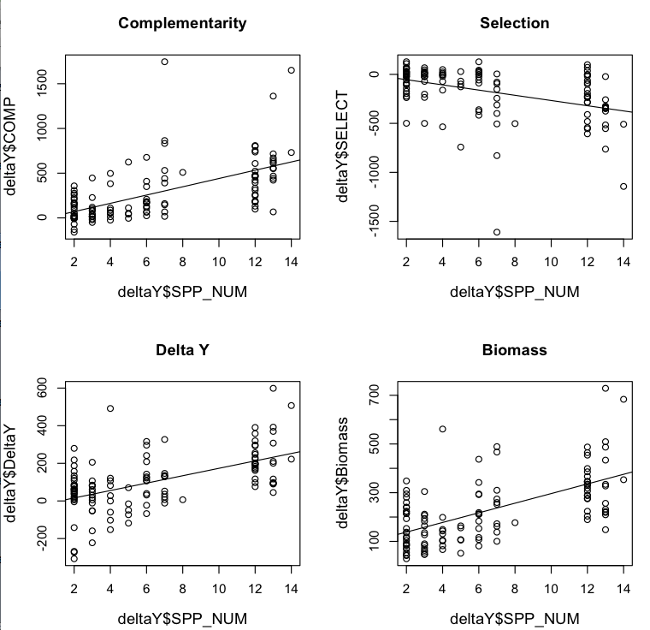

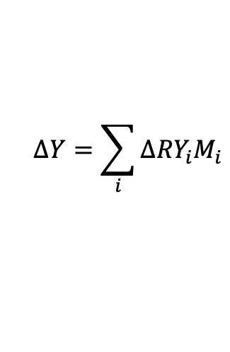

$$N∙\overline{ΔRY}∙\overline{M}$$
$$N∙\text{cov}\left(ΔRY,M\right)$$
$$ΔY=\sum_{i}{Δ{RY}_{i}M_{i}}$$

Slide 23
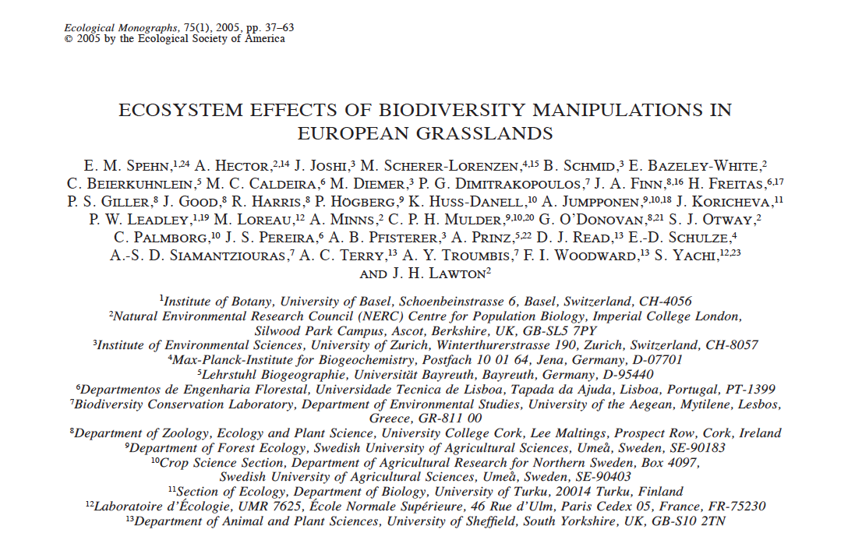
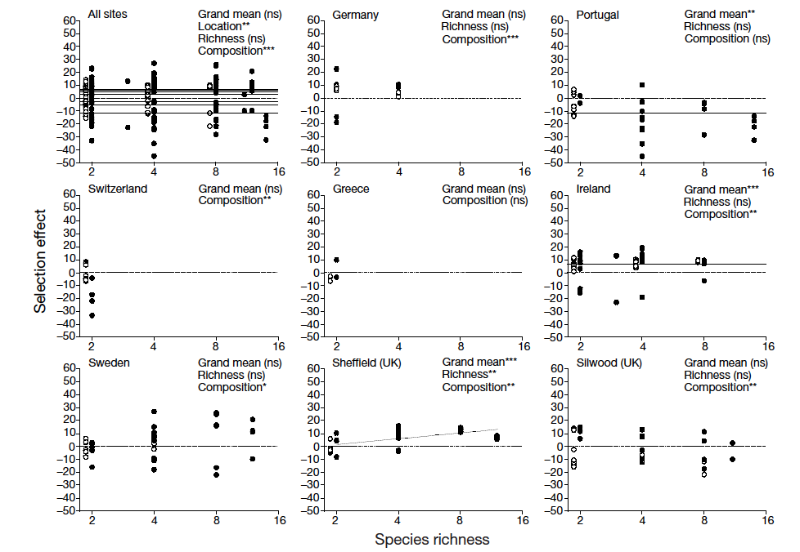
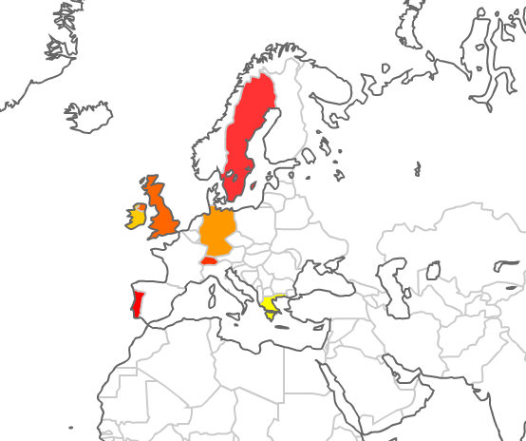
Selection effects in BIODEPTH

Slide 24
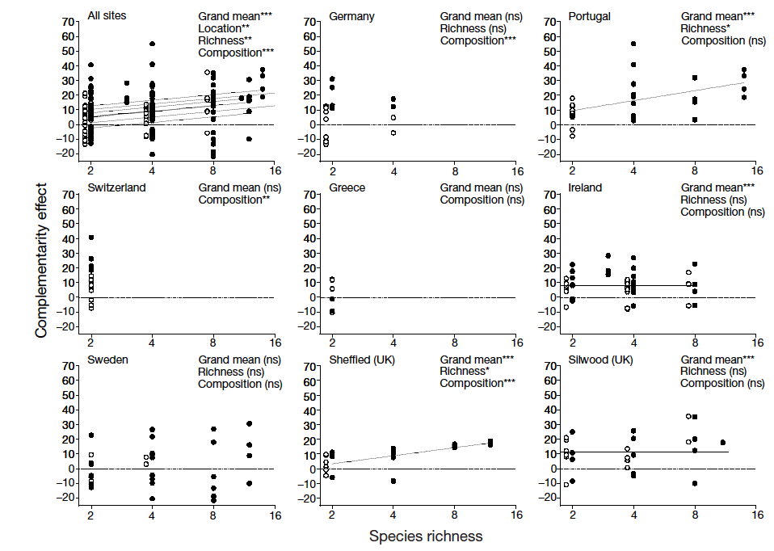
Complementarity effects in BIODEPTH

Slide 25


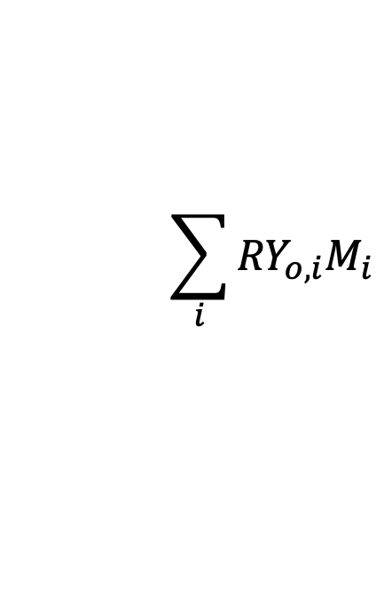
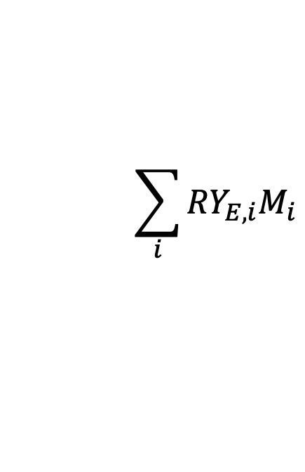

What else can cause complementarity effects?
$$N∙\overline{ΔRY}∙\overline{M}$$
Get into your groups
Think about complementarity, and the equations, and come up with mechanisms that might increase it that are not based on niche differences/coexistence.
$${∆RY}_{i}={RY}_{o,i}−{RY}_{E,i}$$
$$ΔY=Y_{o}−Y_{i}$$
$$\sum_{i}{{RY}_{o,i}M_{i}}$$
$$\sum_{i}{{RY}_{E,i}M_{i}}$$

Slide 26
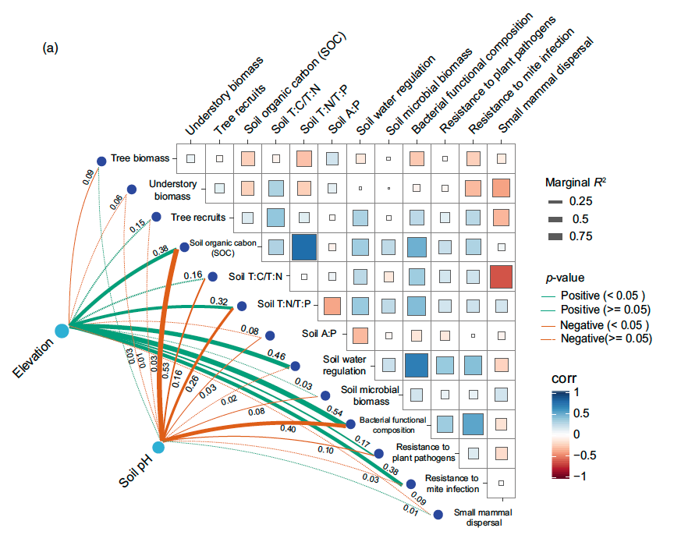
Multifunctionality & services

Slide 27
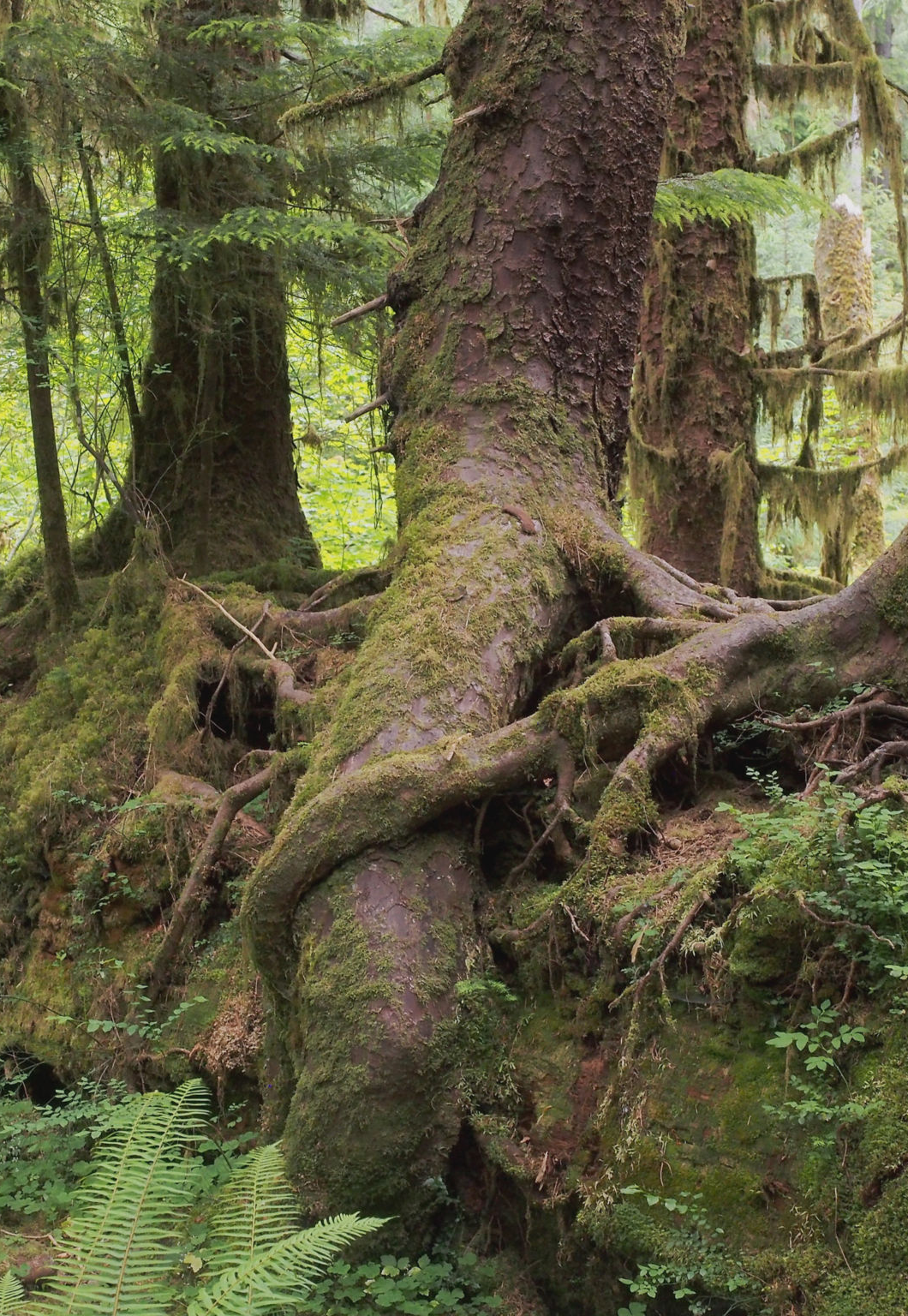
Multifunctionality
Analyzing these individual functions can be illuminating about the processes influencing functions we might care about (for example pollination) but often we think about ecosystem function as a multifaceted and complex aspect of ecosystems and we are able to analyze ecosystems more integratively, and when we do this, the importance of increasing biodiversity for ecosystem function becomes even more apparent.

Slide 28
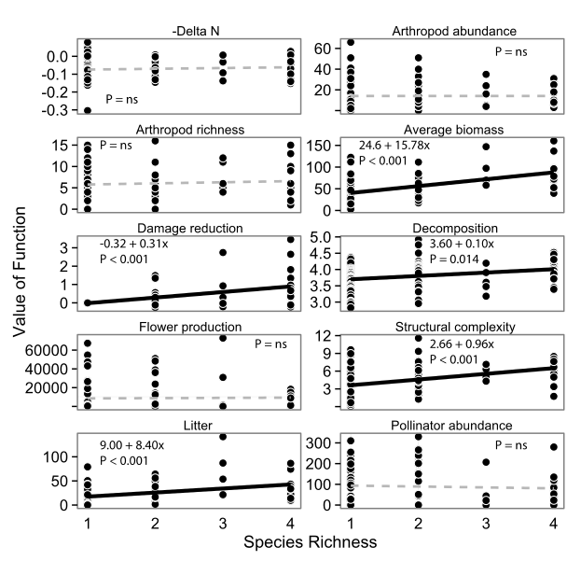
Multifunctionality

Slide 29
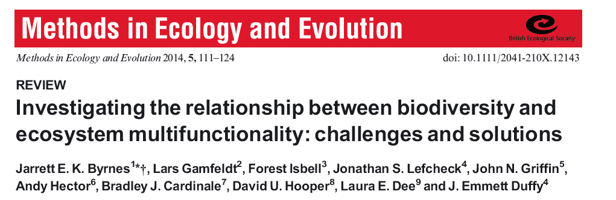

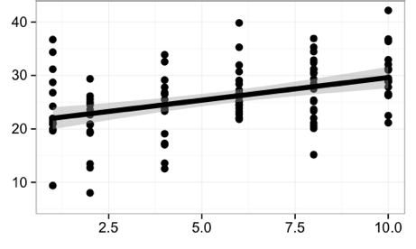

Estimating diversity-function relationships
Functions:
Biomass
Damage reduction
Decomposition
Flower production
Structural complexity
Litter
Pollinator visitation
Soil nitrogen
Arthropod abundance
Arthropod richness
Single functions
Average all functions
Number of functions > threshold
&

Slide 30
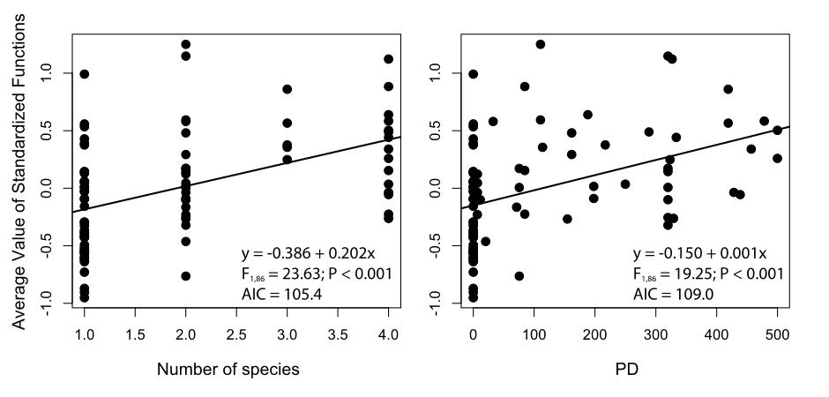
Multifunction
Averaging
Species Richness
PD

Slide 31
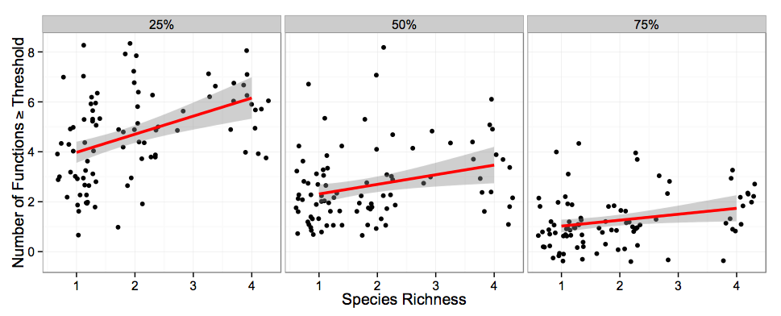
Multifunction
Thresholds
Species Richness

Slide 32

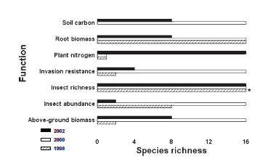
Measured 7 functions. Each function varied from year to year in the number of species required to maximize it.

Slide 33
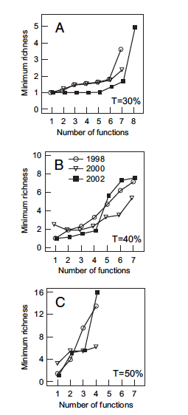
They then asked: how many species are required a threshold (T) for each function (30, 40, 50%).
The richness of any plot exceeding the threshold was enumerated, and used to find min. richness.
This method was also used for multiple functions; i.e., plots meeting 30% of all functions, etc.
Measured 7 functions. Each function varied from year to year in the number of species required to maximize it.

Slide 34
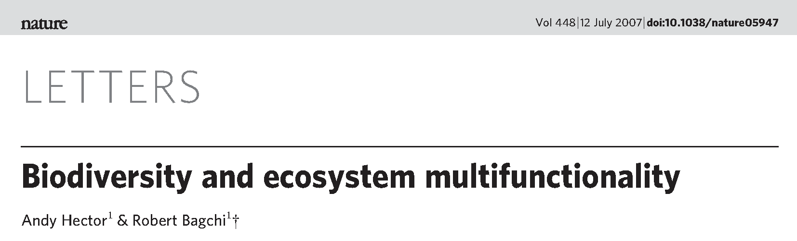
Multifunctionality
They looked at detectable effects of species on different ecosystem functions across the BIODEPTH (Europe) sites.
They estimated the minimum number of species required to support these functions

Slide 35
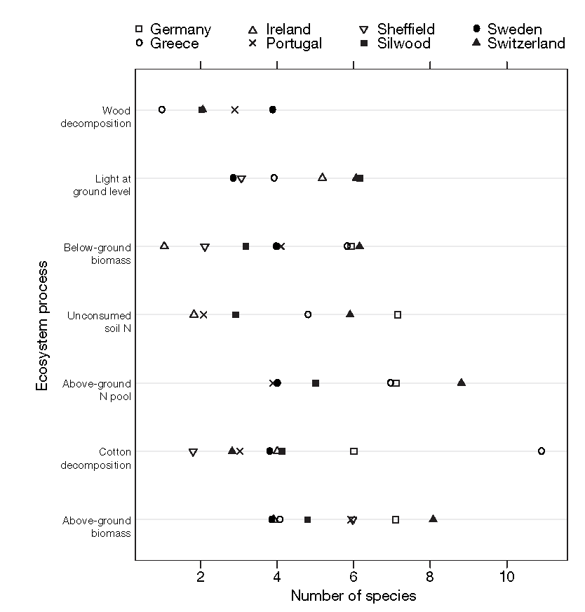
Multifunctionality

Slide 36
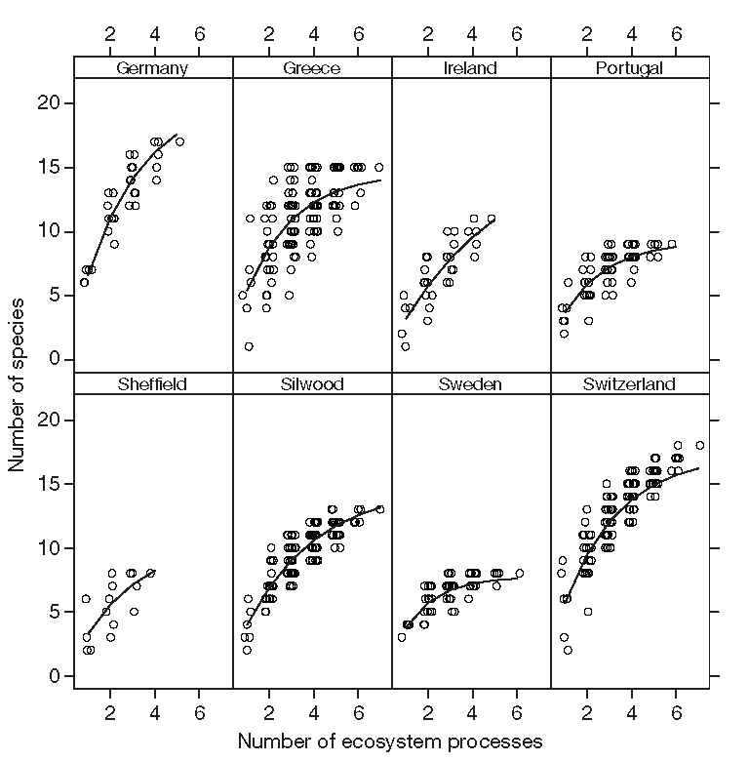
Multifunctionality
They found that between 3 and 7 species were required to maximise individual functions, but that between 8 and 18 species were required to maximise multiple functions.

Slide 37
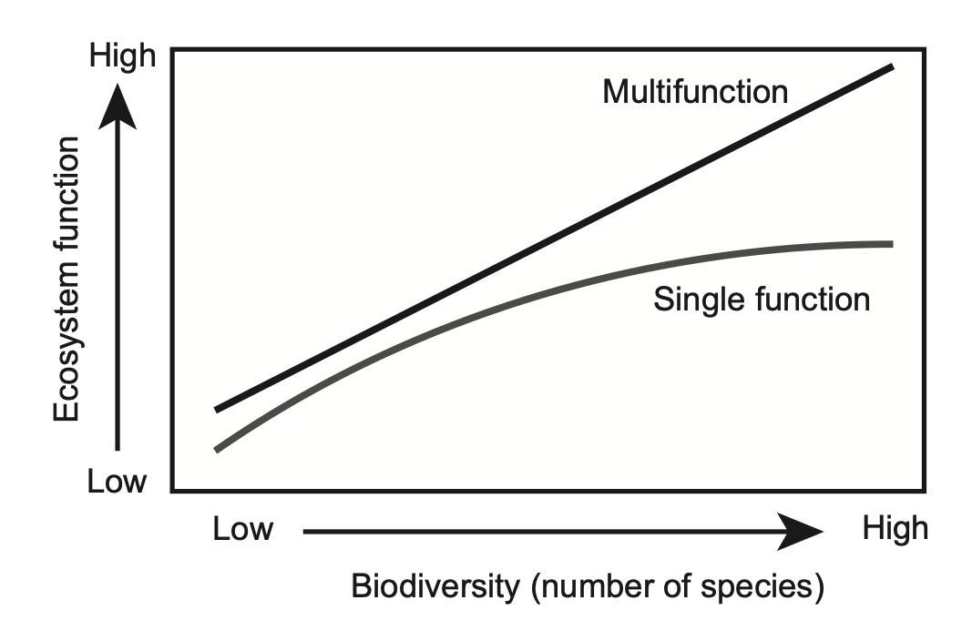
Multifunctions tend to be less saturating

Slide 38
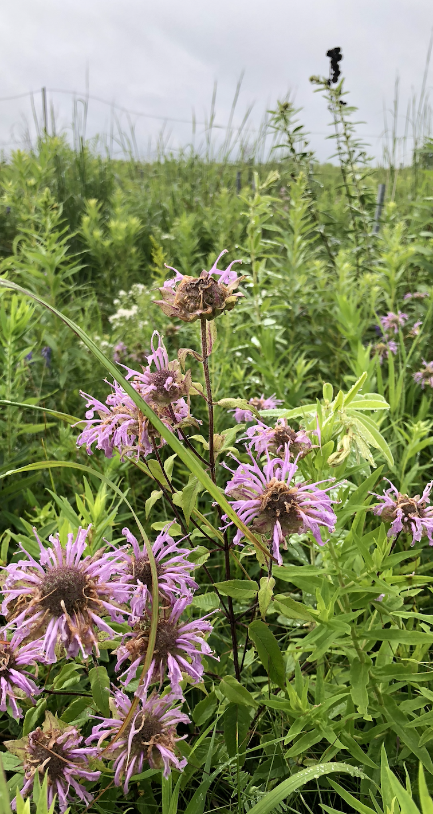
Why is diversity-multifunction stronger than for single functions?
Trade-offs
Environmental niches are multivariate
Less competition/greater stability
Density dependent mechanisms

Slide 39
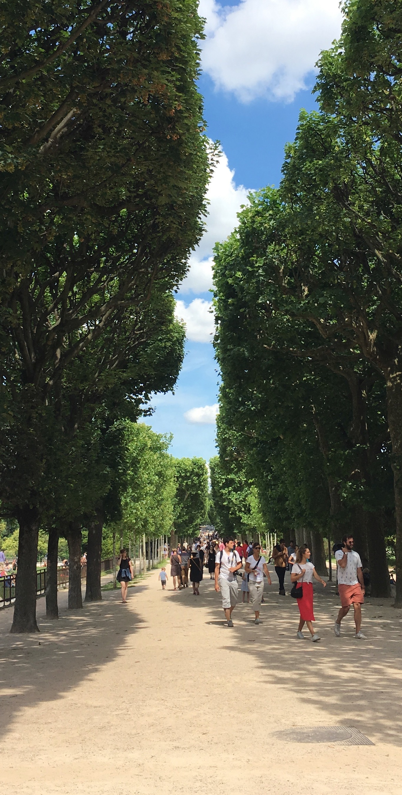
From functions to services
Ecosystem functioning and ecosystem services are interrelated concepts, except that ecosystem services explicitly considers the direct benefits to people.
These services can impact human wellbeing through a number of avenues including environmental conditions, food, monetary returns, recreation, education, artistic inspiration, mental health, or spiritual fulfilment.
Given this complexity of human implications of nature, it is extremely difficult to quantify, value, and communicate the multitude of ecosystem services.

Slide 40
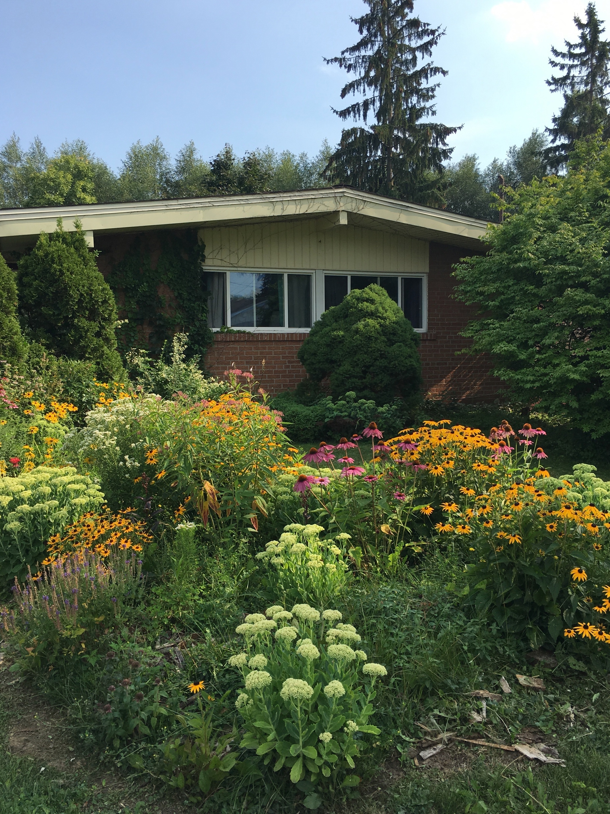
From functions to services
Functions and services are not distinctly different.
If fact they can be the same phenomenon, but its how we weight their value that matters.

Slide 41
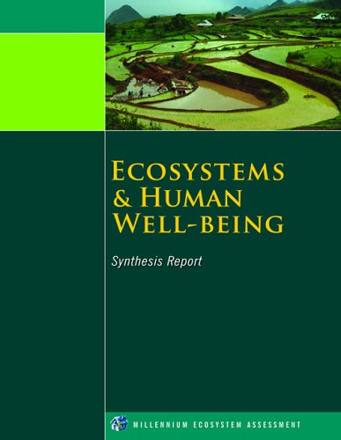
Types of services
Healthy ecosystems (regulating services).
Environmental benefits (supporting services).
Provisioning people (provisioning services).
Experiential connections (cultural services).

Slide 42






1) Healthy ecosystems (regulating services).
Basic functioning of an ecosystem that accounts for the stocks and flows of nutrients and energy, the support of biodiversity, full and complex food webs that result in self-sustaining regulation of pests and pathogens, and supplies diverse communities of pollinators and decomposers

Slide 43
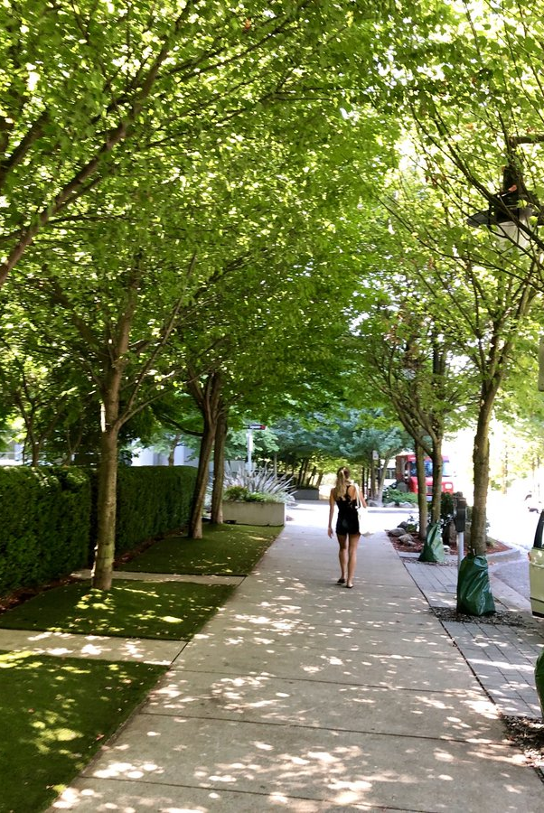



2) Environmental benefits (supporting services)
Refers to the ability of communities to provide a healthy environment by cooling temperatures on hot days, intercepting heavy rain and preventing flooding, filtering out pollution from ground water, absorbing particulate matter that drives poor air quality, and so on

Slide 44




3) Provisioning people (provisioning services).
Natural habitats can provide direct goods to people, like building material, fuel, and all sorts of edible plants, fish, fruit, fungi, etc.
Provisioning services tend to be the most heavily regulated service, and often require permits or licenses.

Slide 45

4) Experiential connections (cultural services).
Describe what happens when we have access to and are exposed to healthy green spaces. There are immense, and often under-appreciated benefits from interactions with nature. Includes recreation, aesthetic inspiration, learning, religious connections, etc.

Slide 46

Nature shapes people
Opportunities to experience nature, unsupervised, have a permanent effect on developing children.
Exposure to nature during childhood can influence confidence, curiosity, problem-solving, etc.

Slide 47

Nature deficit disorder
Nature deficit disorder was coined by Richard Louv to describe the negative consequences of a child’s development in the absence of nature exposure.
Louv believes that growing up without time spent outdoors and in contact with nature increases the propensity of obesity, depression, and attention deficit disorders.

Slide 48

But we need to be cautious…
Overestimating or overstating nature’s impact could undermine general valid facts.
Not a real diagnosis.
Lacks specific mechanisms.
Could undermine more important causes of certain disorders.
Culturally biased

Slide 49
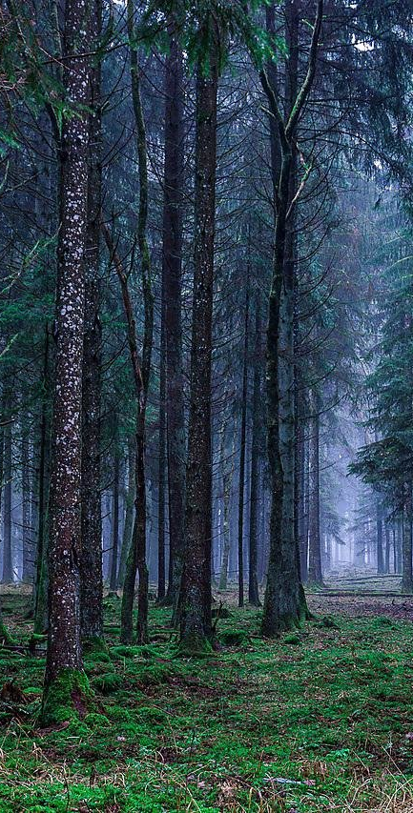
Should services increase with biodiversity?
Logically, the answer should be yes. Think about our forest monoculture that maximises timber production. It is very unlikely that this monoculture, say pine trees, can also supply many other services at high levels. A dense stand of pine trees is ill-suited for provided high-quality recreation. Further, diverse assortments of pollinators will see this habitat as a resource desert.

Slide 50
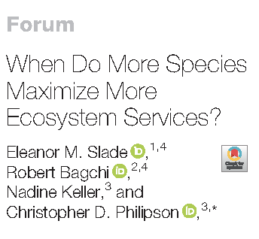
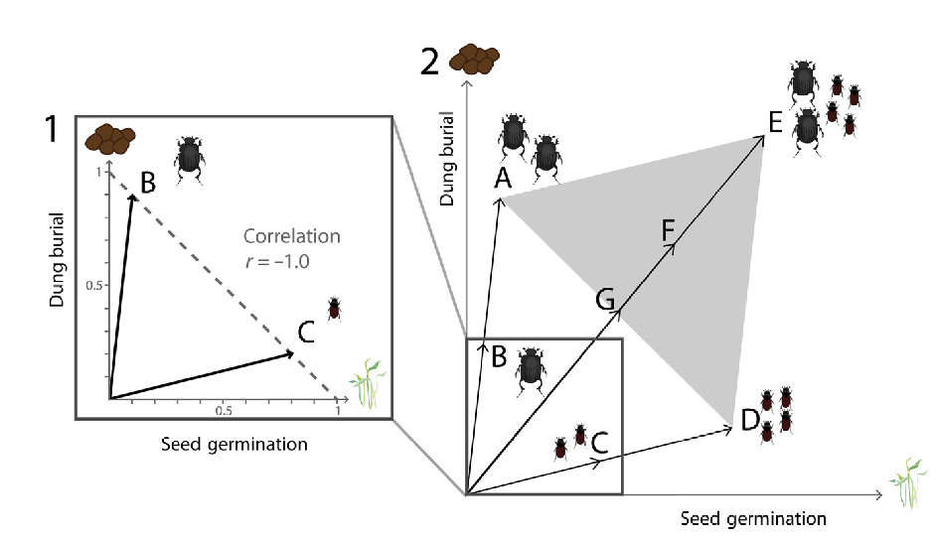
Should services increase with biodiversity?
Most apparent when species contributions to services are weakly correlated (or in a trade-off)

Slide 51
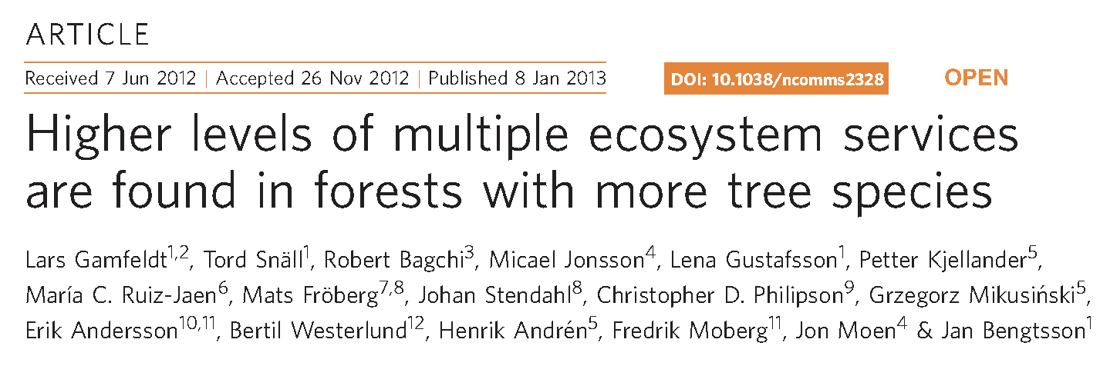
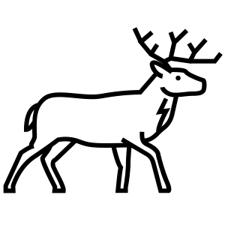



In one of the few robust studies of the linkages between biodiversity and ecosystem services, Gamfeldt et al. provide very convincing evidence of this linkage. They examined production forests across more than 4,500 plots surveyed by the Swedish National Forest Inventory and quantified their delivery of six different services: wood production, carbon storage, berry production, understory plant biodiversity, deadwood amount, and game animal populations.

Slide 52
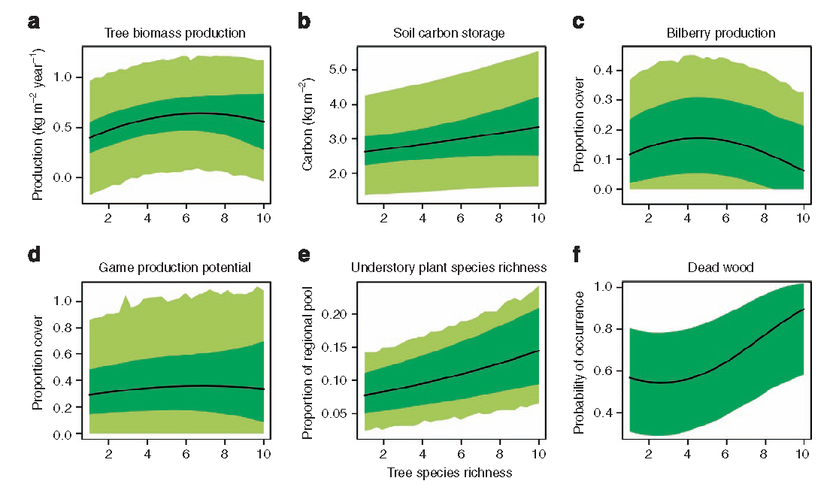
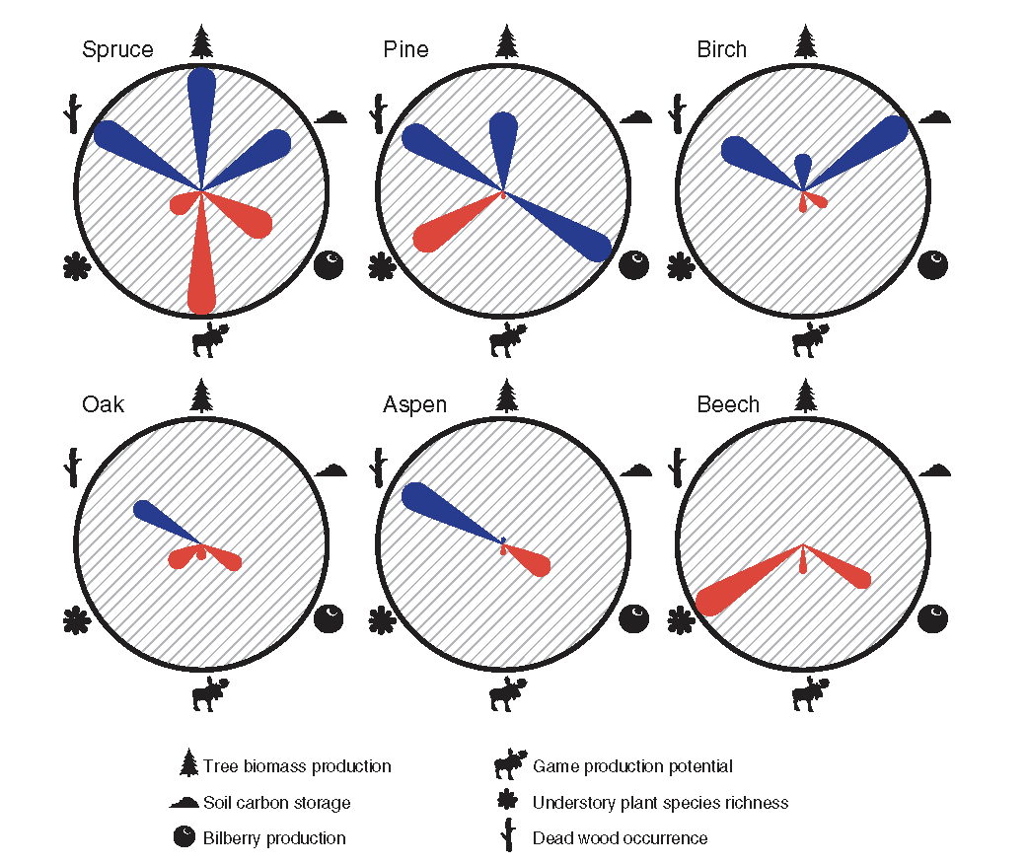
Lots of trade-offs

Slide 53

The double-edged sword
The need to quantify and value isn’t just an academic exercise, it has real-world implications.
For example, pressure to build on undeveloped urban land can be intense in cities. For pro-development politicians, it is relatively easy to estimate the economic benefits of development through estimation of property value and projections of tax revenues.
What if a politician asks for value of services to justify their protection?
What if the value is less?

