Slide 1
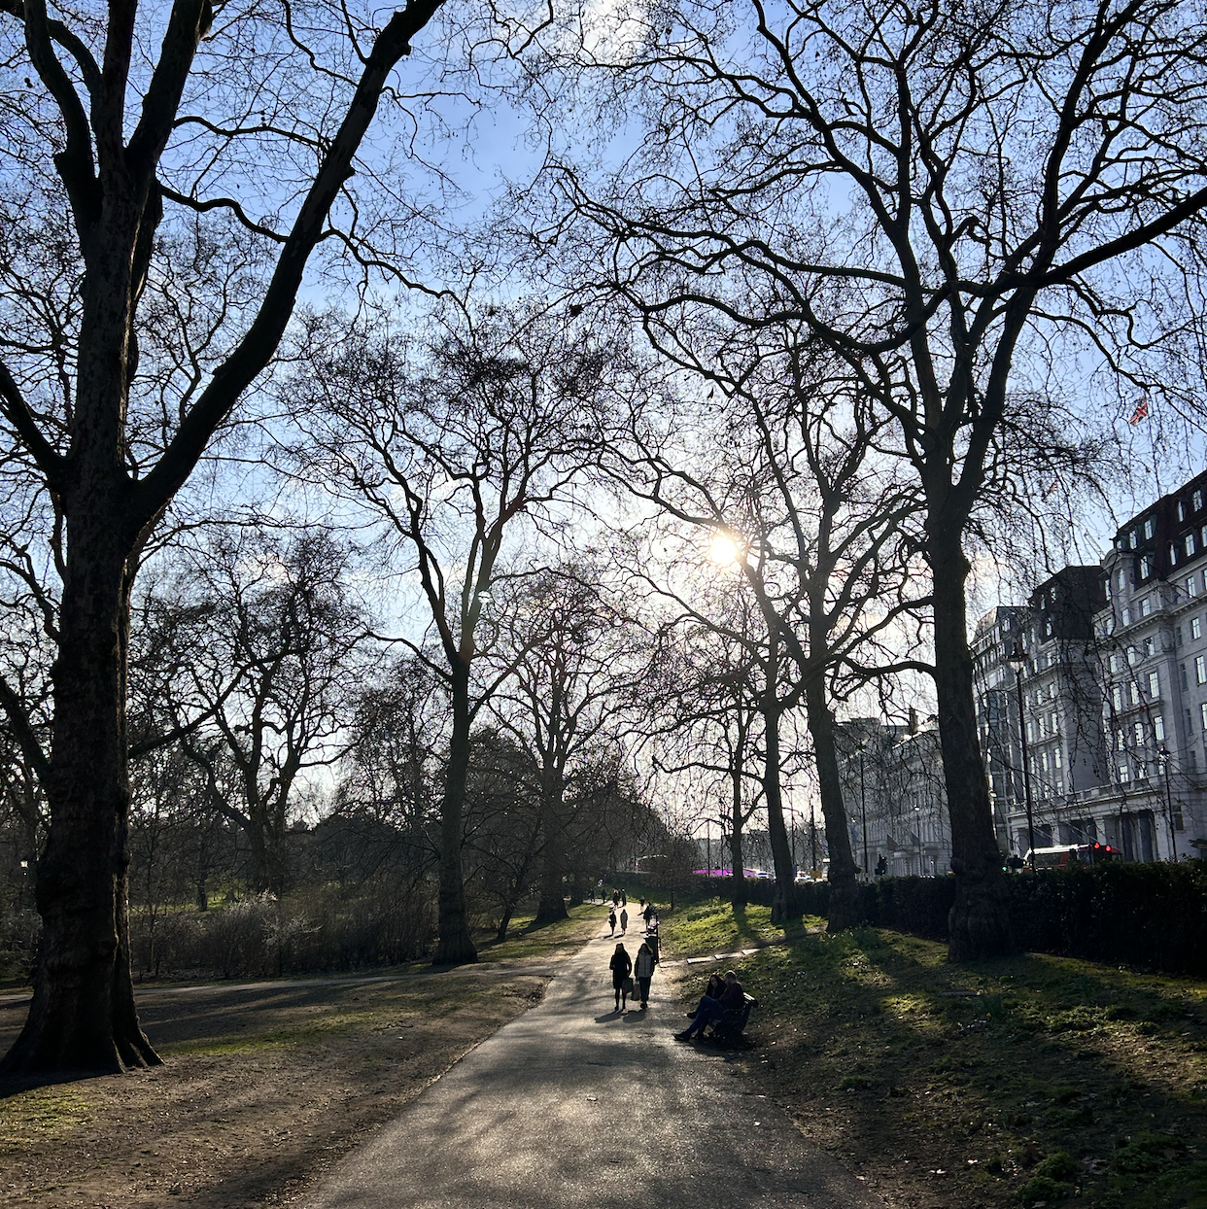
Biodiversity & Ecosystem functioning under anthropogenic stressors
Marc W Cadotte
University of Toronto
Session 3.1: Synthesizing stressors

Slide 2
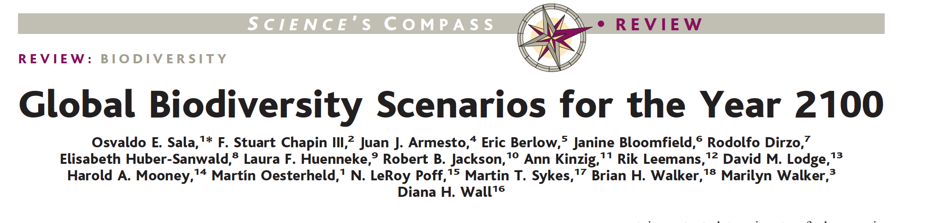
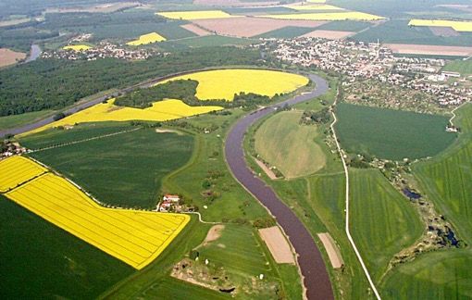
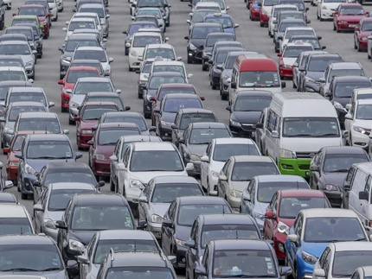
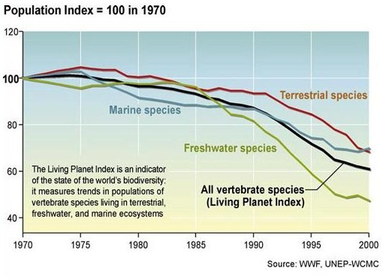
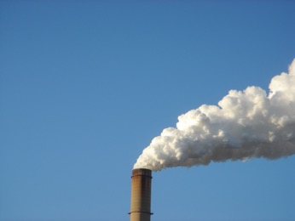

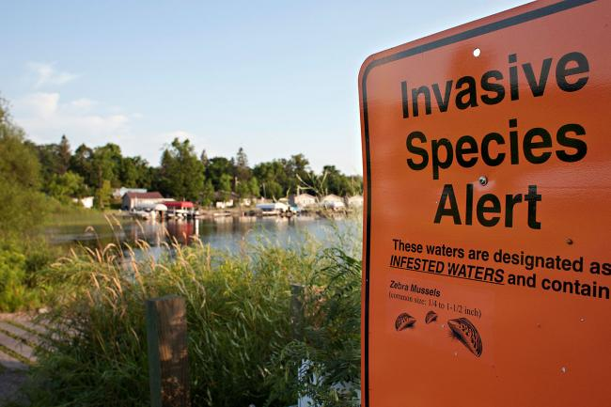
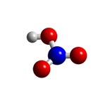
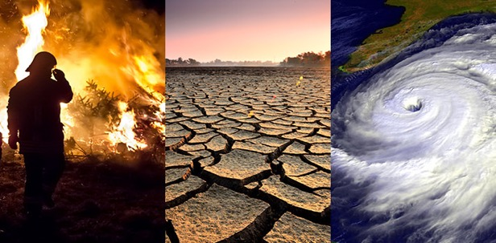
Biodiversity is changing
Land use change
Carbon pollution
Nitrogen
deposition
Species invasion
Climate change

Slide 3









The four external drivers of change
Disturbance
Natural stressor
Anthropogenic stressor
Anthropogenic global change driver

Slide 4
Pulse disturbance/stress
Direct impacts are acute and of short duration and ecosystem is assumed to be able to recover
Pulse
{
Resilience
Ecosystem state
{
{
Resistance
Recovery
Time

Slide 5


Chronic stress (press)
Hysteresis
Ecosystem state
Time

Slide 6
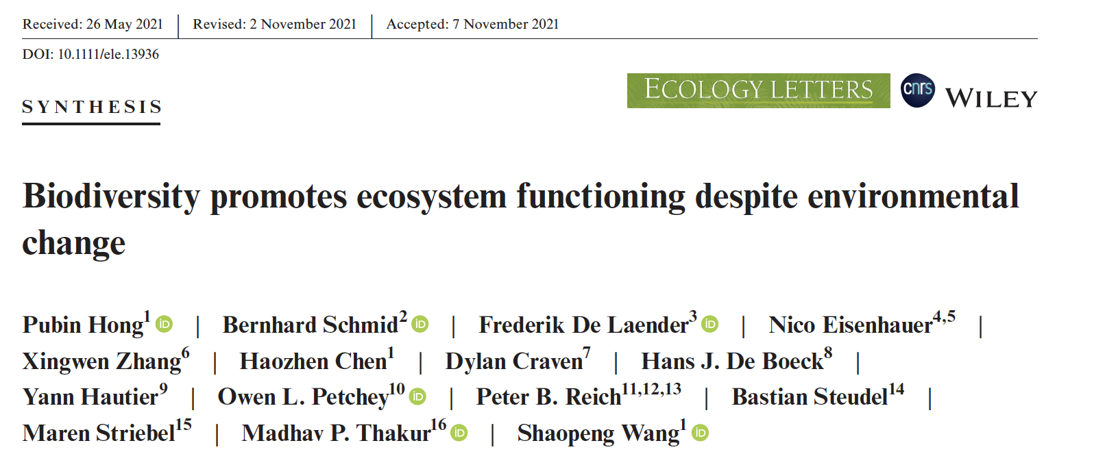
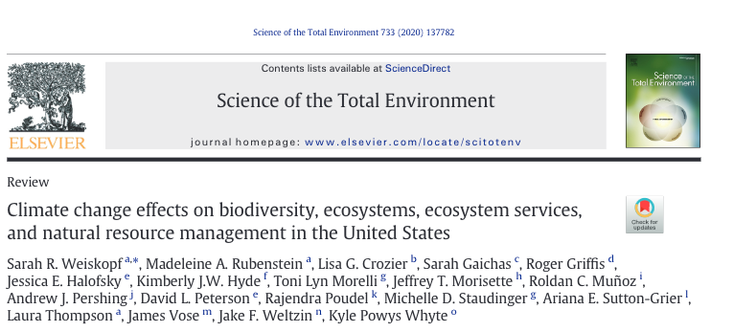
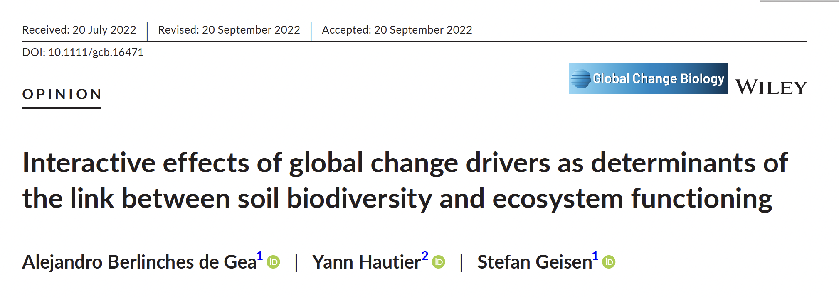
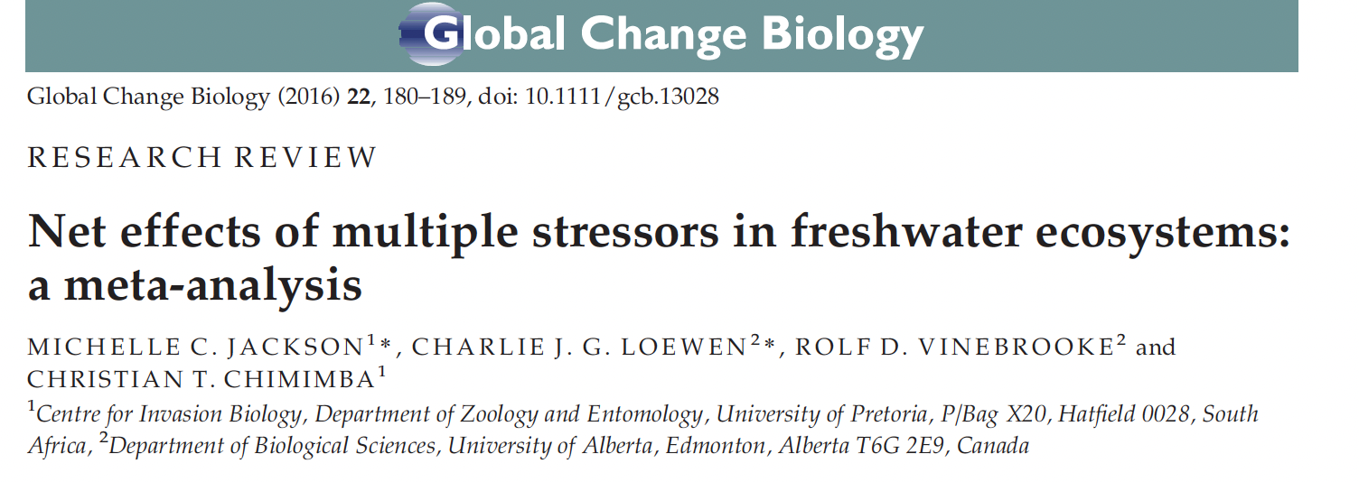
Discussion group activity
Most will read and discuss the following paper, other will read a different paper

Slide 7
Discussion group activity
Your group should give the whole paper a quick read, but each group will focus on one section:
Weiskopf
Group | Section
1 | 2.1
2 | 2.2
3 | 2.3
4 | 2.4
5 | 3.1
6 | 3.2
7 | 3.3
8 | 4.1 & 4.2
9 | 4.3 & 4.4
10 | 6
Your group will put together 1 slide:
1-Summarize the section you read (what were the main takeaway points)
2-What does the information from your section tell you about how stressors can impact biodiversity and ecosystem function/services?
3-How confident are you in the information? What else would you want data for?
Group | Paper
11 | Hong
12 | Jackson
13 | Berlinches de Gea

