Slide 1
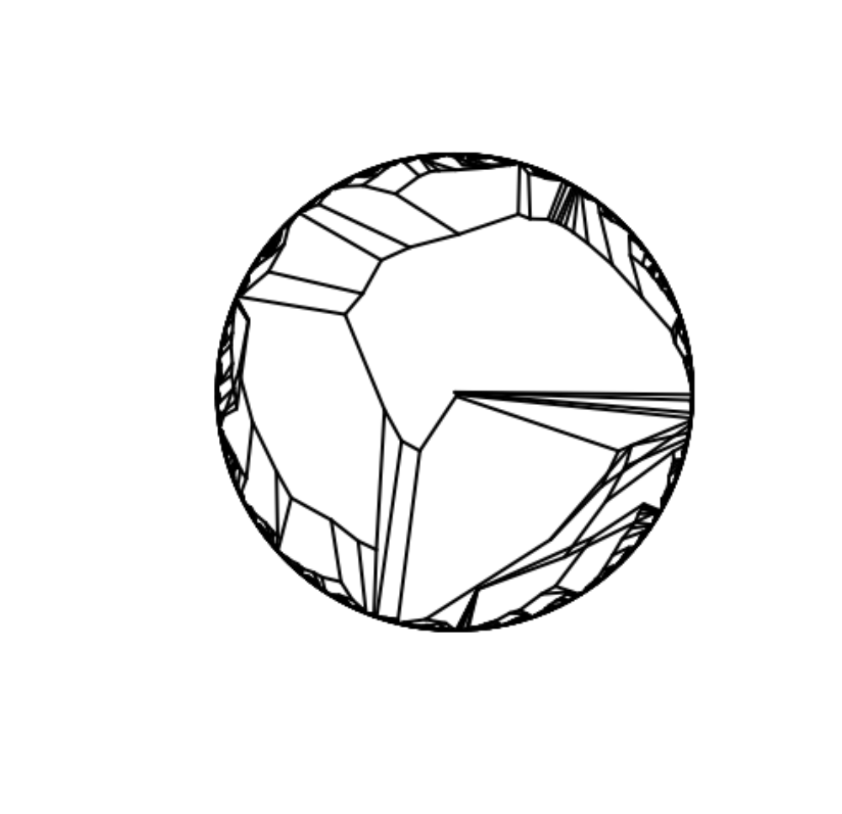
Biodiversity & Ecosystem functioning under anthropogenic stressors
Marc W Cadotte
University of Toronto
Session 4.2: Thinking about functional and phylogenetic BEF

Slide 2
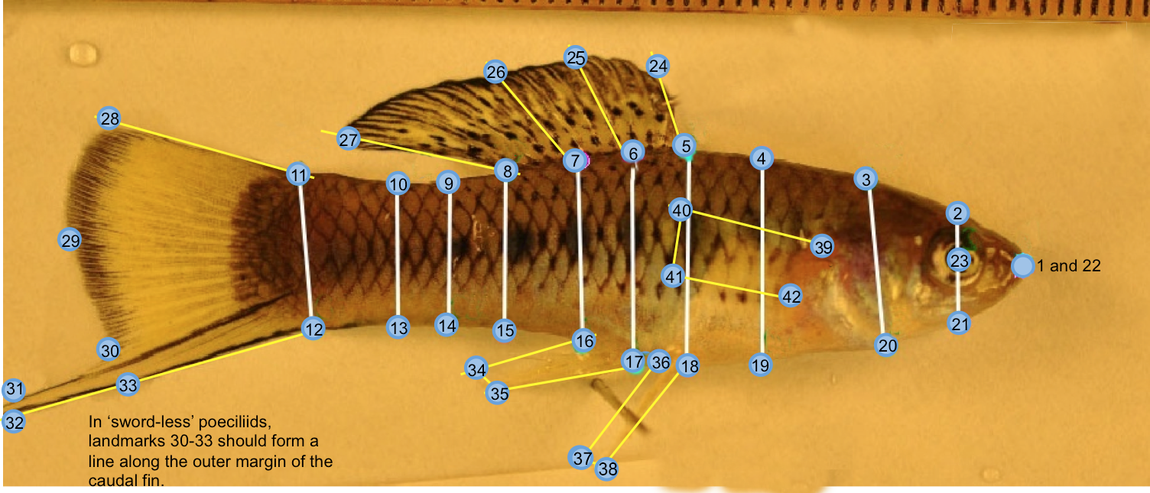
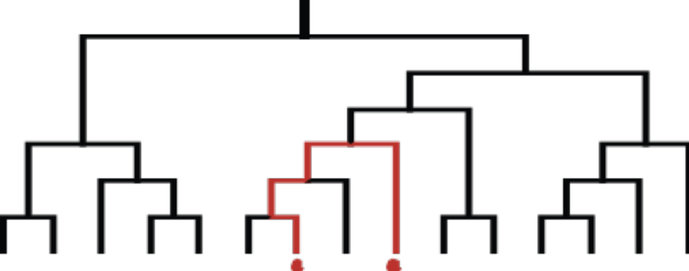
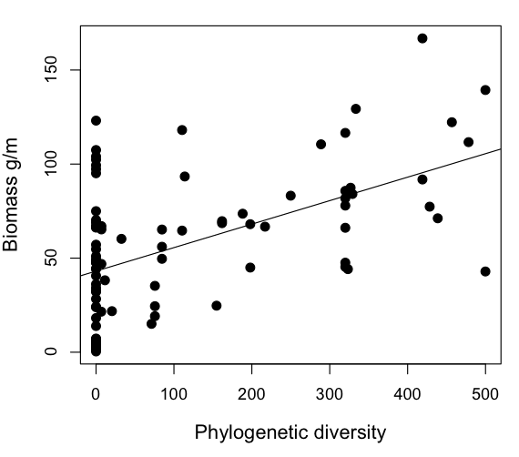
Two methods have emerged
1) Trait/functional approach
2) Evolutionary relationships
Late
Early
Trait 2
Trait 1

Slide 3
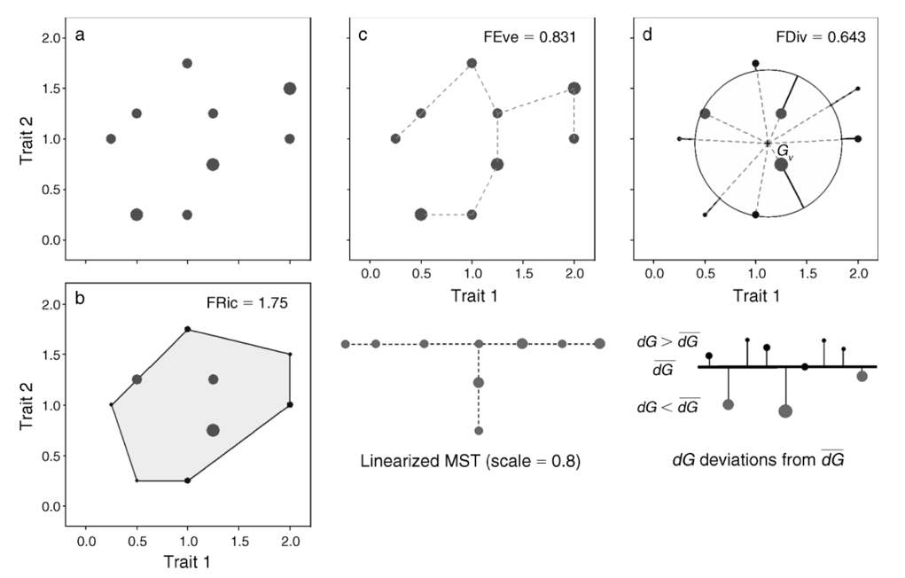




Functional diversity
A relatively small number of statistical methods to quantify the multivariate volume, divergence or evenness of traits.
Villeger et al. 2008 Ecology

Slide 4
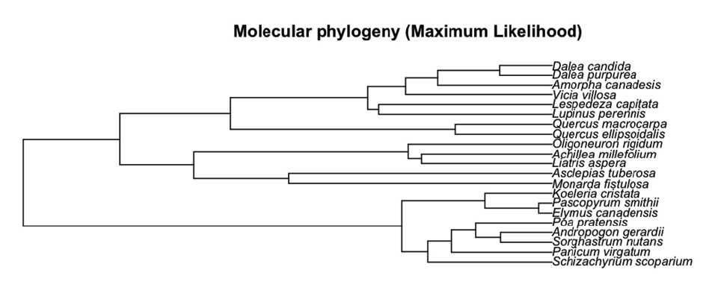
Phylogenies

Slide 5
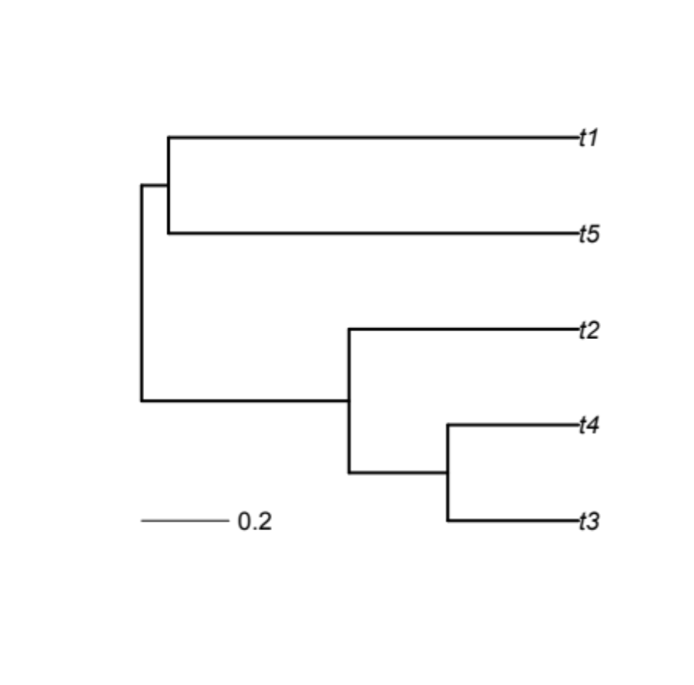
Many measures to quantify dissimilarity, but two broad classes are common.
‘Richness’ measures are summations quantifying total accumulated dissimilarity among species.
Divergence measures quantify the average distances separating species.
Trait 2
+
Trait 1

Slide 6




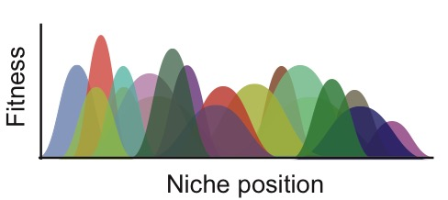
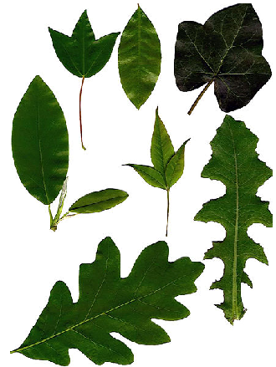
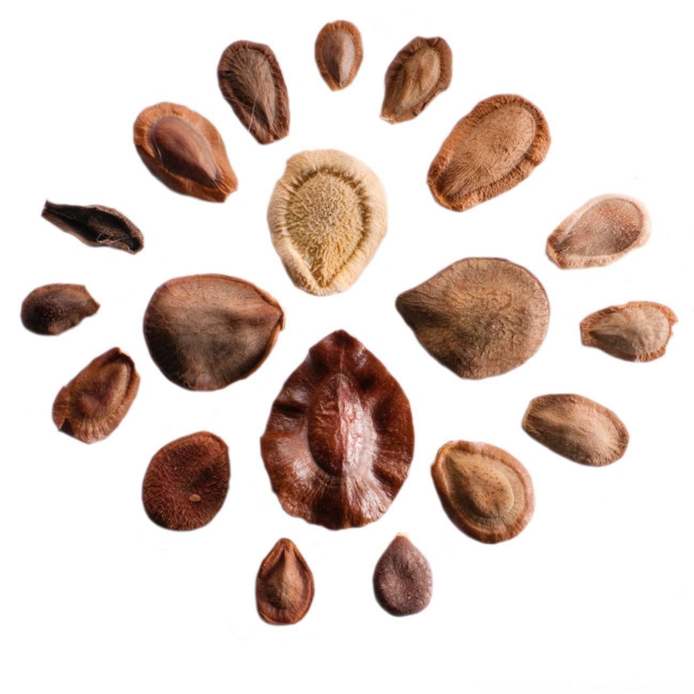
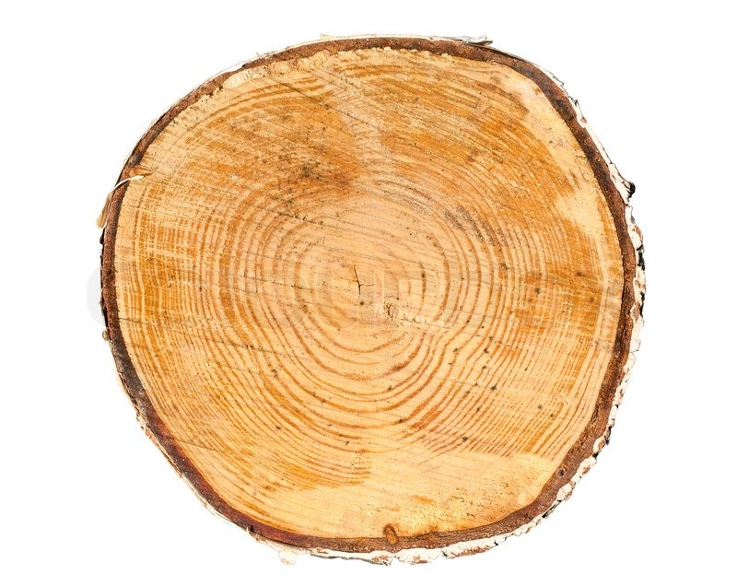
Better insight from traits?
Abundance
Logically, traits should provide better prediction compared with PD.
Traits are how species actually experience the world.
Niche position (soil moisture)

Slide 7
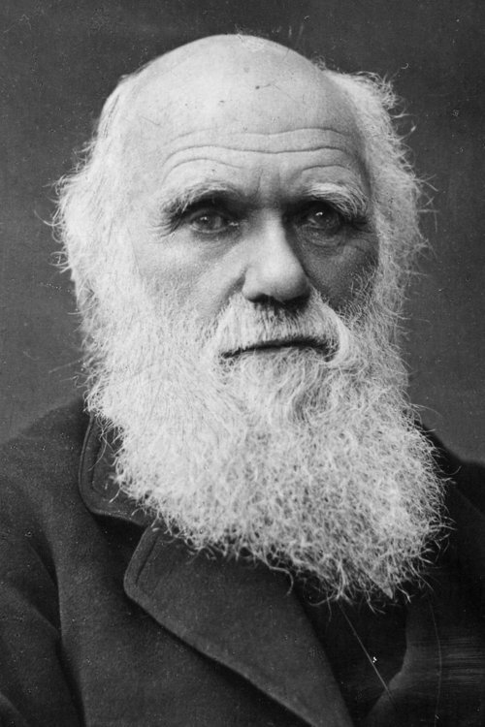
Simple expectations
“if a plot of bare ground be sown with one species of grass, and a similar plot be sown with several distinct genera of grasses, a greater number of plants and a greater weight of dry herbage can thus be raised.” (Darwin 1859, pg. 156)

Slide 8
Simple expectations
“if a plot of bare ground be sown with one species of grass, and a similar plot be sown with several distinct genera of grasses, a greater number of plants and a greater weight of dry herbage can thus be raised.” (Darwin 1859, pg. 156)
Community biomass
Phylogenetic diversity
e.g., Srivastava et al. 2012 Ecol. Letts

Slide 9
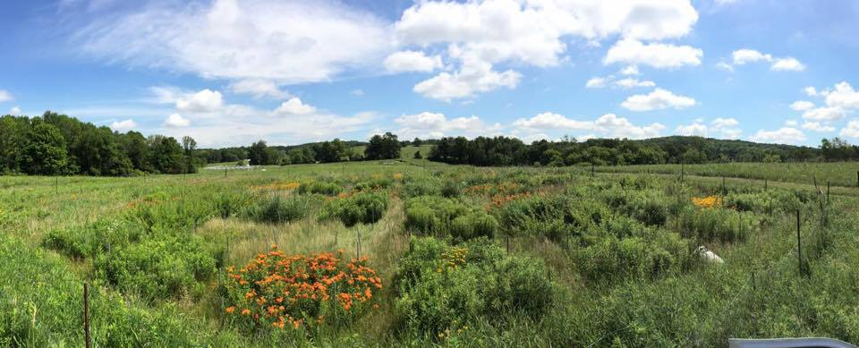
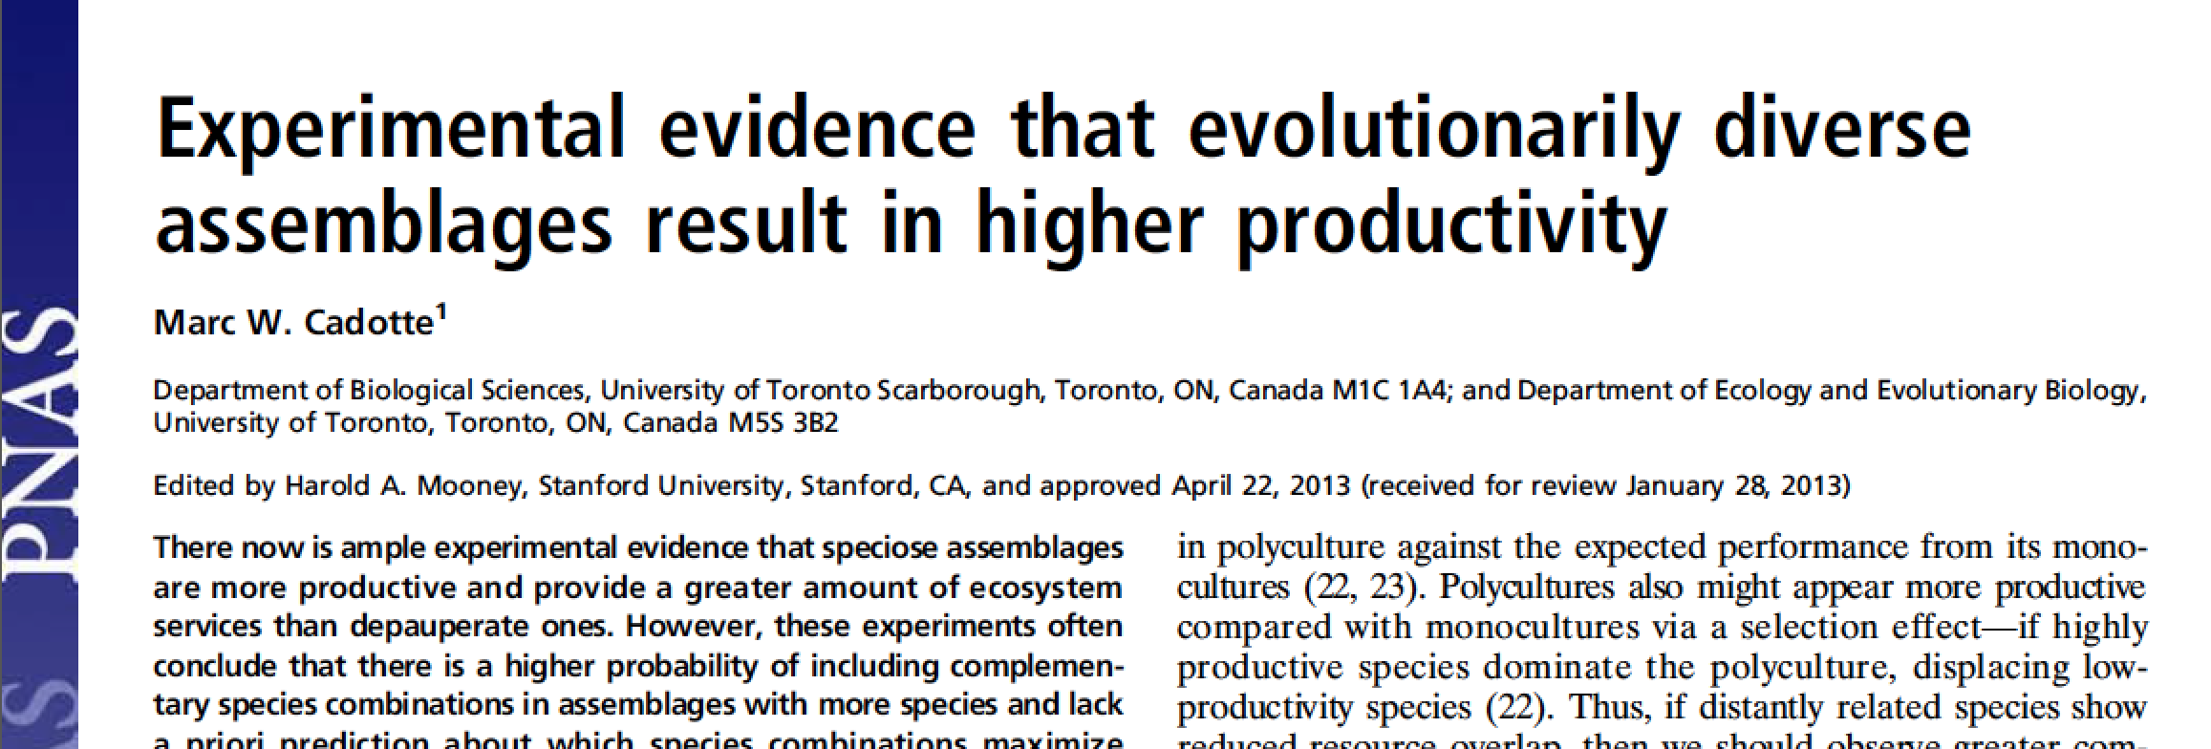
Phylo-diversity ecosystem function experiment
Data collection Aug. 2012-2014.

Slide 10
Phylogenetic experiment
First data collection Aug. 2012.
Aboveground biomass collected in 0.25 x 1 m strips.
Dried and weighed.
Predictors include several different diversity measures (next slide).
Linear model and quadratic models compare using AIC.
Calculated additive partitioning (Loreau & Hector 2001 Nature).
Cadotte 2013 PNAS

Slide 11
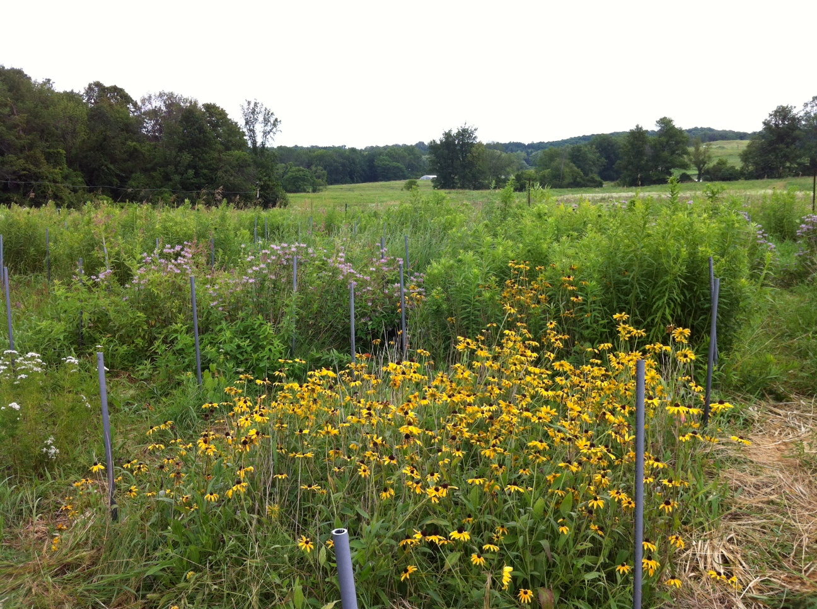
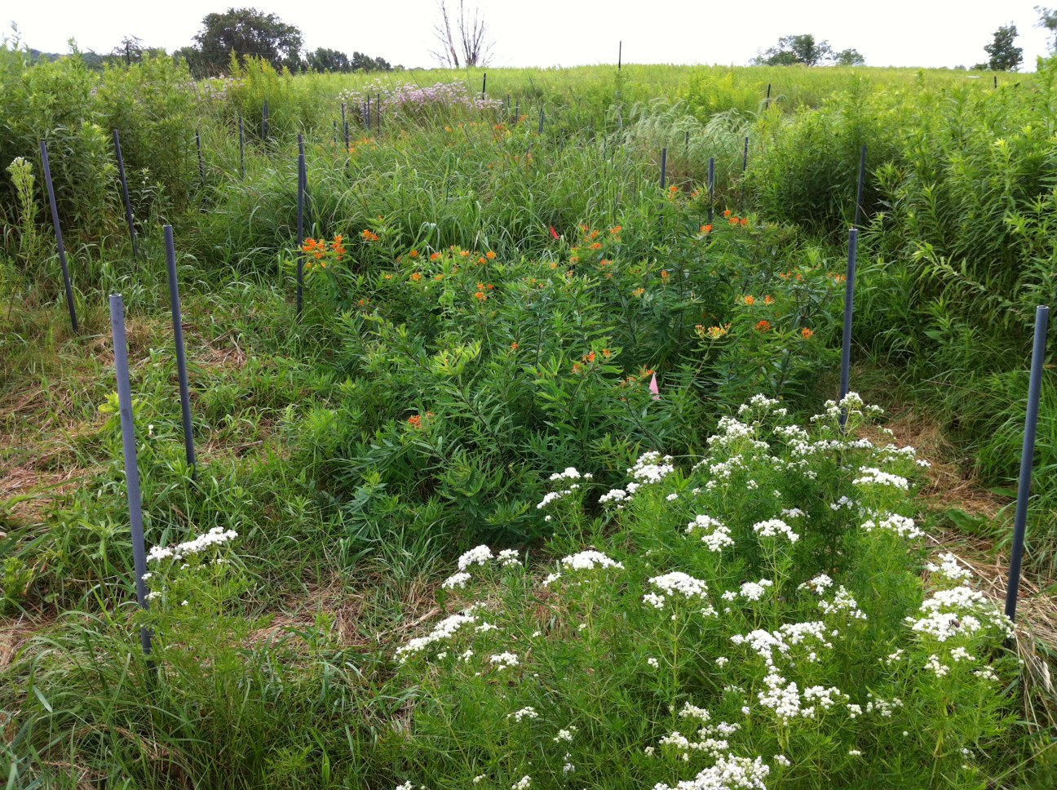

Phylogenetic experiment
.

Slide 12

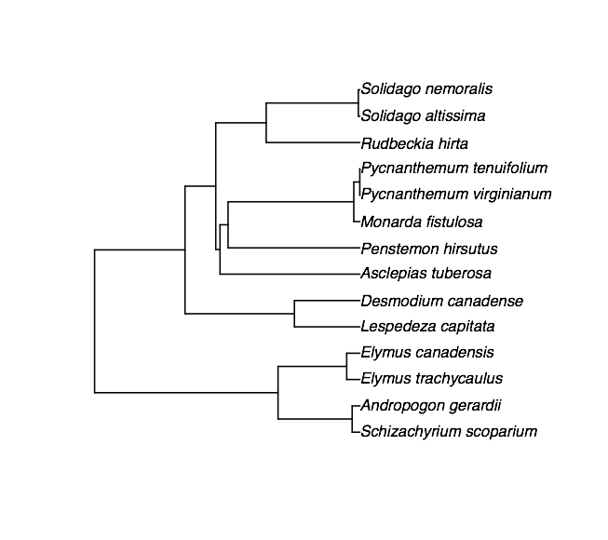
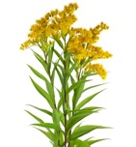
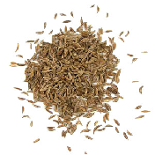



Phylogenetic diversity
1000 seeds/m²
X 3 replicates/
species
Monoculture
Moderately related
Closely related
X 7-9 replicates/
species
Richness = 2, 3 or 4
Distantly related
Cadotte 2013 PNAS

Slide 13
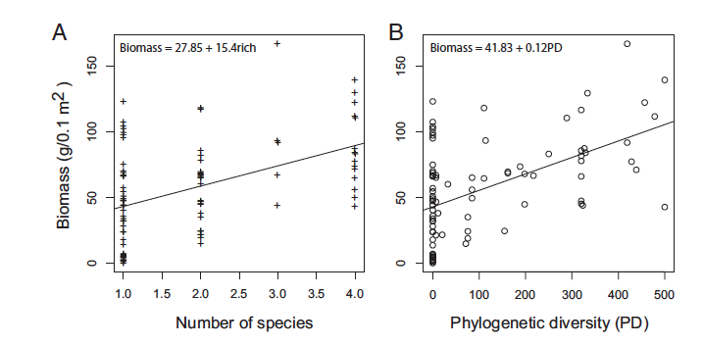
Phylogenetic diversity
Cadotte 2013 PNAS

Slide 14
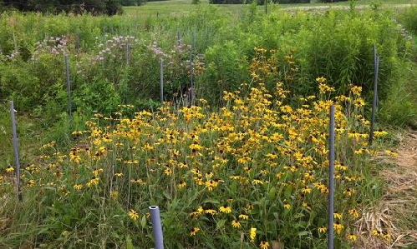
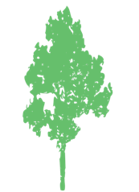




Selection vs. complementarity
Is this polyculture more productive with 2 species than what we expect from monocultures?
Polyculture = 2 species
ΔY = ‘biodiversity effect’
Selection effect:
Complementarity:
$$\}∆Y$$
Dominates
Ecosystem function
Each species produces more than expected from monoculture (50%)
1 2
Number of species

Slide 15

Main results -partitioning
The biodiversity effect (ΔY) quantifies how species contribute to the productivity of an assemblage, relative to other species and its own monocultures.
Selection effect
Complementarity
Additive partitioning
Loreau & Hector 2001 Nature

Slide 16
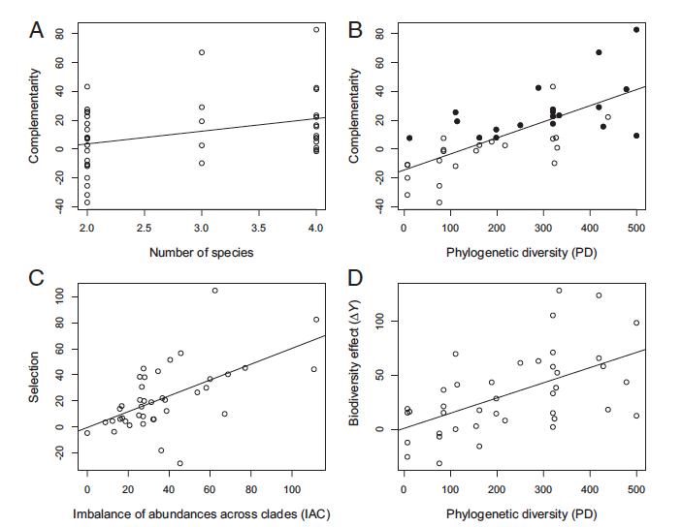
Main results -partitioning
Cadotte 2013 PNAS

Slide 17
Main results -partitioning
Phylogenetic diversity is a good predictor of biomass production.
The biodiversity benefit is driven mostly by complementarity.
The selection effect is not explained by richness or PD.
Cadotte 2013 PNAS

Slide 18
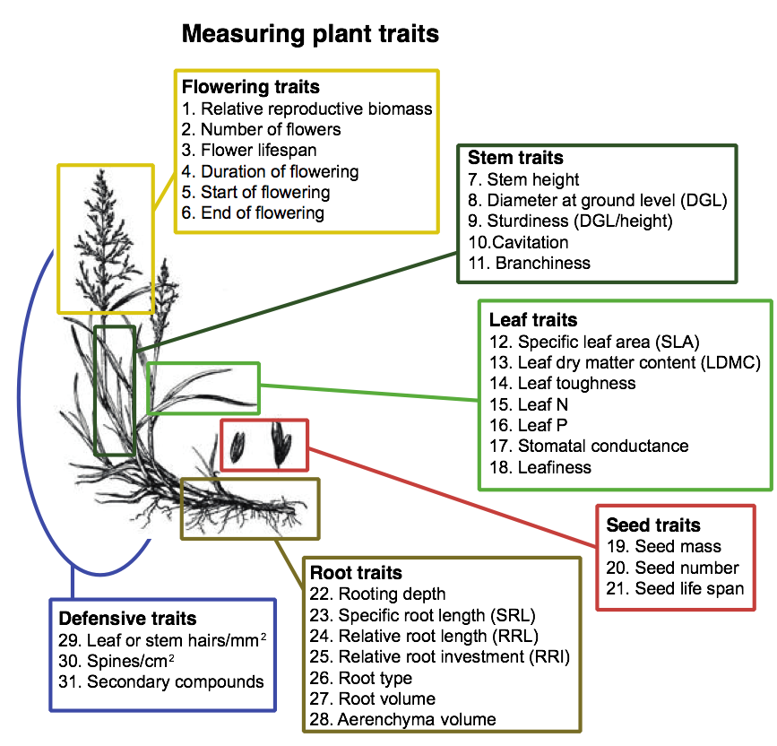
Better insight from traits?

Slide 19










Better insight from traits?
Technically measured as Community Weighted Mean (CWM)
d
Average
Height
d
d
d
Average
Height
Trait 2
+
Many very technical ways, commonly used: Functional Dispersion (FDis)
Trait 1

Slide 20
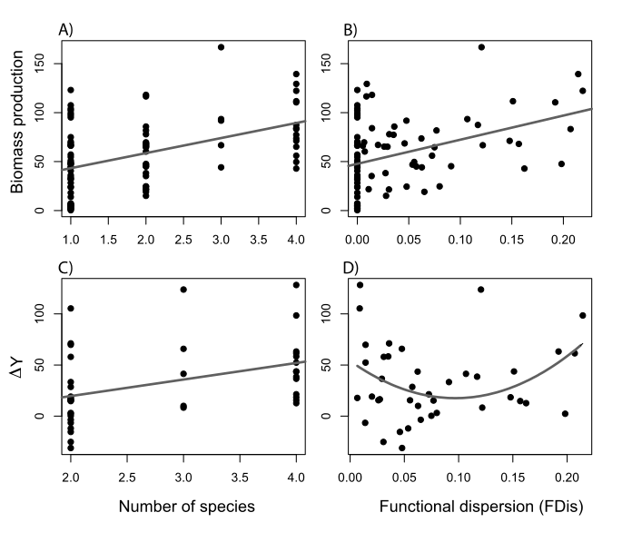




Functional (trait) diversity
Cadotte 2017 Eco. Letts

Slide 21
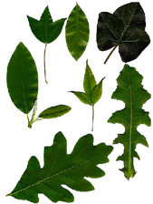
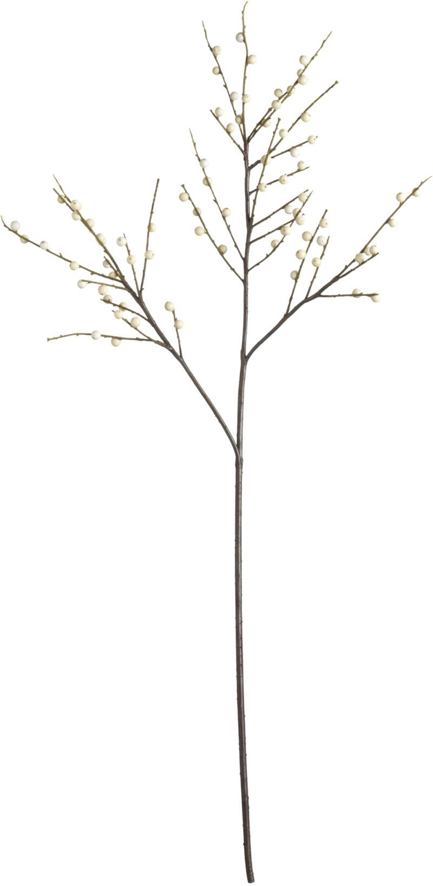

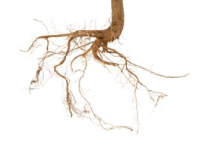
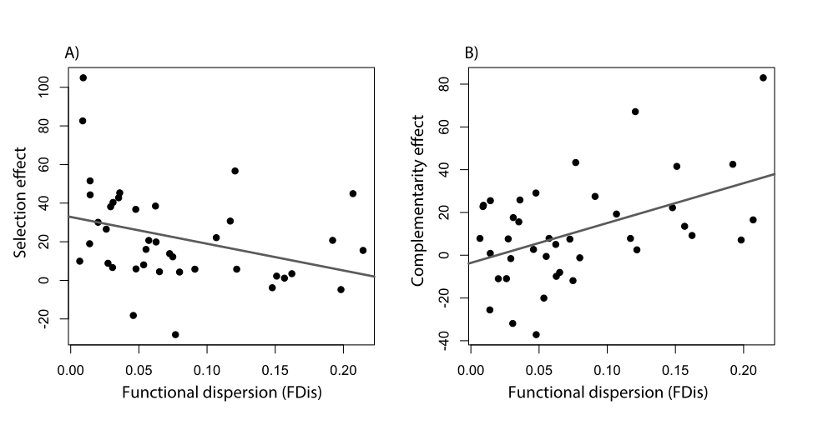



Driven by many different traits
Driven by height alone
Cadotte 2017 Eco. Letts

Slide 22


Complementarity is driven by niche differences which require complex/integrative measures of species differences (i.e., phylogeny is better)
Canada
China
MPD MPD
MPD MPD
Selection effect
Selection effect
Complementarity effect
Complementarity effect
FD FD
FD FD
Huang, Liu, Zhou & Cadotte. Oikos 2020

Slide 23
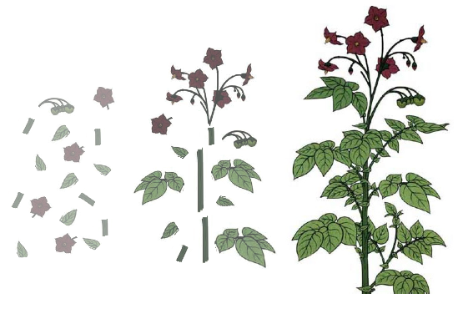

Why are measured traits not more informative?
Get into your groups and come up with reasons why traits do not do a better job than phylogenies.
Give reasons why traits should do better
https://padlet.com/marccadotte/why-traits-not-better-xvesc210eci0bhqc

Slide 24
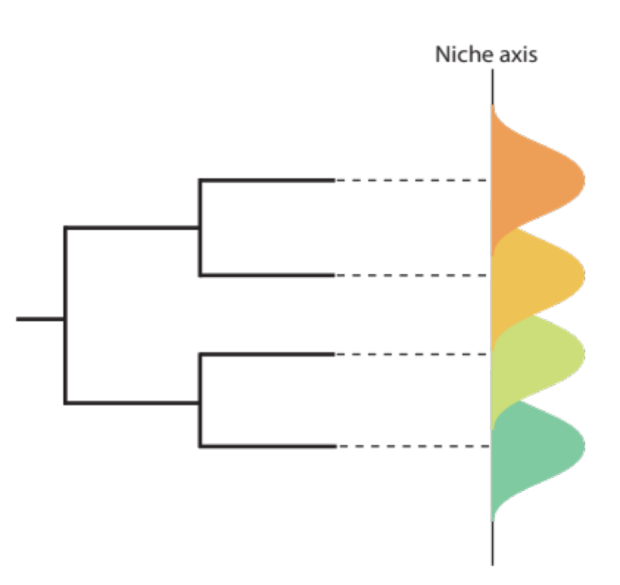
Moving from single to multiple functions, we may lose sight of the fact that there may be different diversity-function relationships and different mechanisms given rise to these relationships.

Slide 25
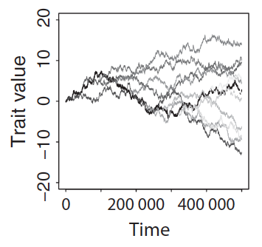

How does evolution generate different biodiversity-ecosystem function relationships?
Brownian motion evolution

Slide 26
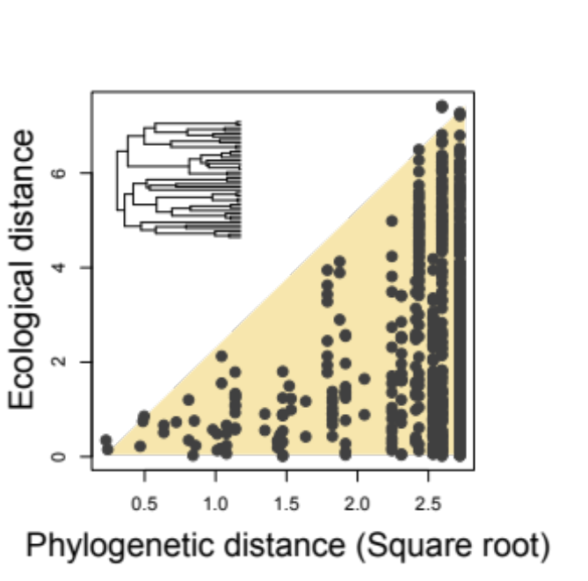
How does evolution generate different biodiversity-ecosystem function relationships?
Brownian motion evolution

Slide 27
How does evolution generate different biodiversity-ecosystem function relationships?
Single function
Brownian motion evolution
Multifunction
Function
Richness
PD
PD = mean pairwise phylogenetic distance

Slide 28
How does evolution generate different biodiversity-ecosystem function relationships?
Single function
Brownian motion evolution
Multifunction
Function
Richness
PD
PD ≈ Richness
*
*But depends on rate of evolution

Slide 29
How does evolution generate different biodiversity-ecosystem function relationships?
Brownian motion evolution
Divergent selection
Notes:
Check repetitive titles.

Slide 30
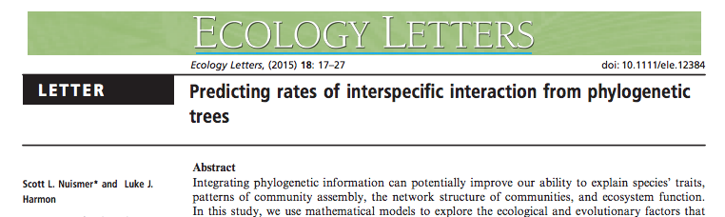
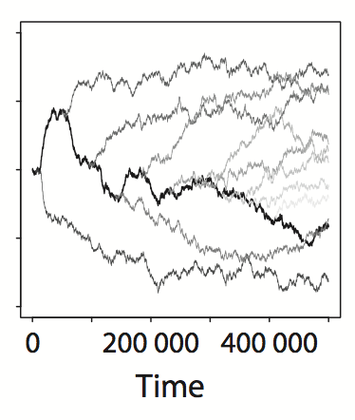
How does evolution generate different biodiversity-ecosystem function relationships?
Brownian motion evolution
Divergent selection
Trait value

Slide 31
How does evolution generate different biodiversity-ecosystem function relationships?
Brownian motion evolution
Divergent selection
Single function
Multifunction
Function
Richness
PD

Slide 32
How does evolution generate different biodiversity-ecosystem function relationships?
Brownian motion evolution
Divergent selection
PD >> Richness
Single function
Multifunction
Function
Richness
PD

Slide 33
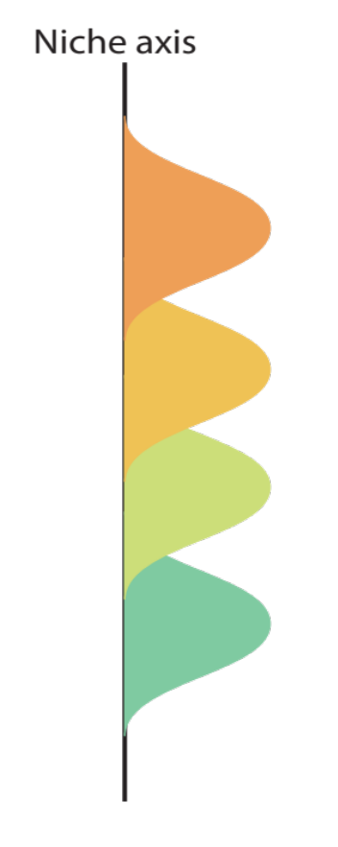
These two mechanisms require coexistence
Species use differing resources and need to persist together to realize the higher ecosystem function
One mechanism does not require coexistence.

Slide 34
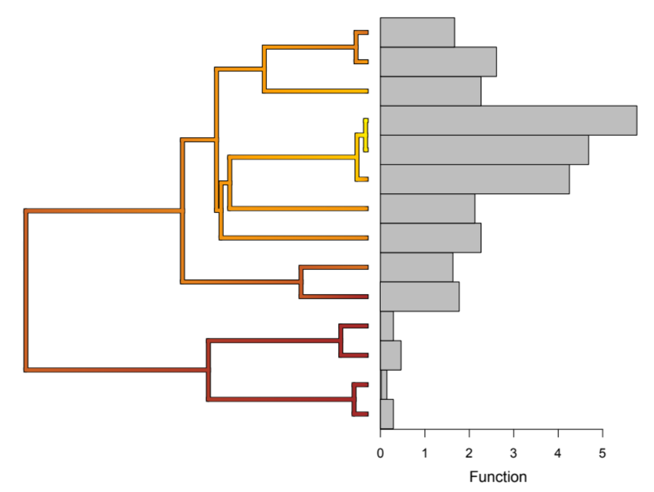
How does evolution generate different biodiversity-ecosystem function relationships?
Brownian motion evolution
Divergent selection
Evolutionary innovation

Slide 35
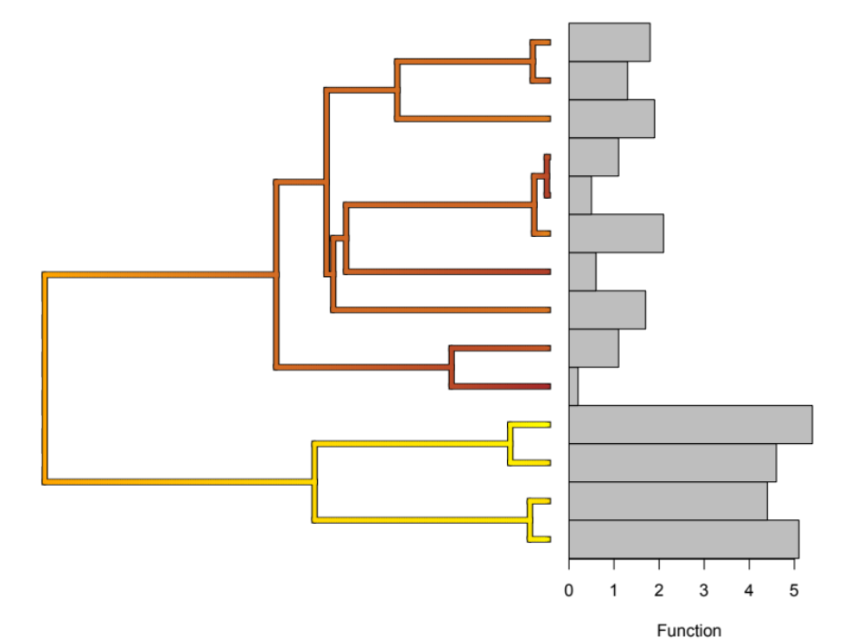
How does evolution generate different biodiversity-ecosystem function relationships?
Brownian motion evolution
Divergent selection
Evolutionary innovation
However, if multiple functions are maximized in different clades then PD very important for multifunction

Slide 36
How does evolution generate different biodiversity-ecosystem function relationships?
Brownian motion evolution
Divergent selection
Evolutionary innovation
Single function
Multifunction
Function
Richness
PD

Slide 37
How does evolution generate different biodiversity-ecosystem function relationships?
Brownian motion evolution
Divergent selection
Evolutionary innovation
PD < Richness
Single function
Multifunction
Function
Richness
PD

Slide 38

How does evolution generate different biodiversity-ecosystem function relationships?
Brownian motion evolution
Divergent selection
Evolutionary innovation
Extremely rapid evolution

Slide 39
How does evolution generate different biodiversity-ecosystem function relationships?
Brownian motion evolution
Divergent selection
Evolutionary innovation
Extremely rapid evolution
Single function
Multifunction
Richness
Function
PD

Slide 40
How does evolution generate different biodiversity-ecosystem function relationships?
Brownian motion evolution
Divergent selection
Evolutionary innovation
Extremely rapid evolution
PD << Richness
Single function
Multifunction
Richness
Function
PD

Slide 41
How does evolution generate different biodiversity-ecosystem function relationships?
Function
Brownian motion evolution
Divergent selection
Evolutionary innovation
Extremely rapid evolution
Richness
PD
Function
Single function
Multifunction
Richness
PD
Function
Richness
PD
Function
Richness
PD
Notes:
#3 mismatch between single and multi. Also use labels on bottom and use evol models as headers
Use panels on the four model slides

Slide 42
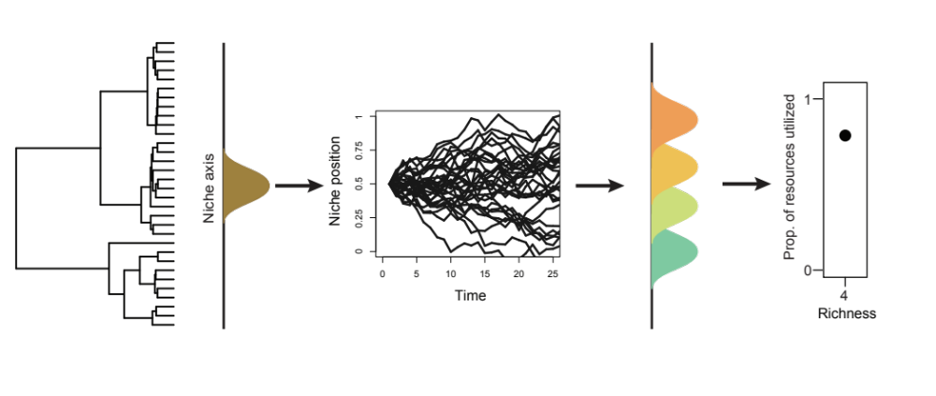
Simulations

Slide 43
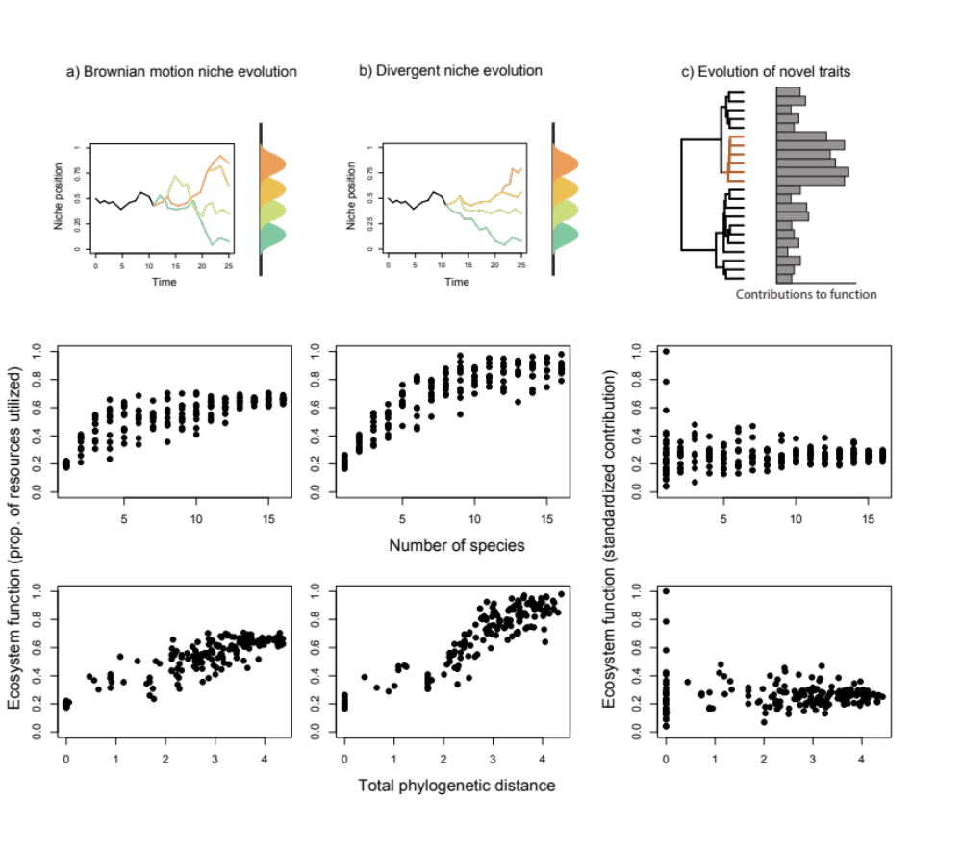
Simulations

Slide 44
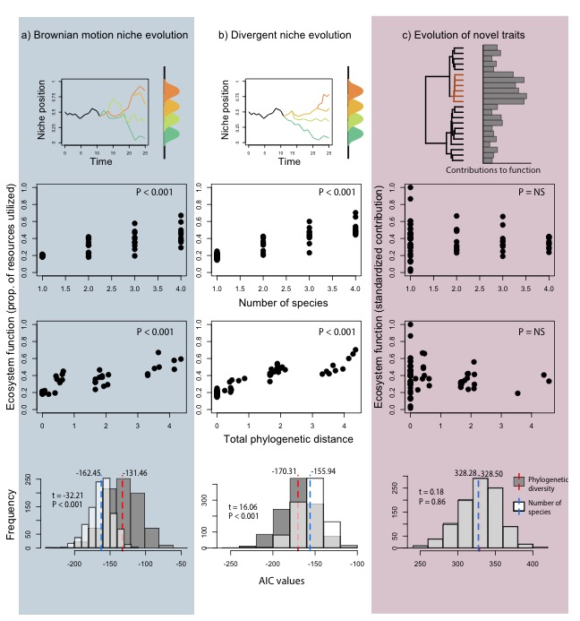

Slide 45
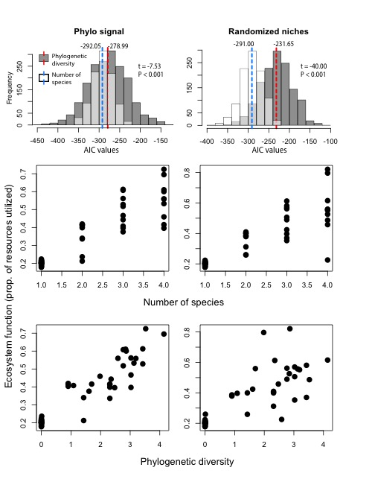

Slide 46
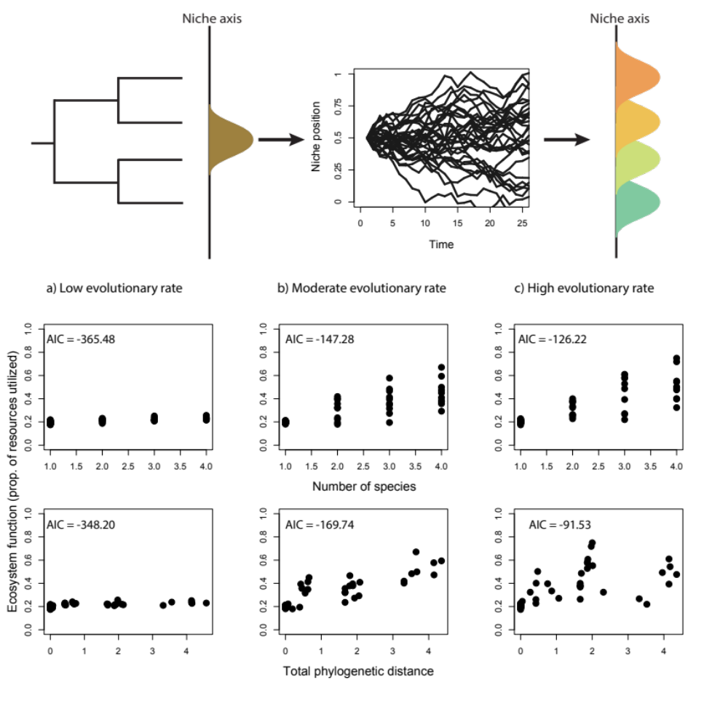
Simulations
For BM evolutionary rate is important for which is a better predictor (PD vs richness).

Slide 47
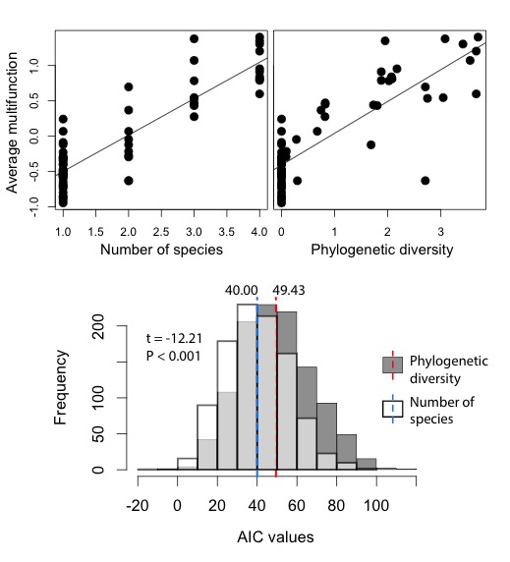
Simulations: multifunction

Slide 48

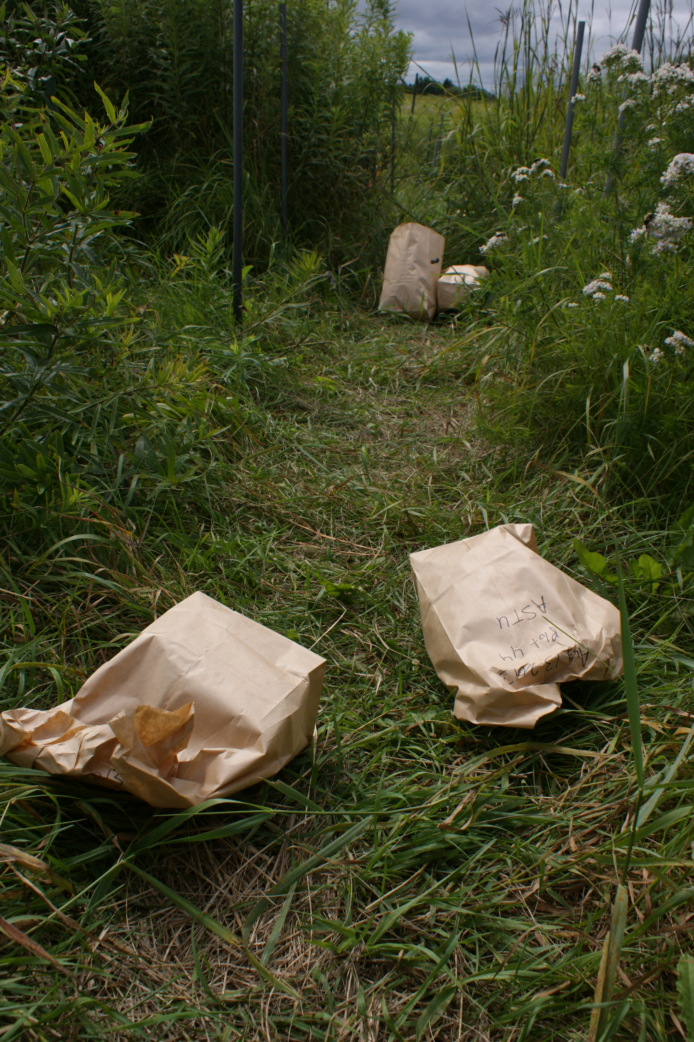
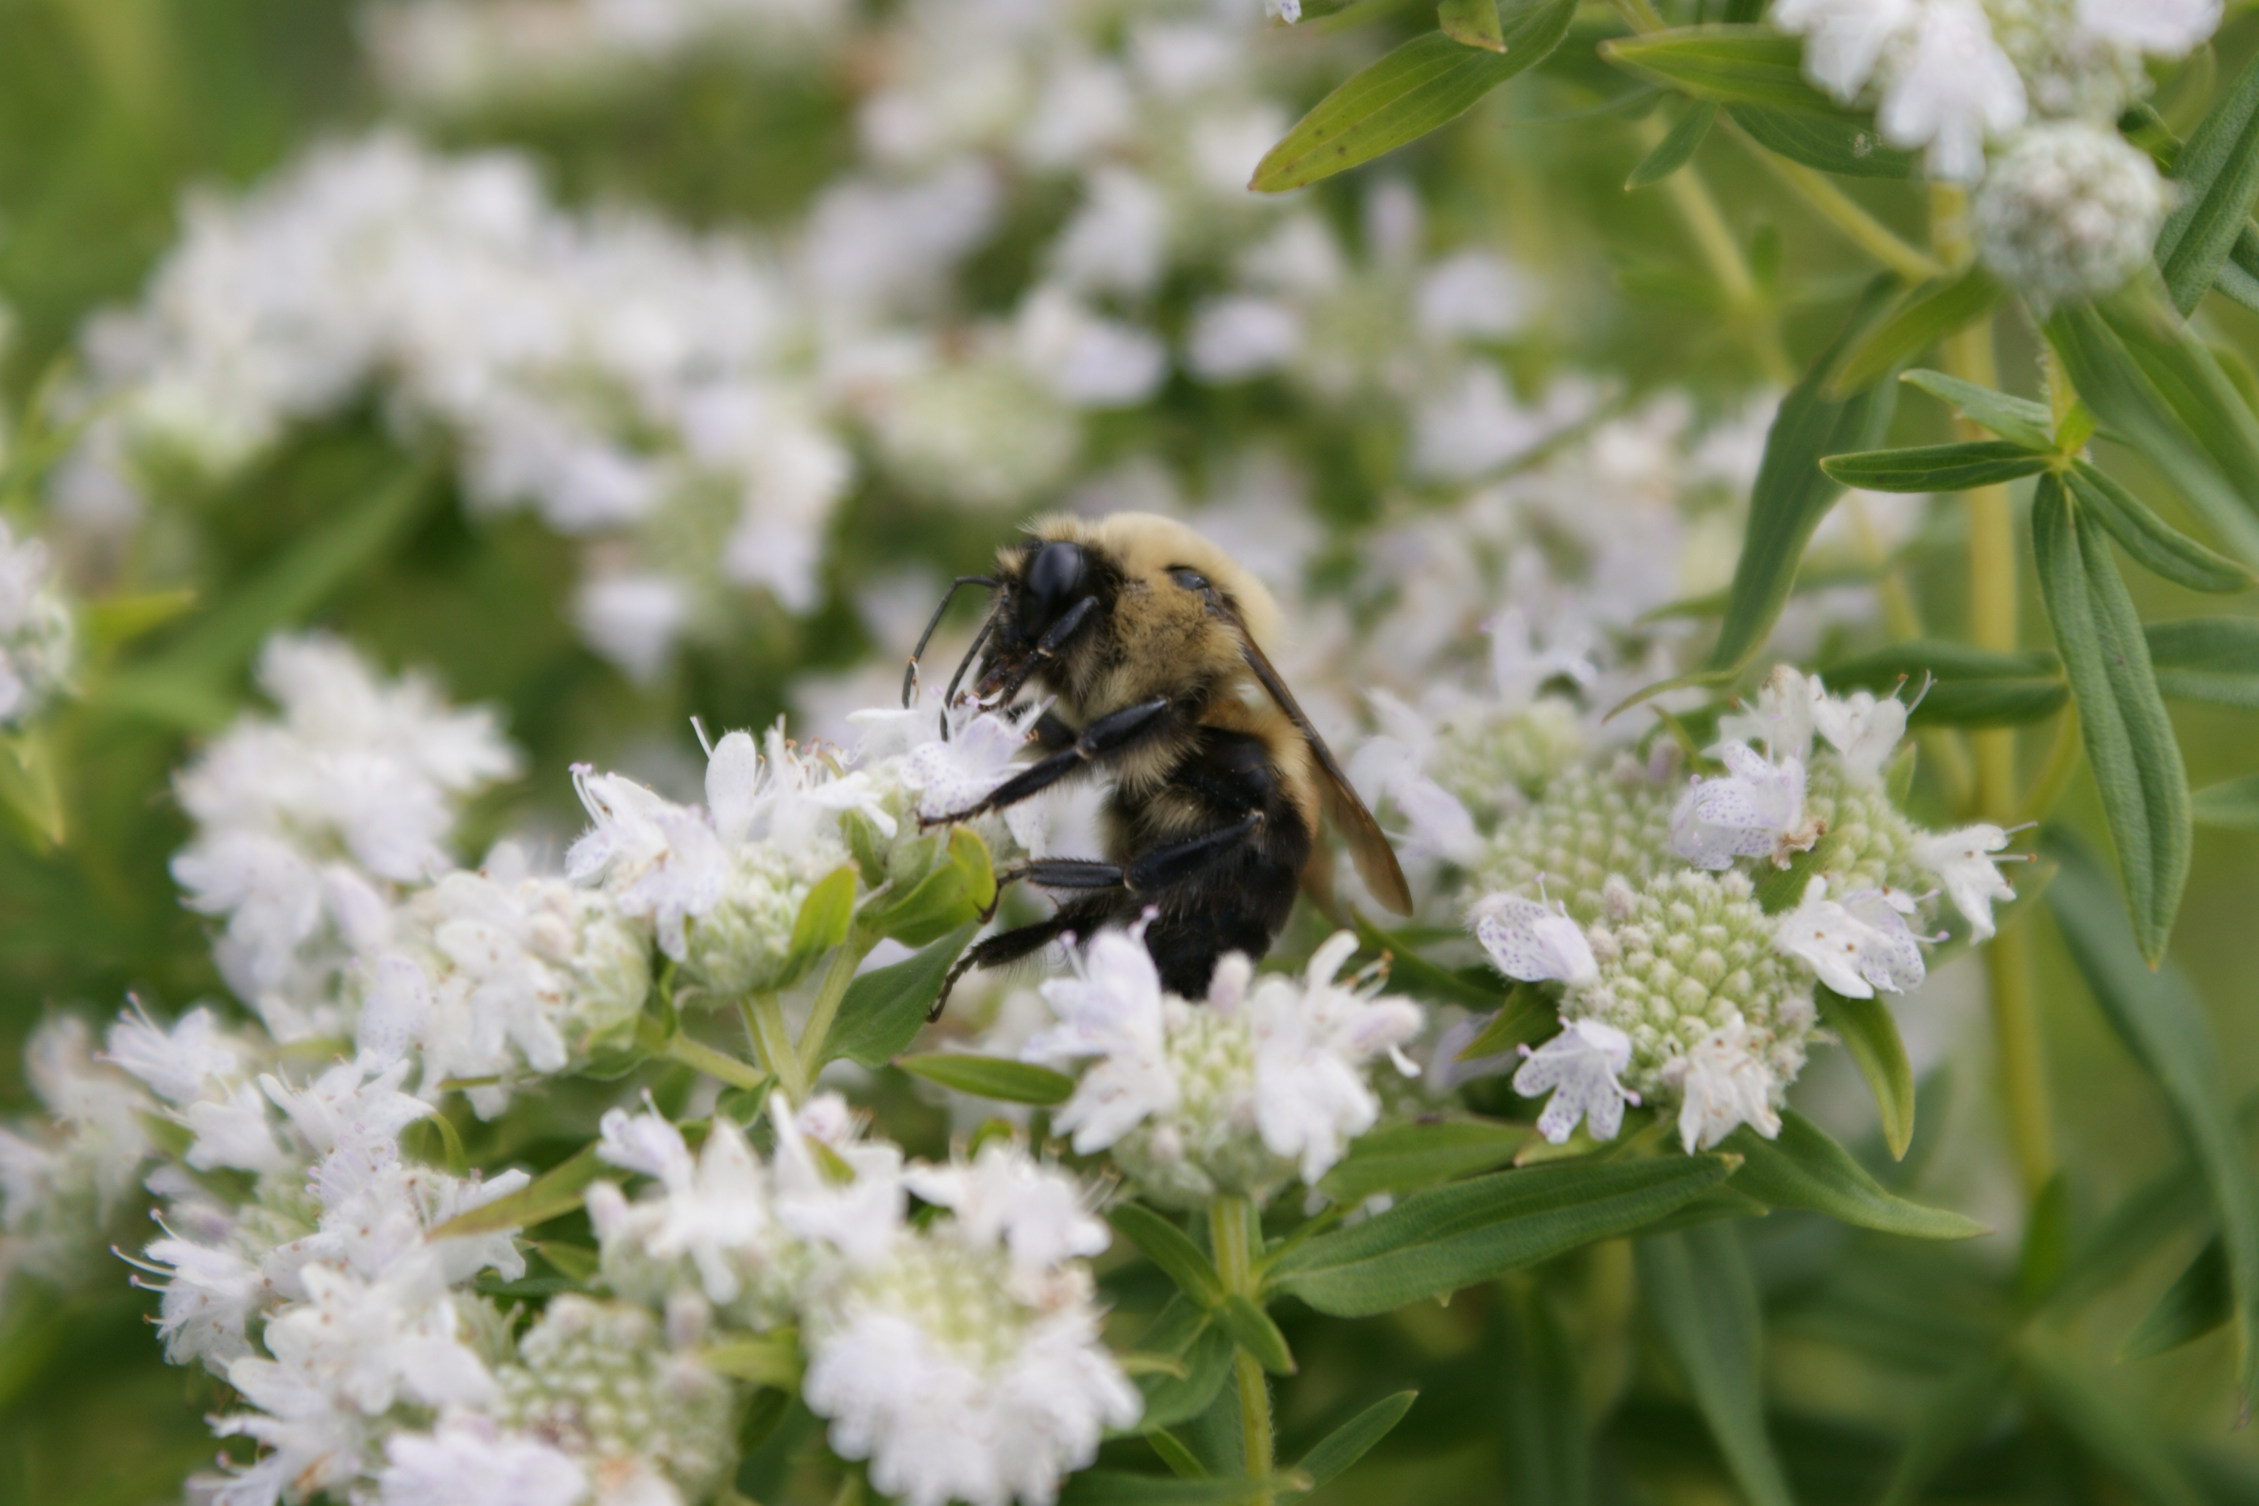
Now let’s look at the measured functions

Slide 49
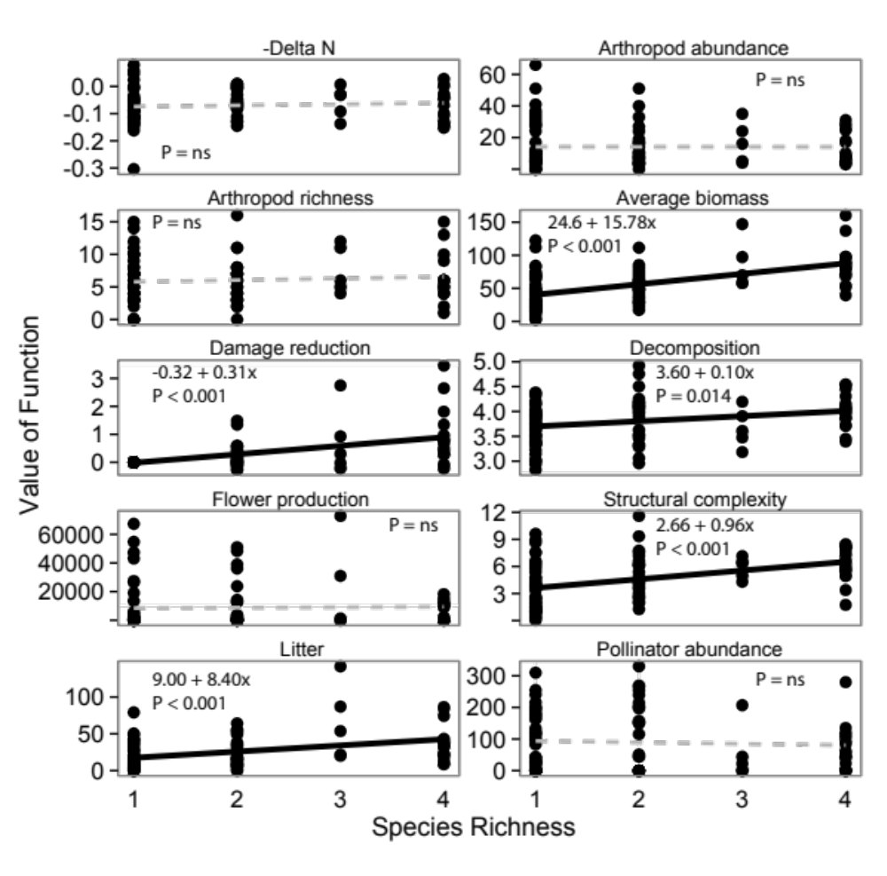
Single functions
Species Richness

Slide 50
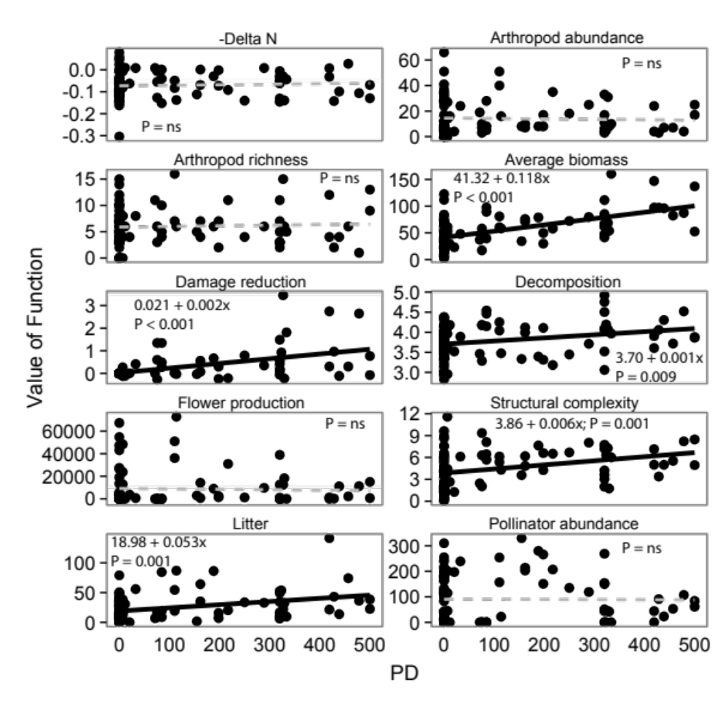
Single
functions
PD

Slide 51
Single
functions
PD
= divergent selection

Slide 52
Single
functions
PD
= divergent selection
Species Richness
= BM with high rate

Slide 53
Single
functions
PD
= divergent selection
Species Richness
= BM with high rate
Evolutionary novelty

Slide 54
