Slide 1
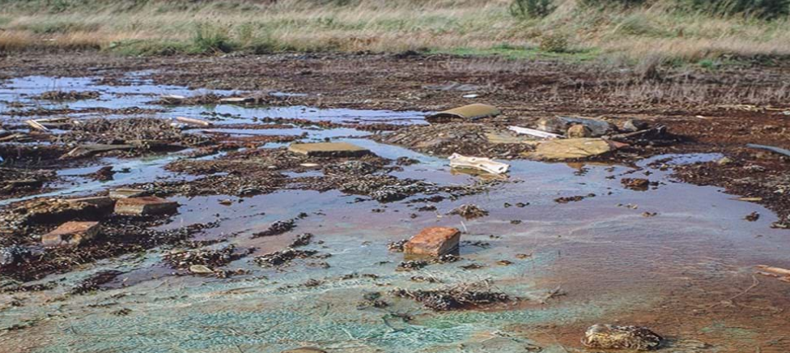
Biodiversity & Ecosystem functioning under anthropogenic stressors
Marc W Cadotte
University of Toronto
Session 4.3: Stressor effects on BEF reltionships

Slide 2
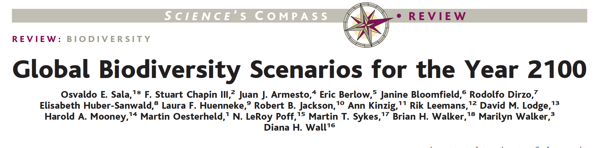
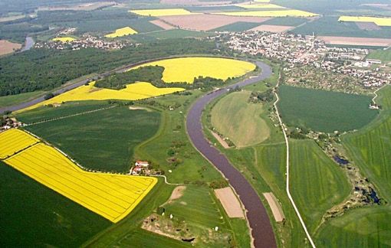
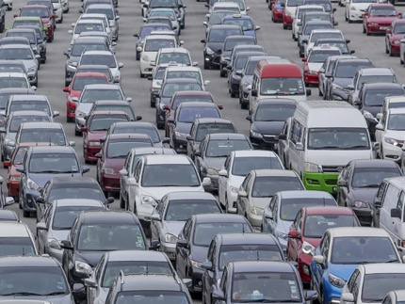
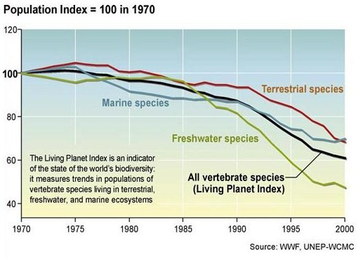
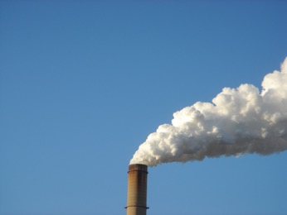

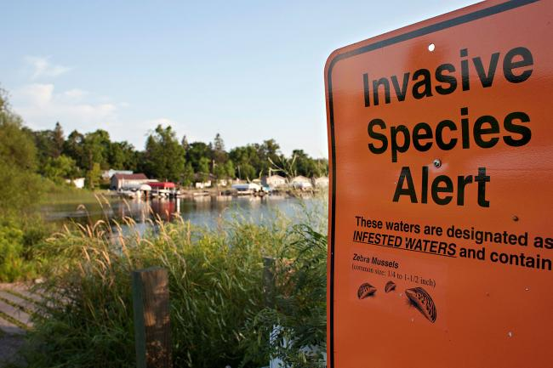
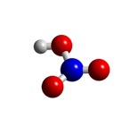
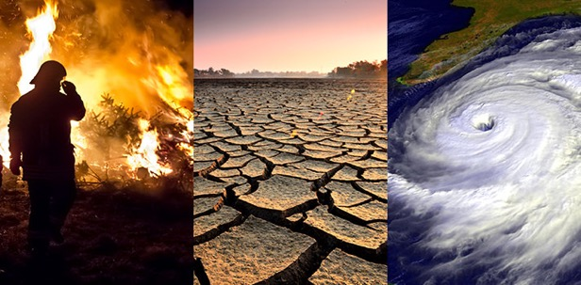
Biodiversity is changing
Land use change
Carbon pollution
Nitrogen
deposition
Species invasion
Climate change

Slide 3
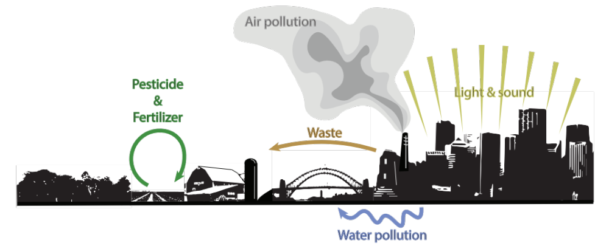
Human activities generate a complex suite of environmental impacts

Slide 4
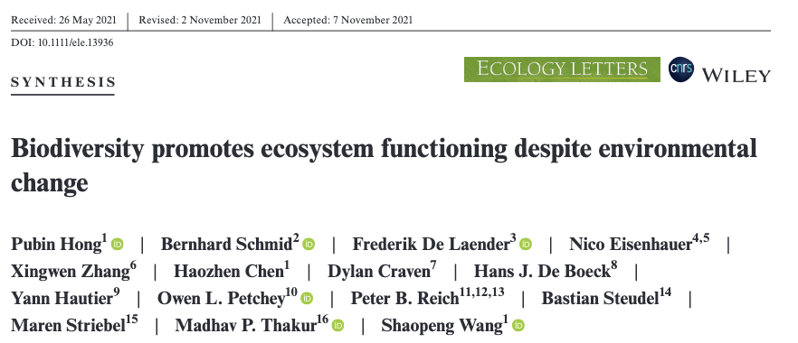
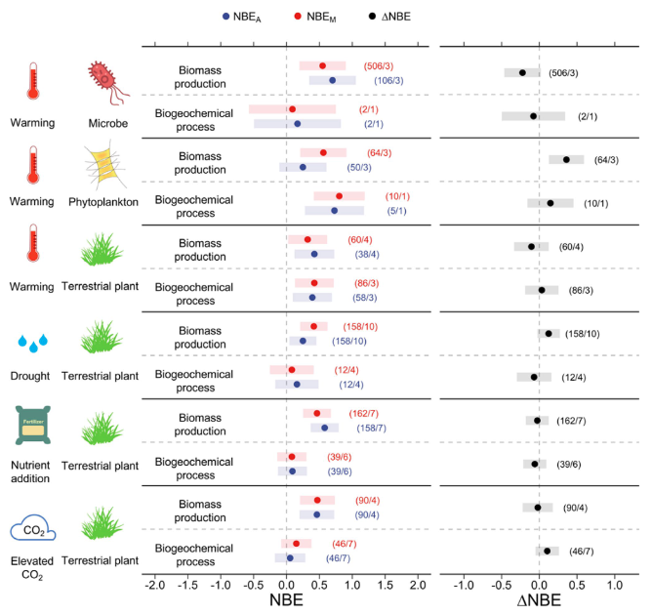
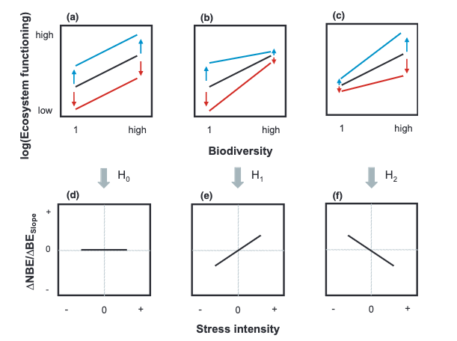

Slide 5
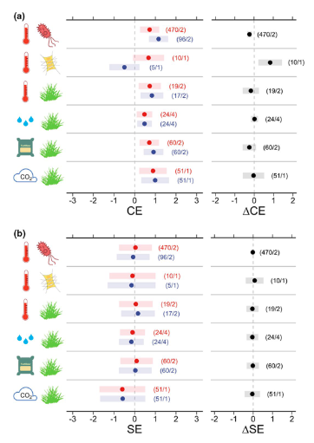

Slide 6
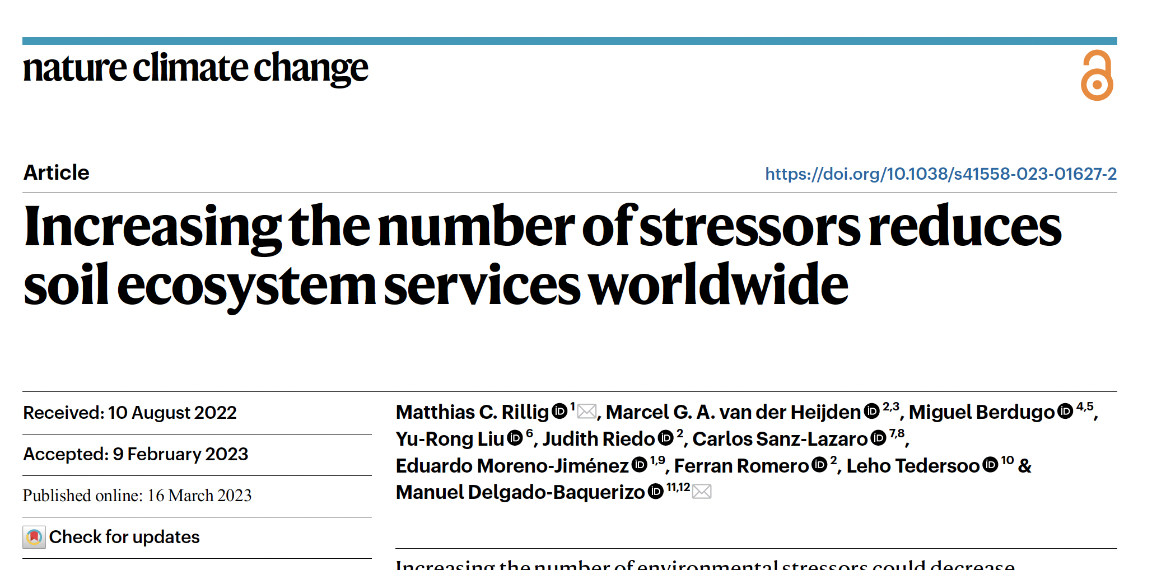
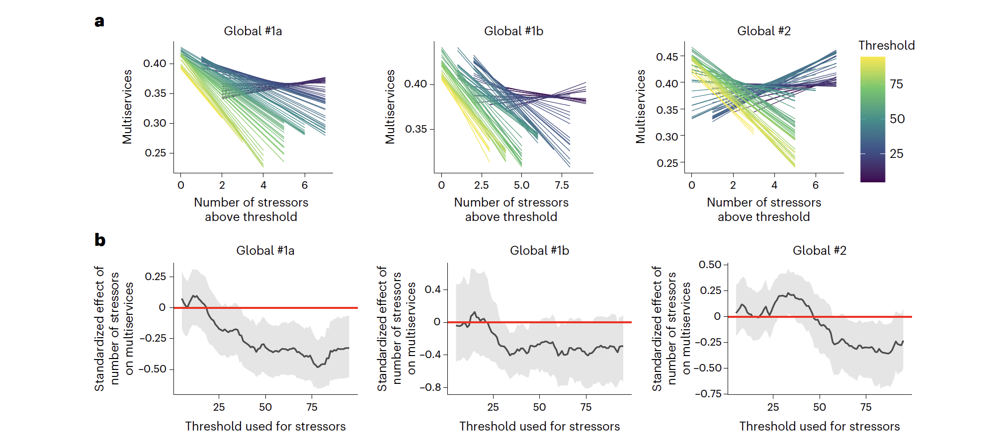

Slide 7
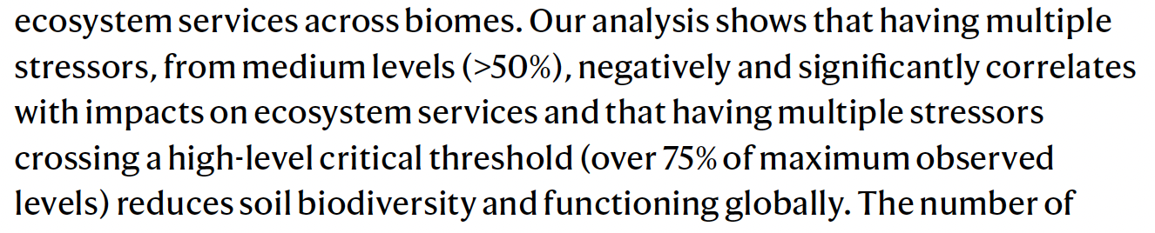


Slide 8

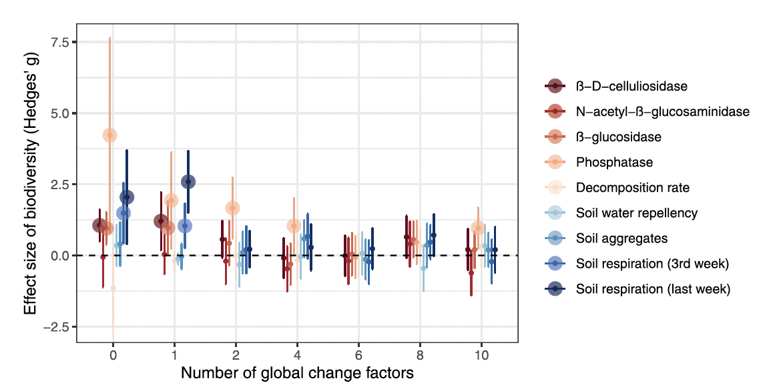
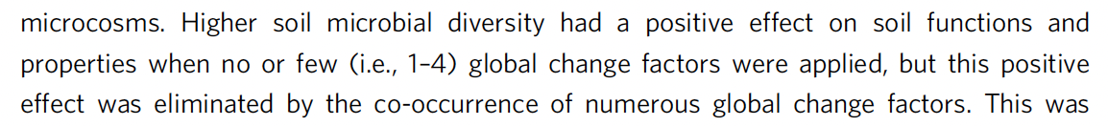

Slide 9


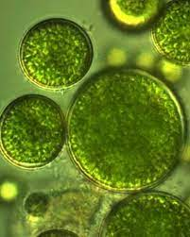
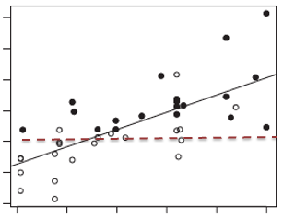
How can stressors and BEF relationships interact?

Slide 10
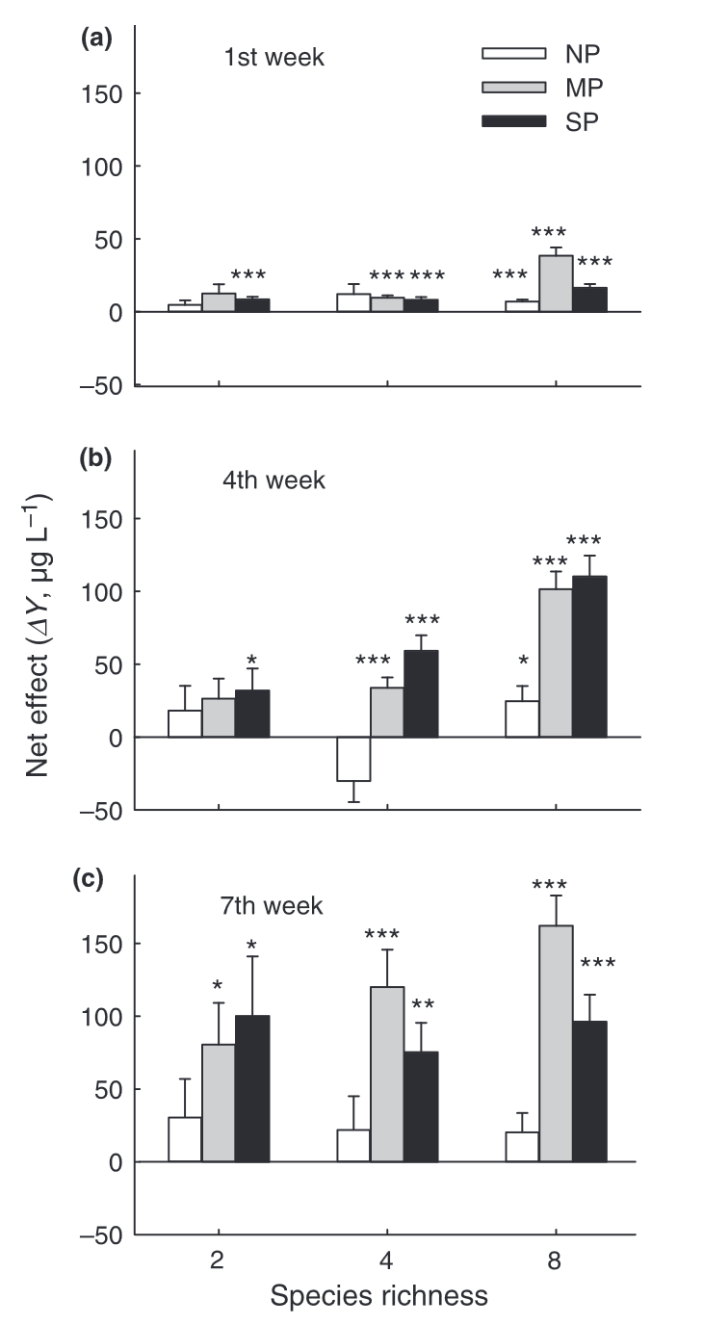
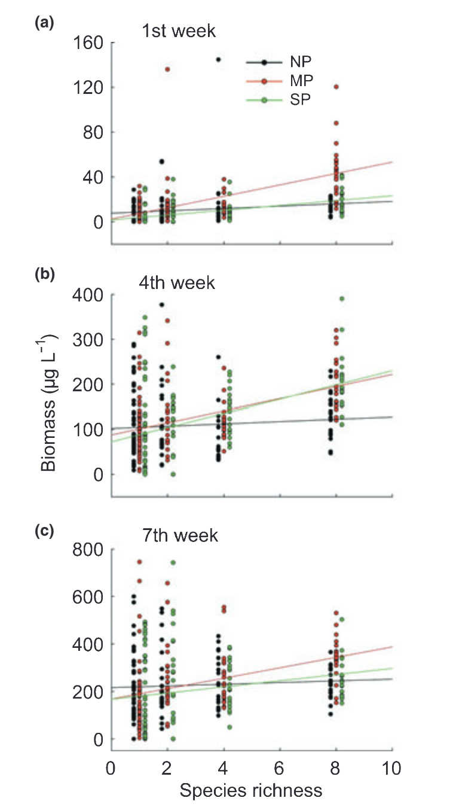
How can stressors and BEF relationships interact?

Slide 11
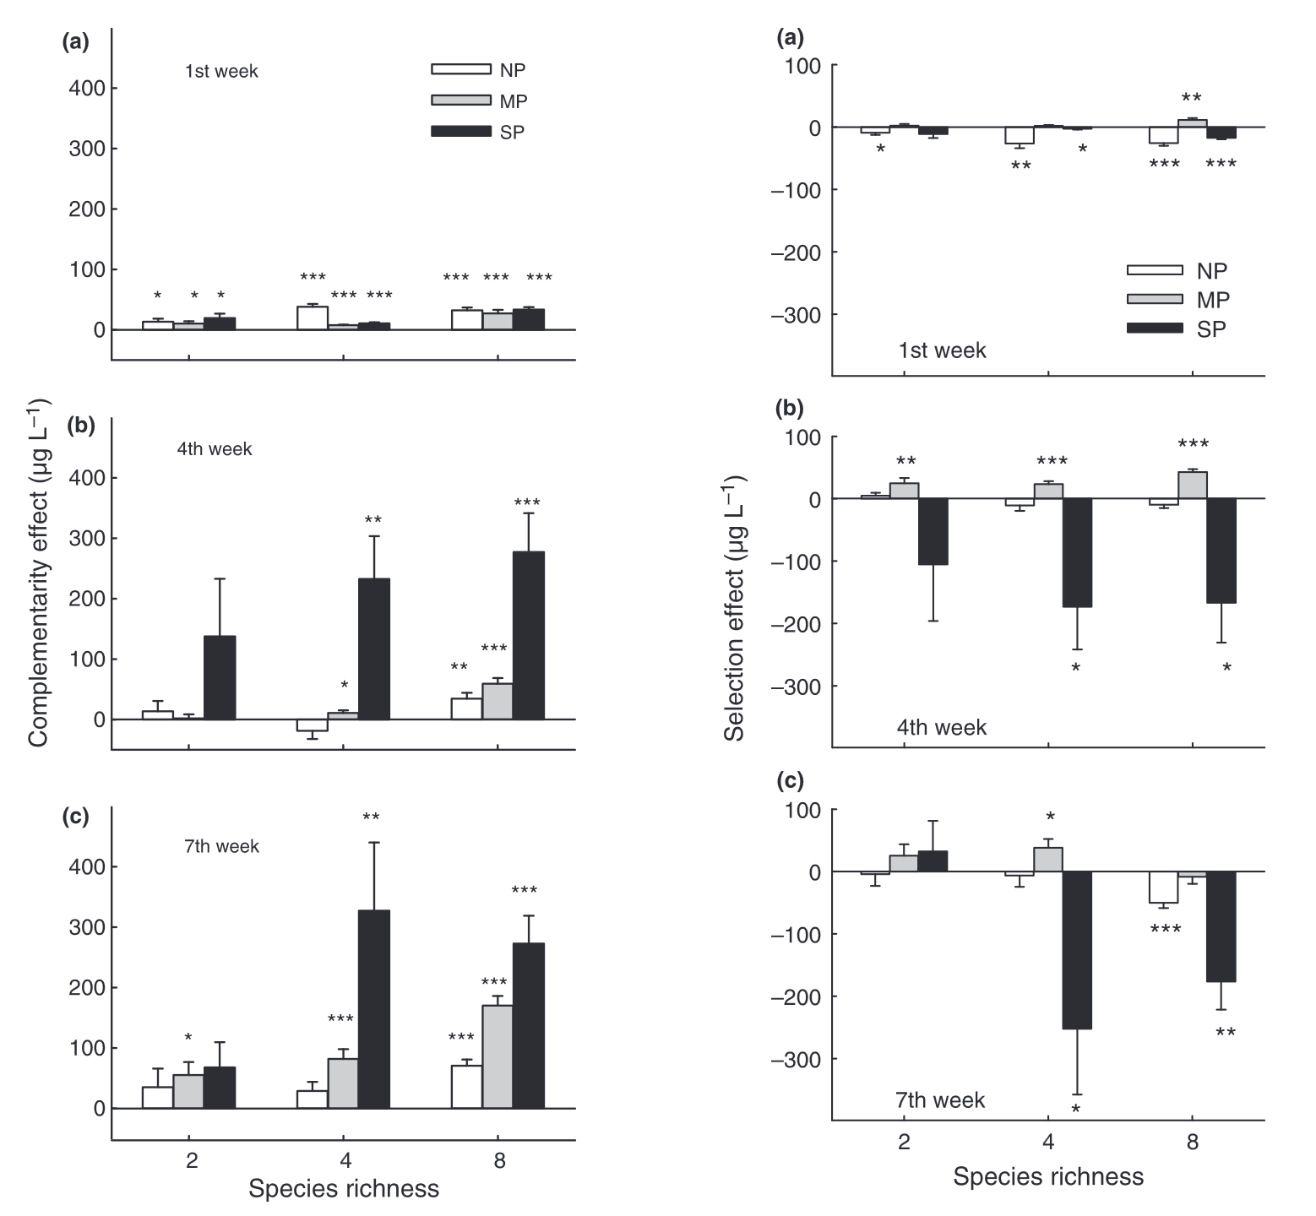
How can stressors and BEF relationships interact?

Slide 12


How do stressors interact with biodiversity loss to influence ecosystem functioning?
Only pure binary environmental filtering would change richness in isolation.
Stressors will alter both species fitness (competition) and ability to access resources (niche).
This will lead to complex predictions.
$$δ$$
Functioning (biomass)
Species richness

Slide 13
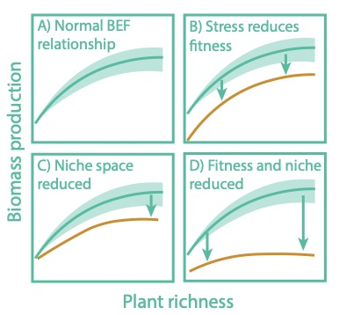
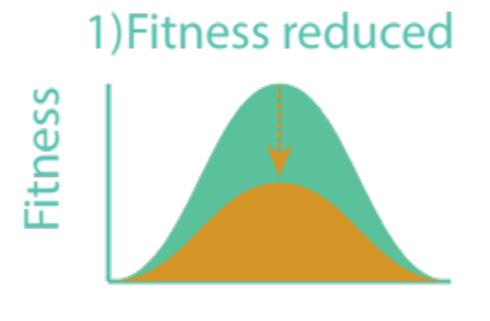
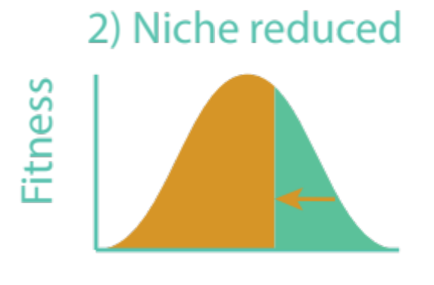
Two ways plant species are impacted by stressors (Negatively).

Slide 14
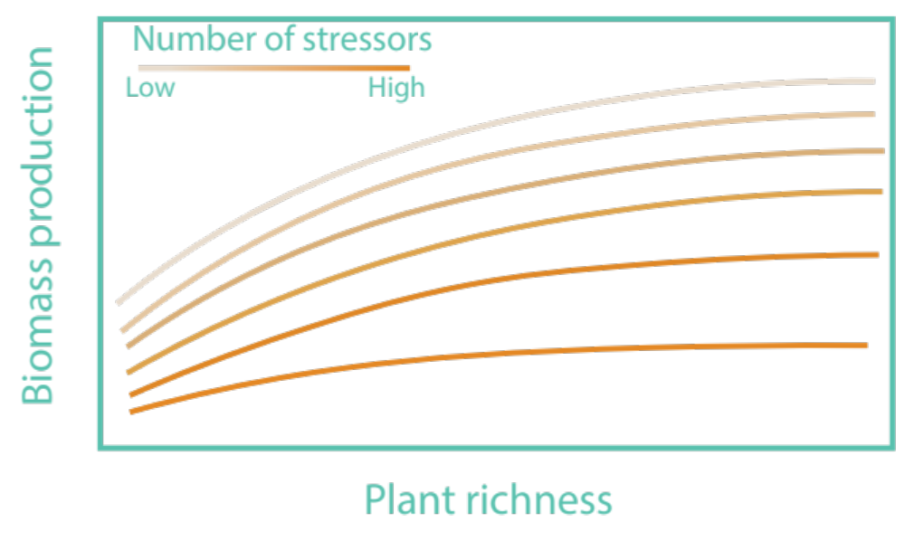
Combining multiple stressors
We should expect that species have different sensitivities to individual stressors (fitness and/or niche), and combining multiple stressors should then be more likely to exhibit community-wide fitness and niche impacts.

Slide 15

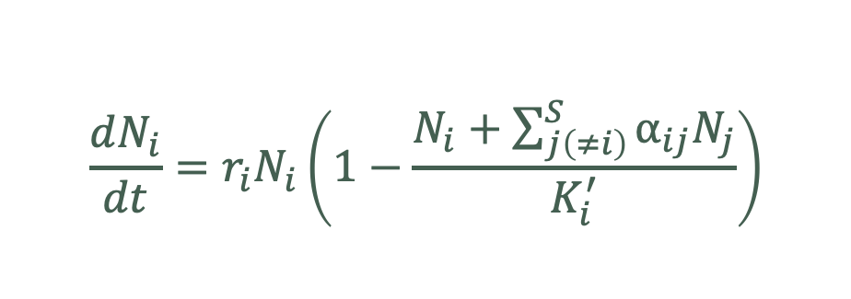
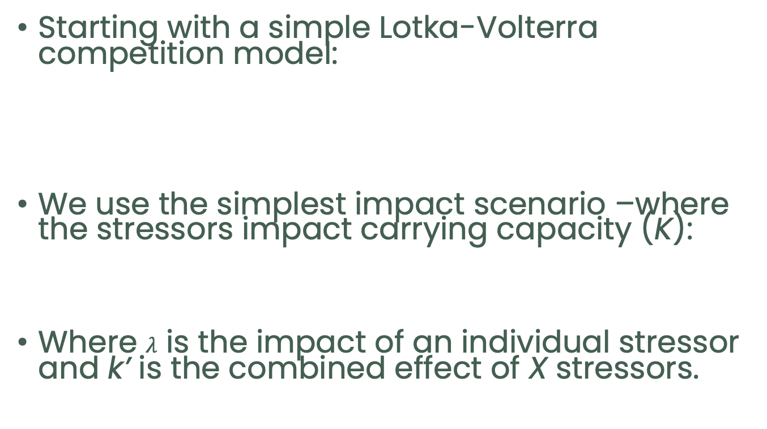
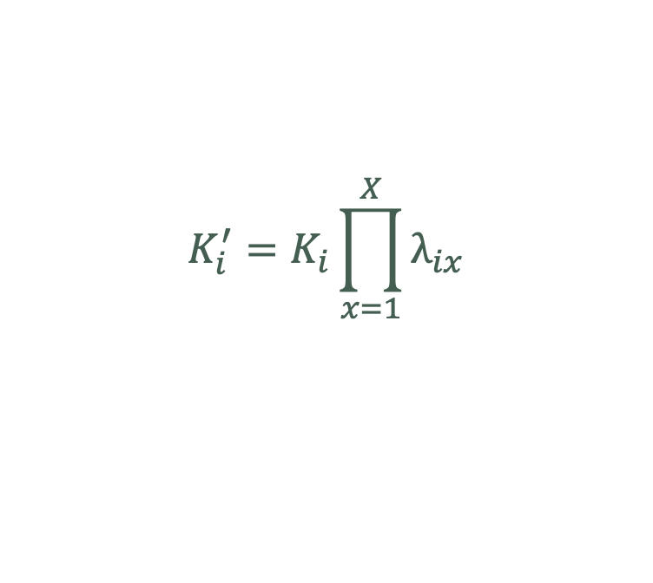
Theoretical predictions
Shinichi Tatsumi
Starting with a simple Lotka-Volterra competition model:
We use the simplest impact scenario –where the stressors impact carrying capacity (K):
Where $λ$ is the impact of an individual stressor and k’ is the combined effect of X stressors.
$$\frac{dN_{i}}{dt}=r_{i}N_{i}\left(1−\frac{N_{i}+\sum_{j\left(≠i\right)}^{S}{α_{ij}N_{j}}}{K_{i}^{′}}\right)$$
$$K_{i}^{′}=K_{i}\prod_{x=1}^{X}{λ_{ix}}$$

Slide 16




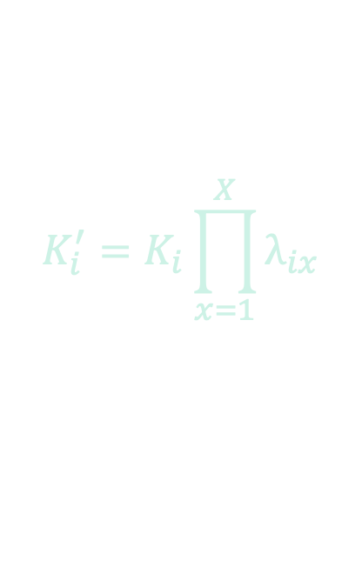
Combining stressors
$$K_{i}^{′}=K_{i}\prod_{x=1}^{X}{λ_{ix}}$$
We considered two scenarios:
  The average effects of stressors varied:
  The variation in stressor effects increased, creating tradeoffs and different sensitivities:
$$μ$$
$$σ$$
1
2
A B
A B
Stressor
Stressor

Slide 17
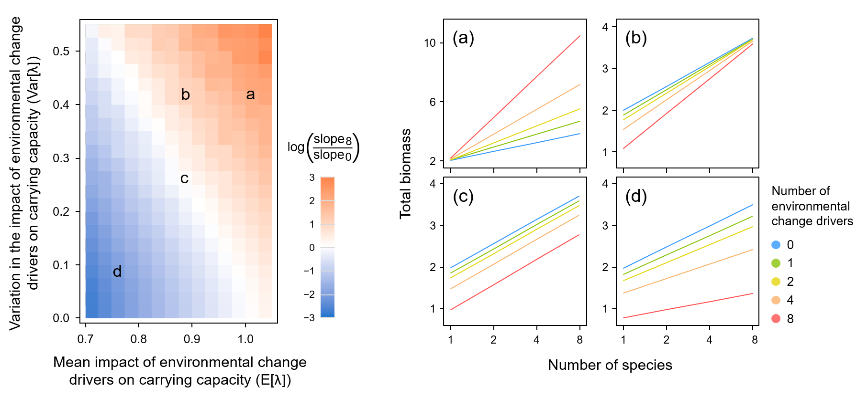


Stressors alter the nature of BEF relationships
No effect of stressors
$$σ$$
$$μ$$

Slide 18
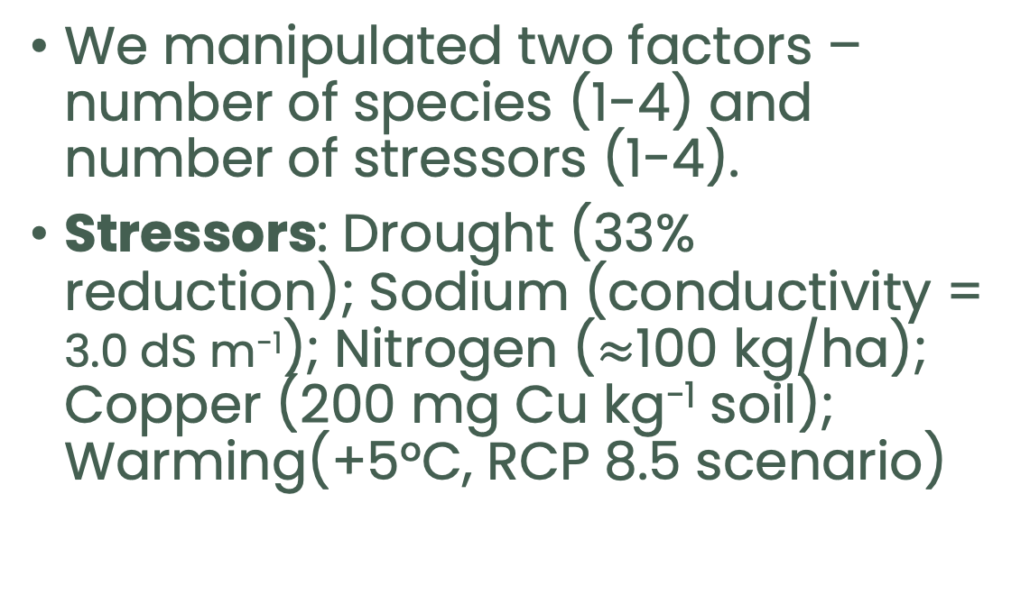
The experiment
(sBEF)
We manipulated two factors –number of species (1-4) and number of stressors (1-4).
Stressors: Drought (33% reduction); Sodium (conductivity = 3.0 dS m⁻¹); Nitrogen ($≈$100 kg/ha); Copper (200 mg Cu kg⁻¹ soil); Warming(+5°C, RCP 8.5 scenario)
Species:
Latin name | English name | Characteristics
Elymus virginicus | Virginia Wild Rye | C3 grass
Bouteloua curtipendula | Side-oats Grama | C4 grass
Rudbeckia hirta | Black-eyed Susan | Biennial
Monarda fistulosa | Wild Bergamot | Perennial
Astragalus canadensis | Canadian Milk Vetch | Perennial

Slide 19
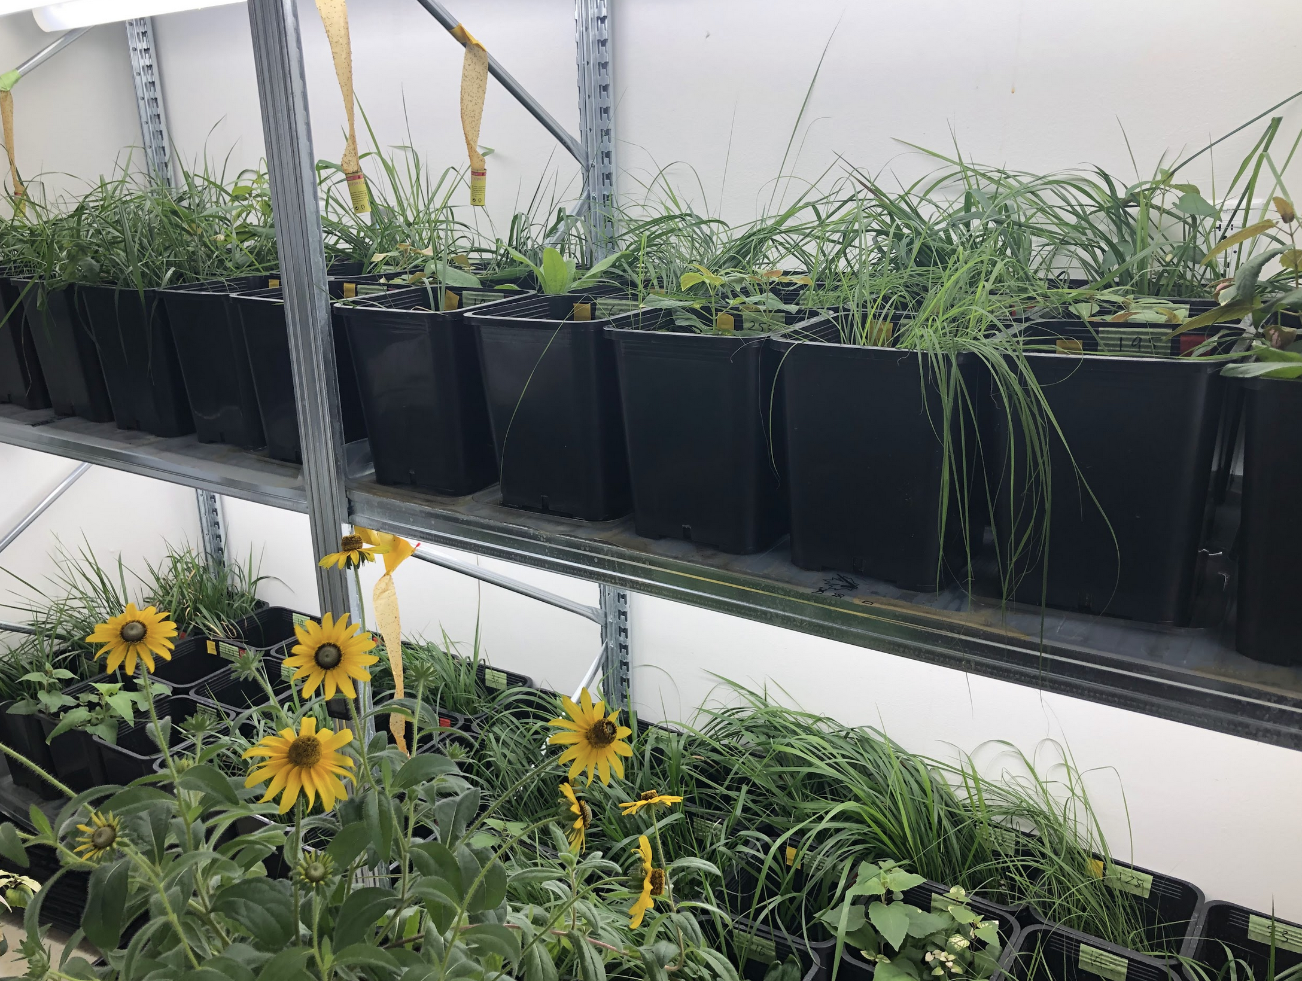
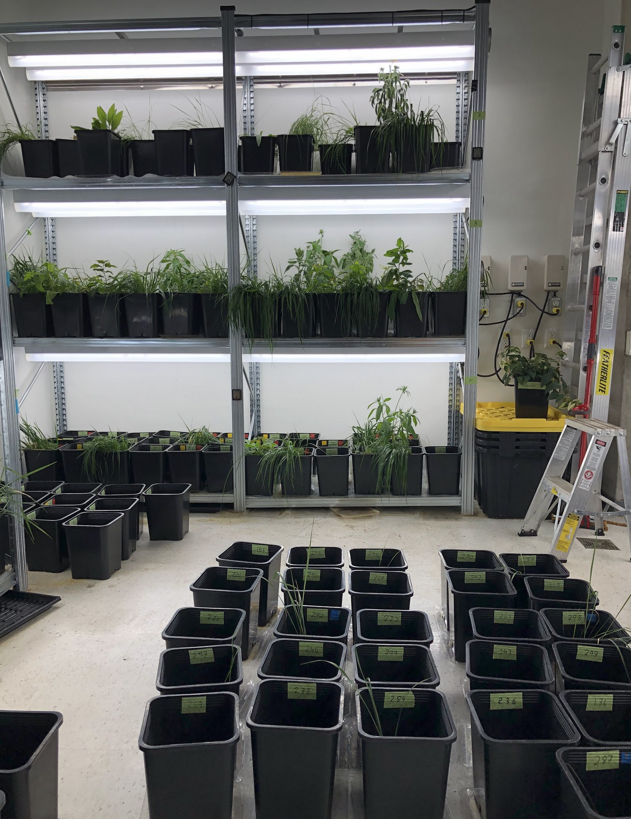
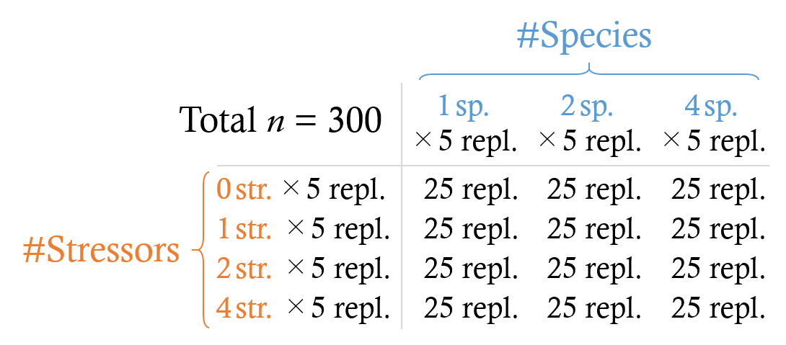
The experiment
(sBEF)
1.5 L of sterilized soil per pot, including 0.15 L natural topsoil for microbial inoculum.
40 individuals added (corrected by germination rates).

Slide 20
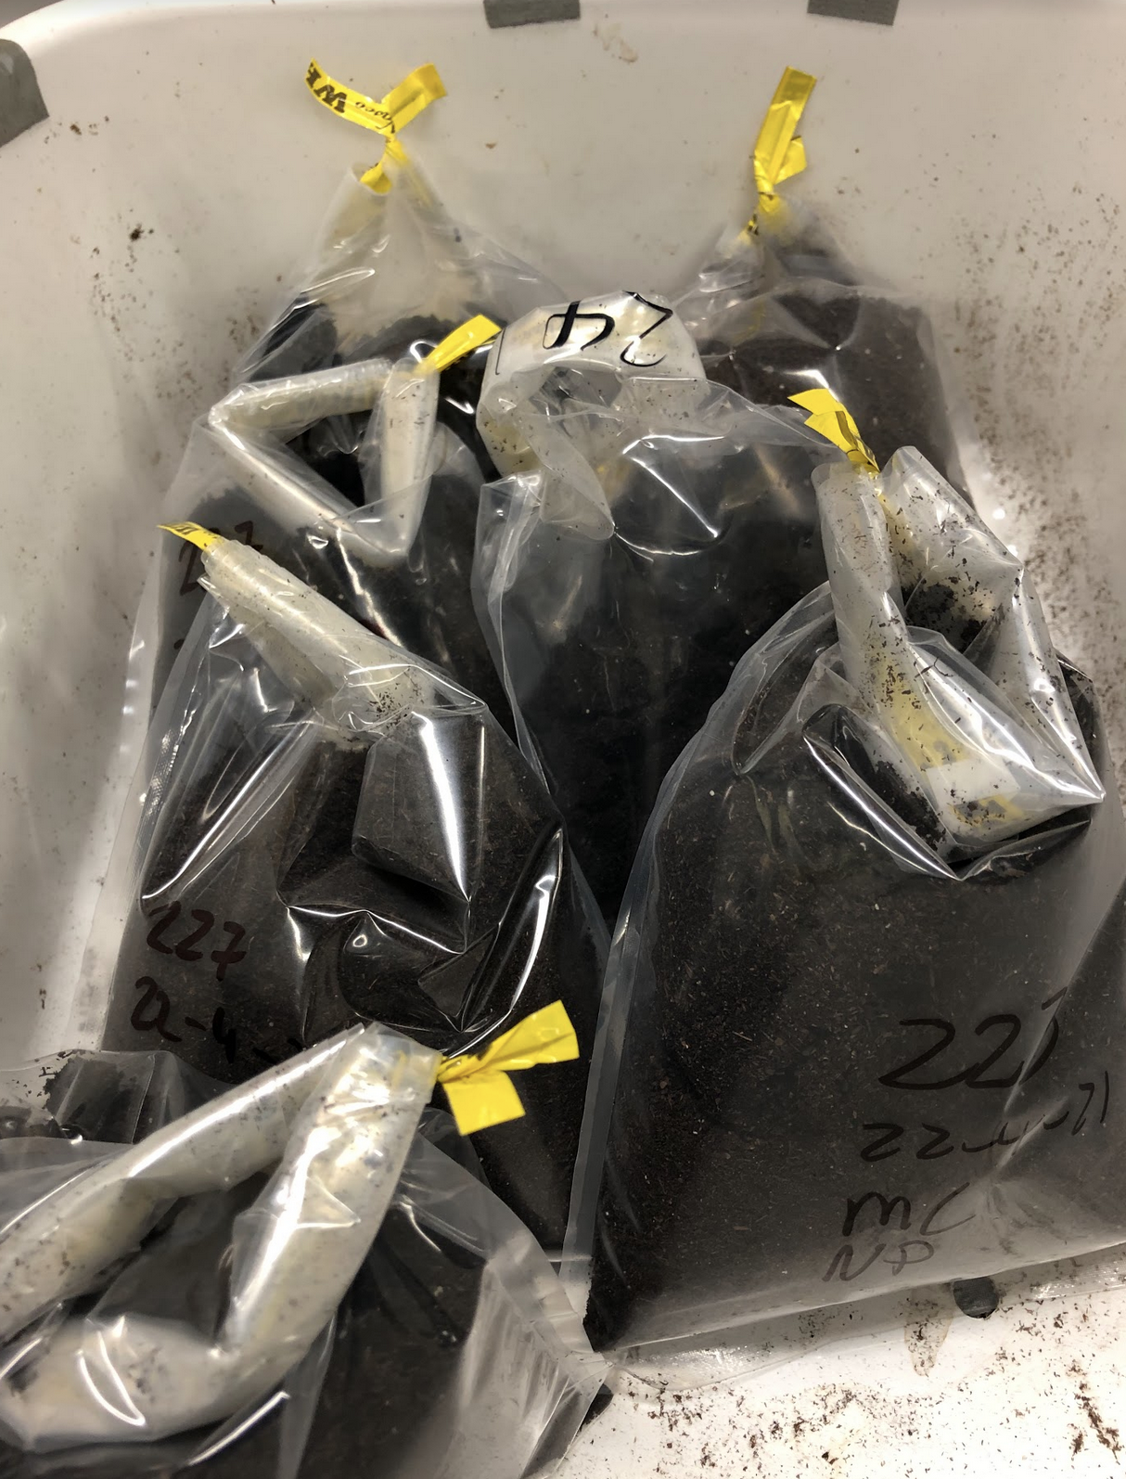
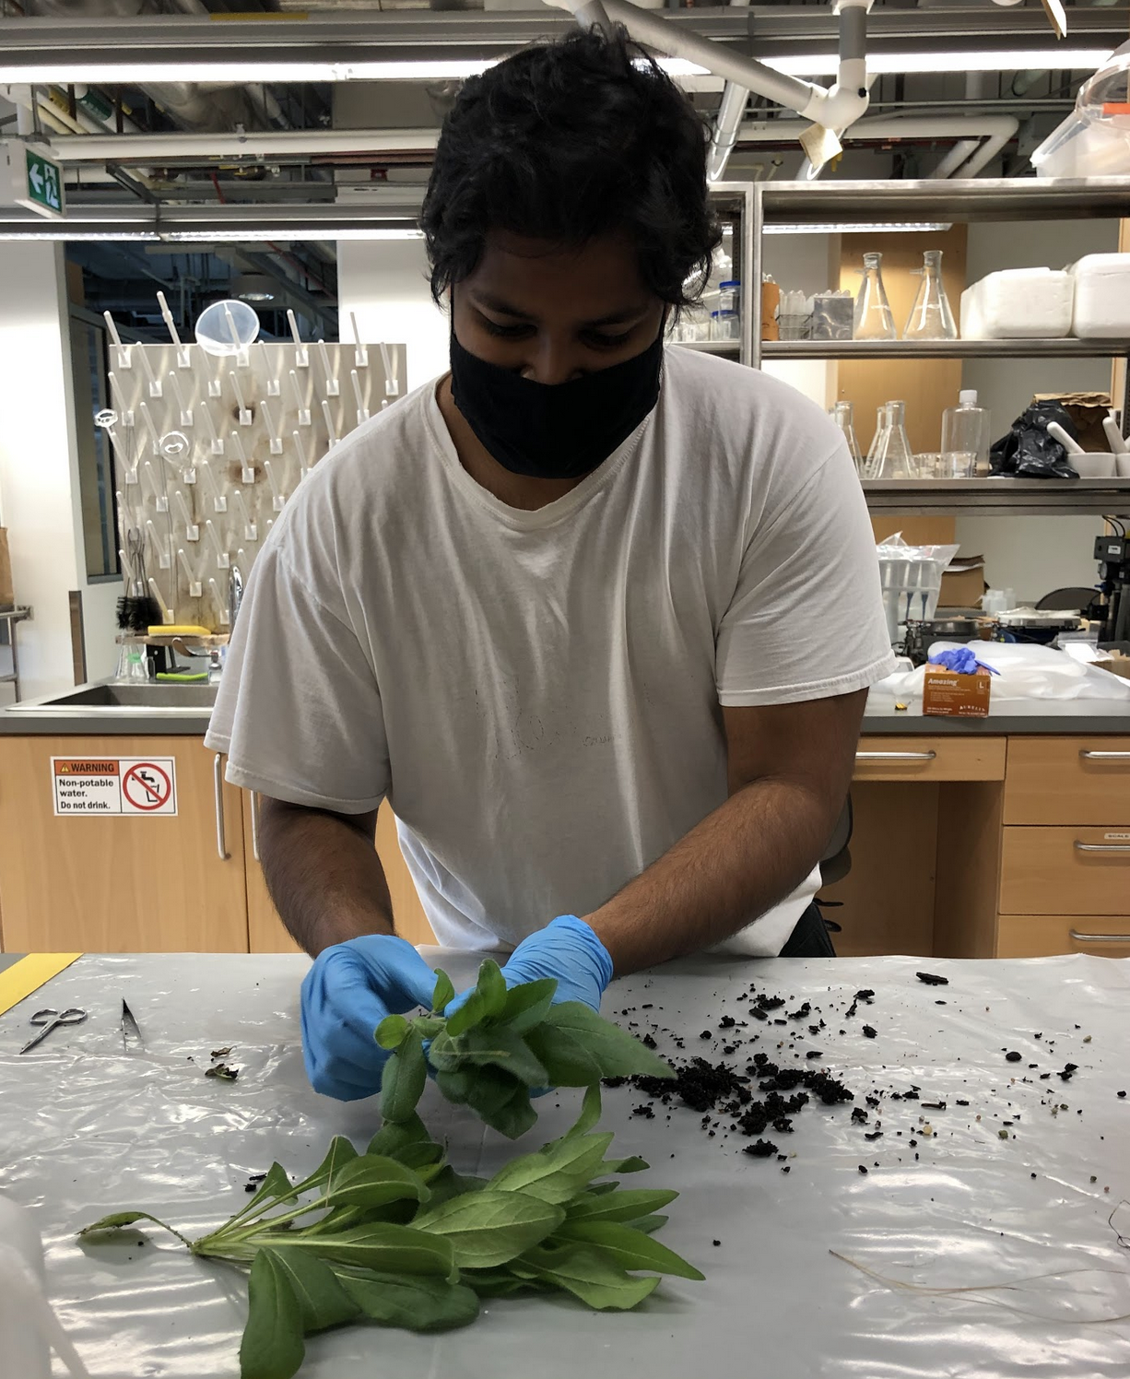
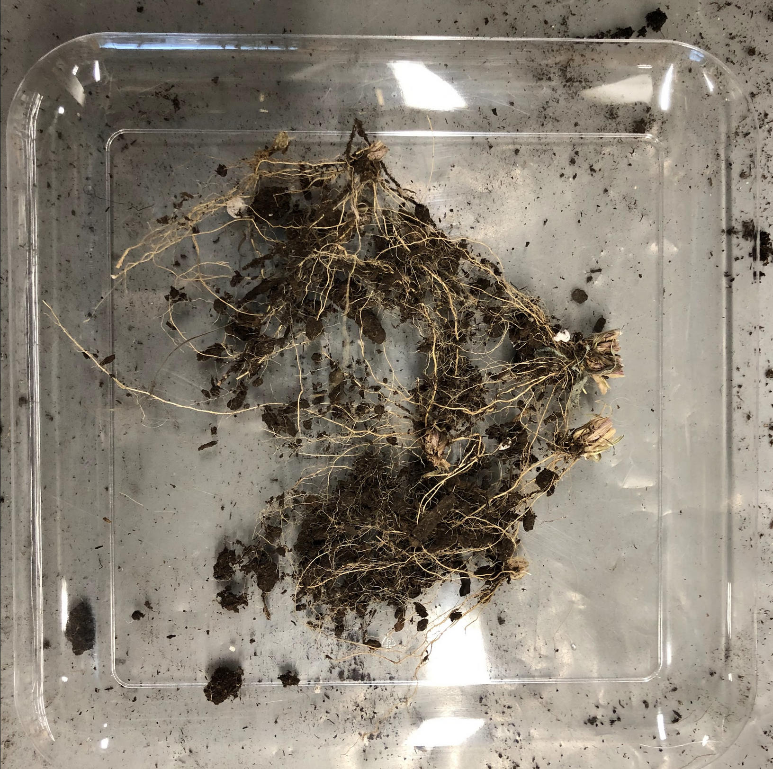
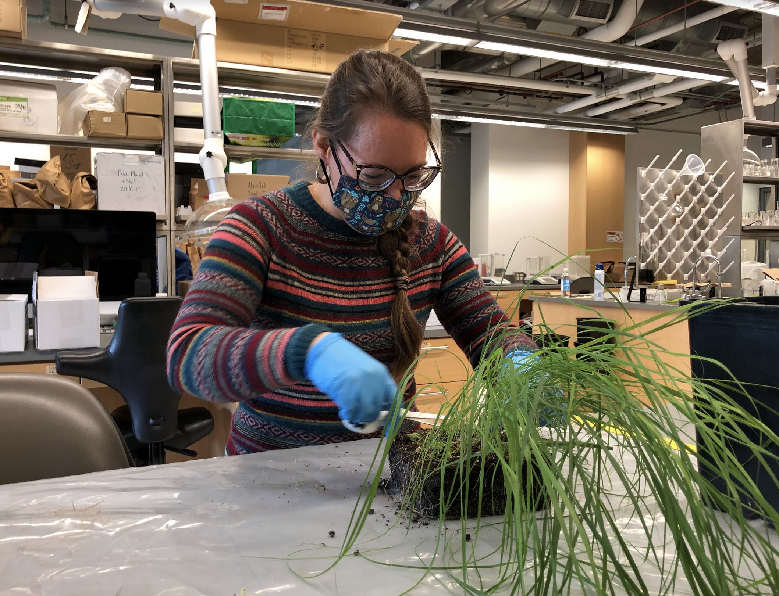
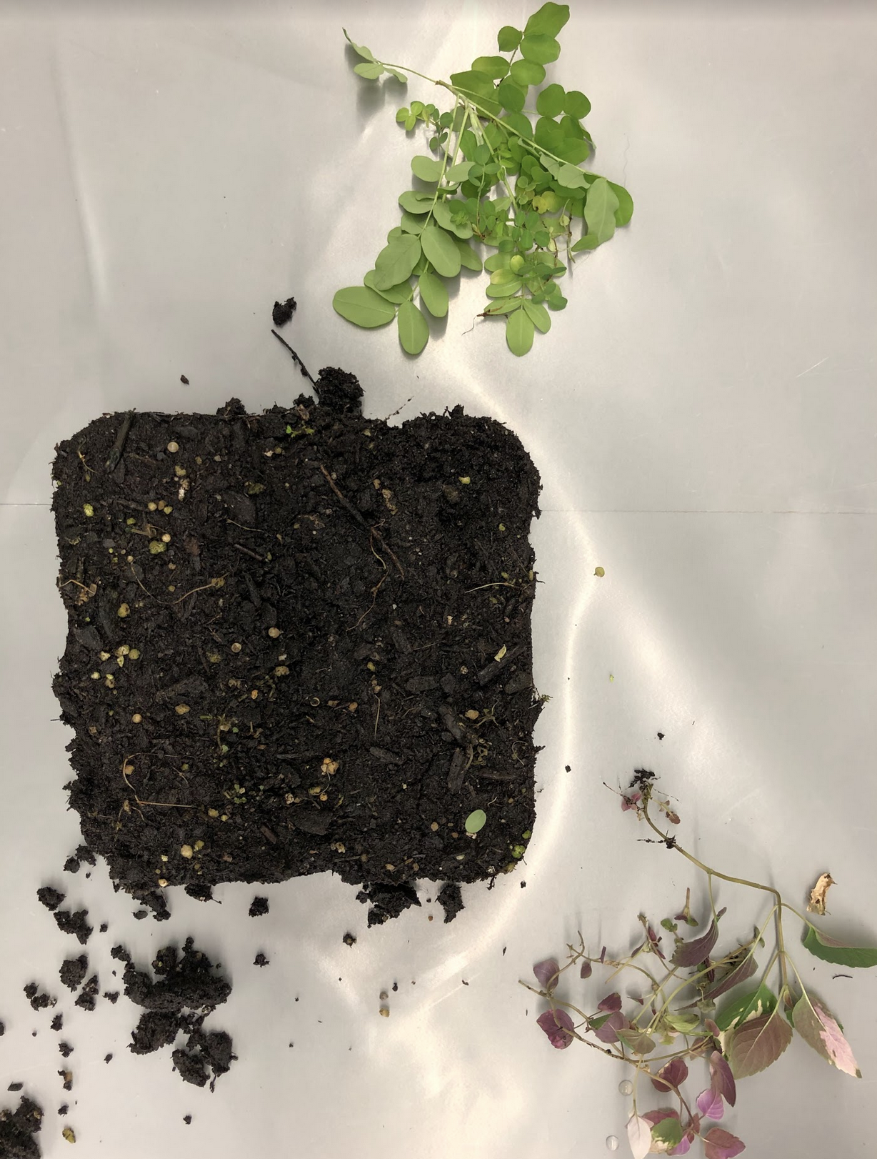
The experiment (sBEF)
Plants were harvested after 16 weeks after germination.
Separated into above and below ground components.
Soil samples collected.
Mixed effects model with shelving unit as random effect.
Structural equation model.

Slide 21

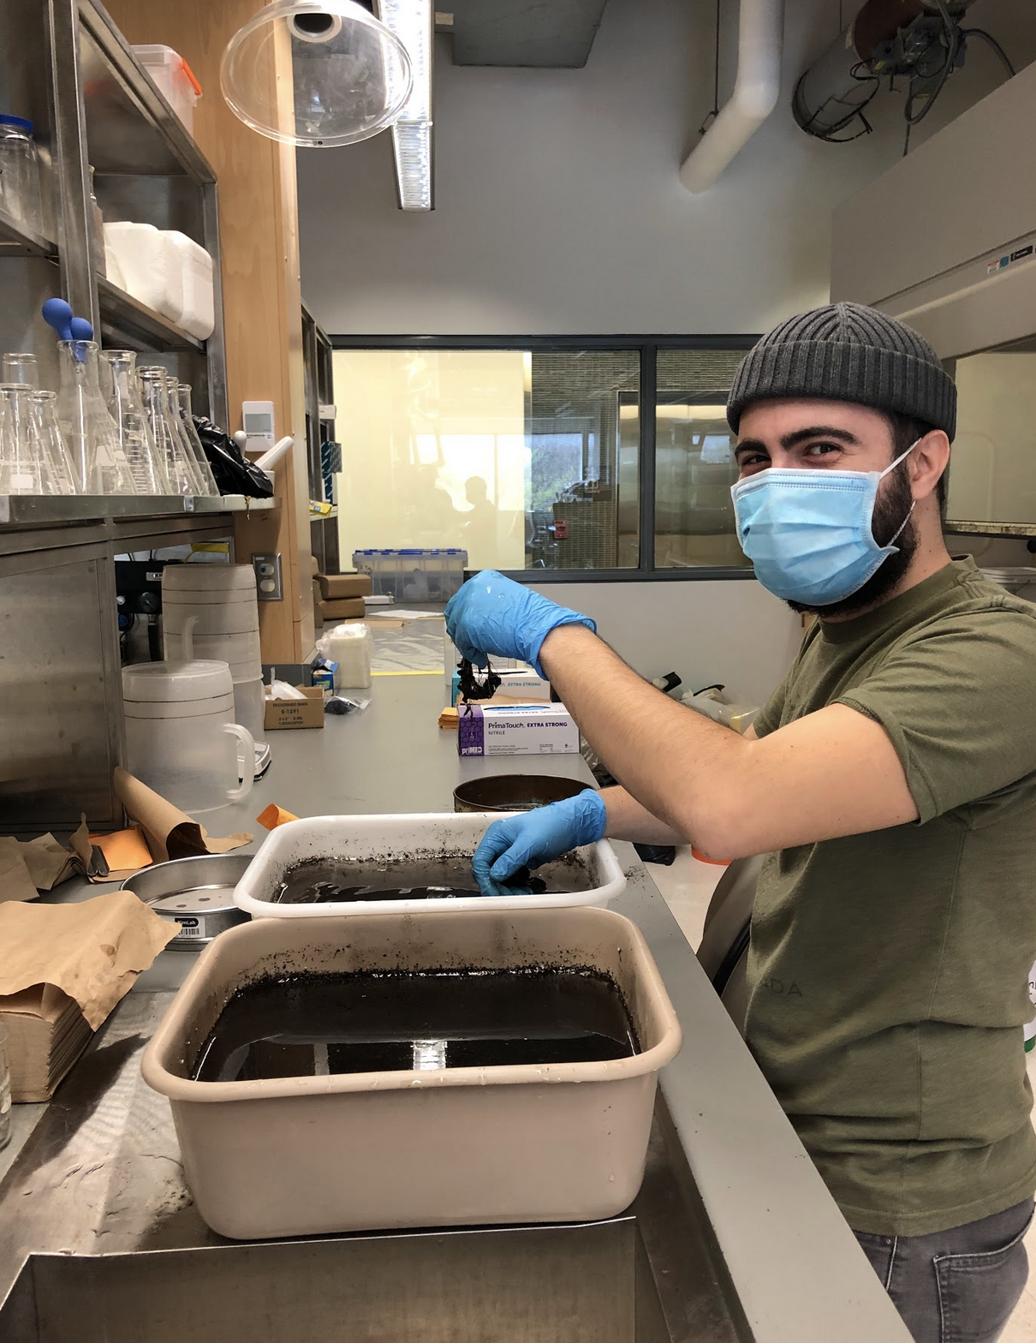
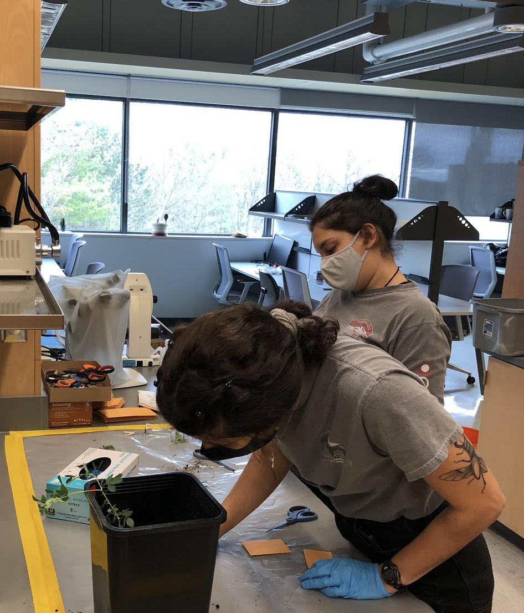
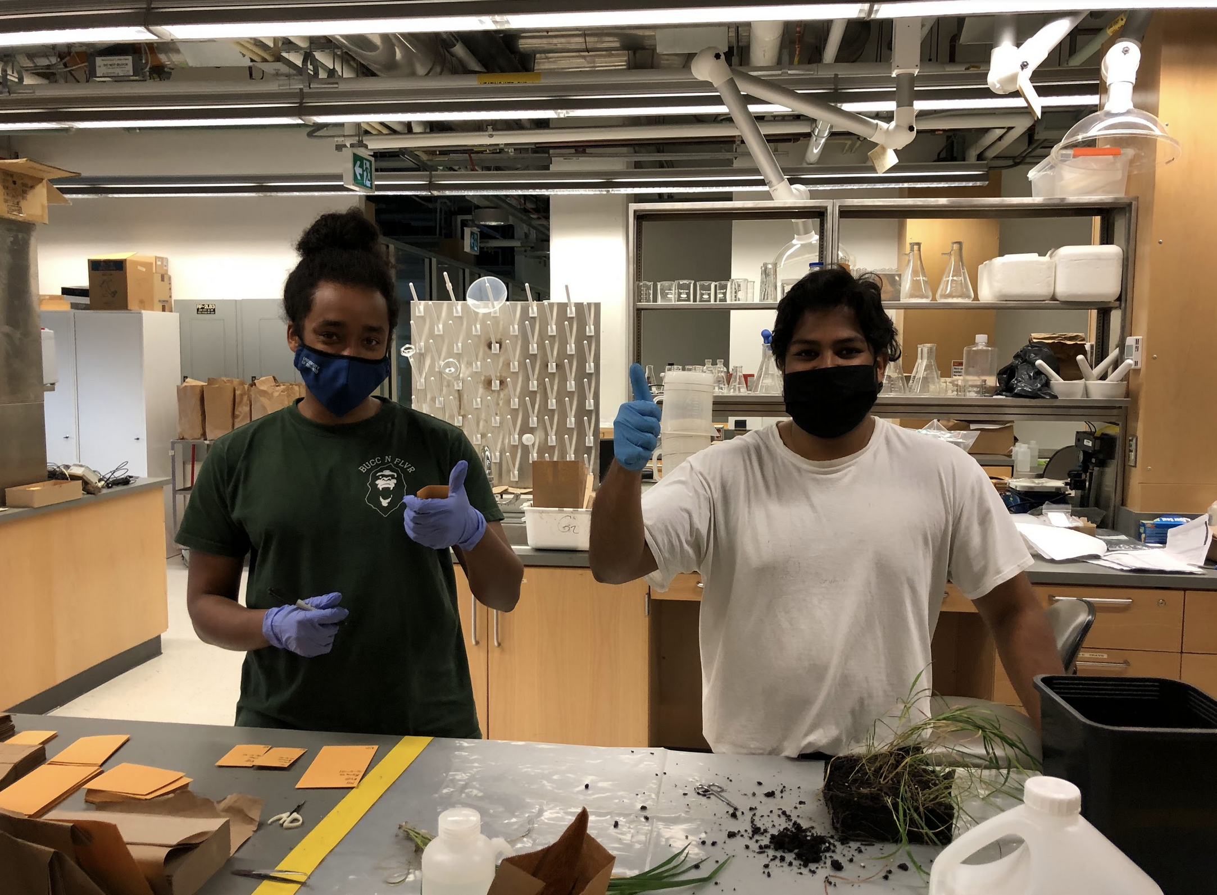
Despite COVID

Slide 22
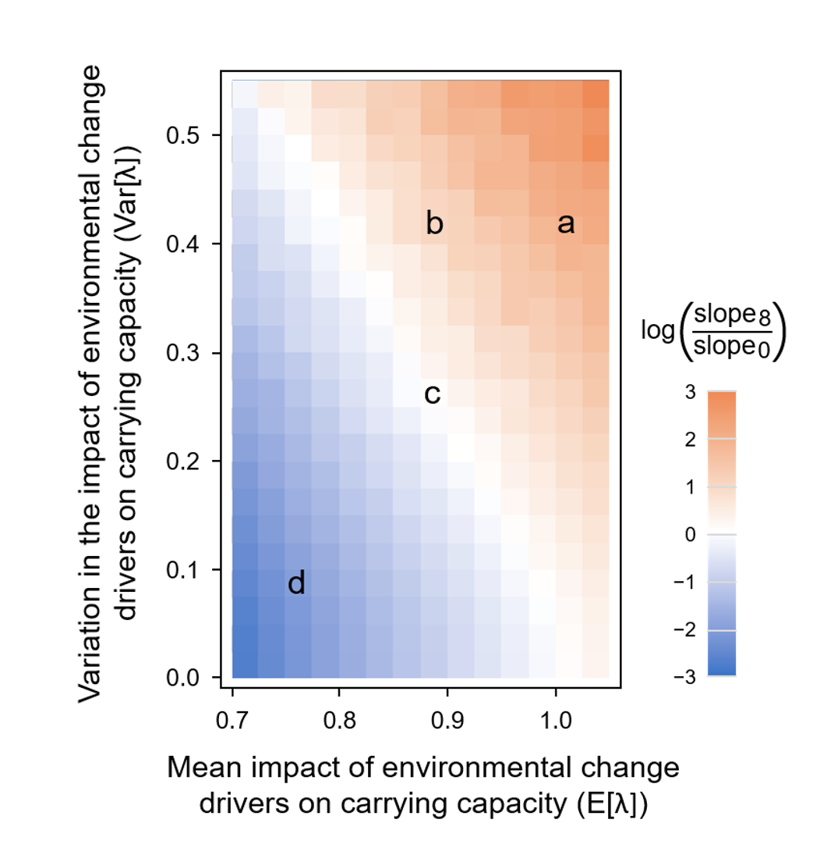
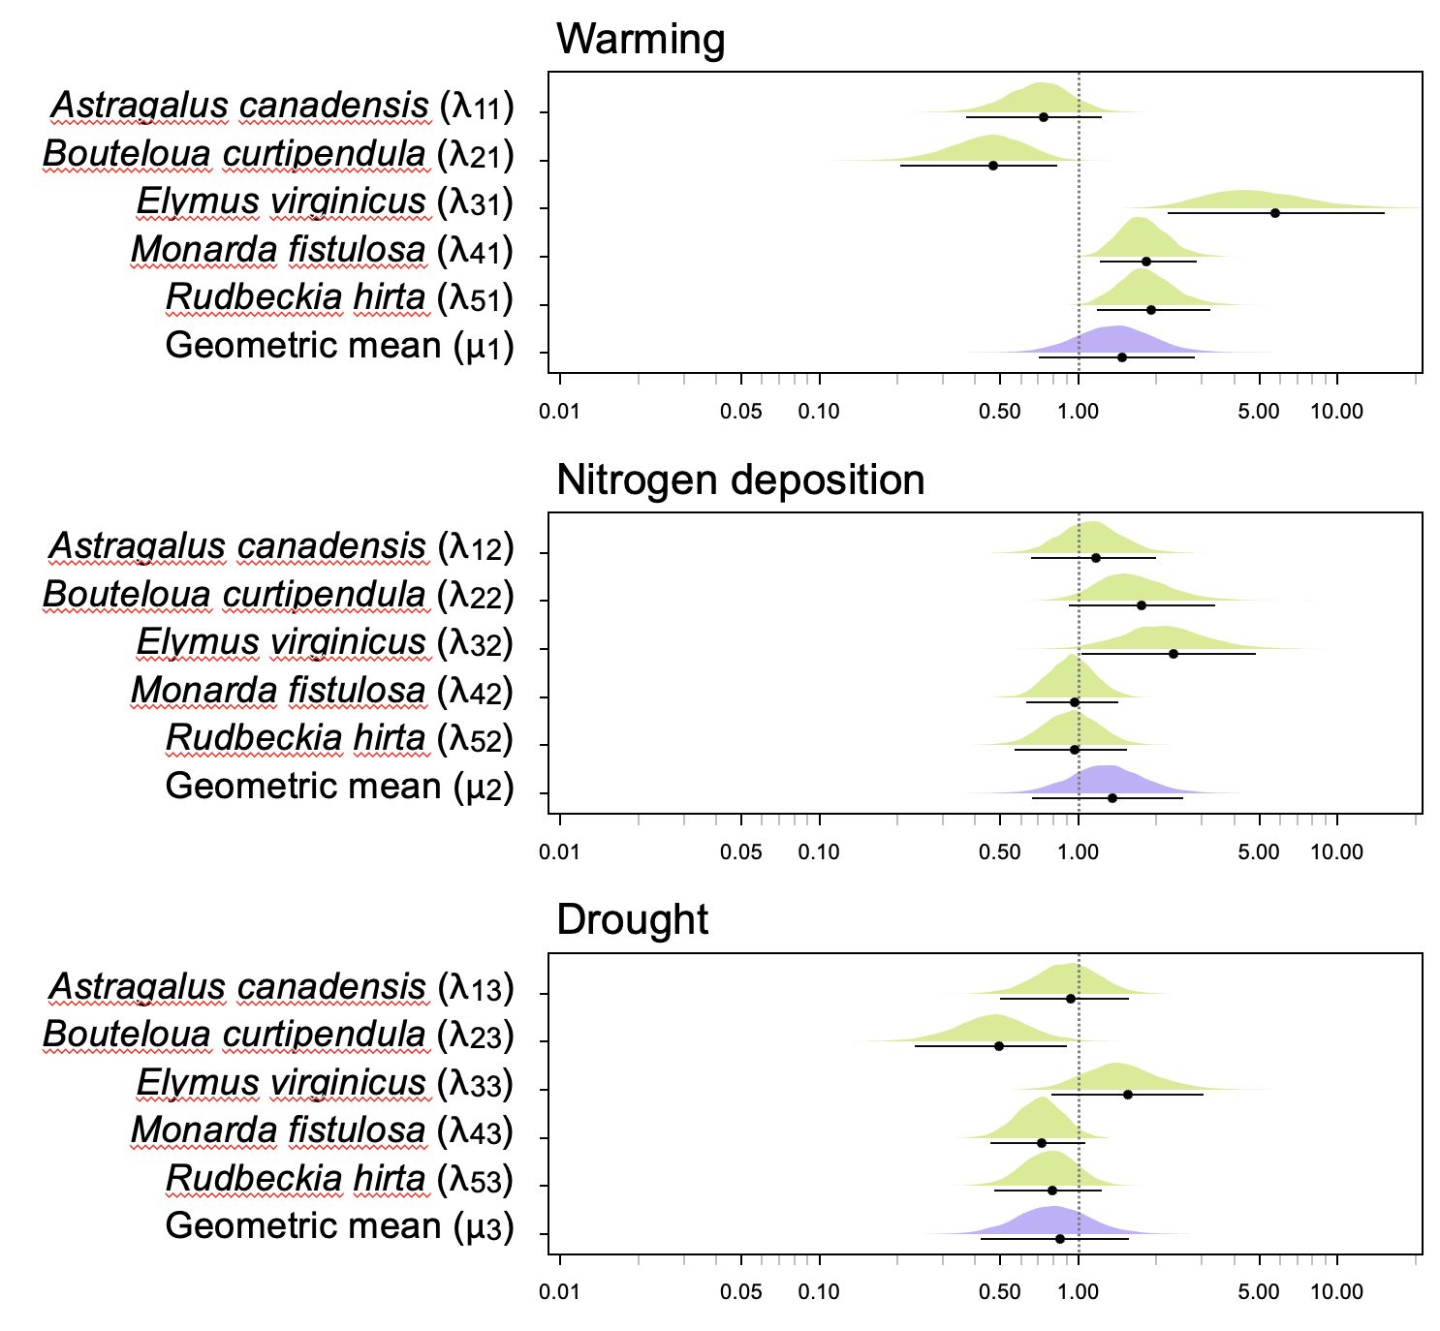
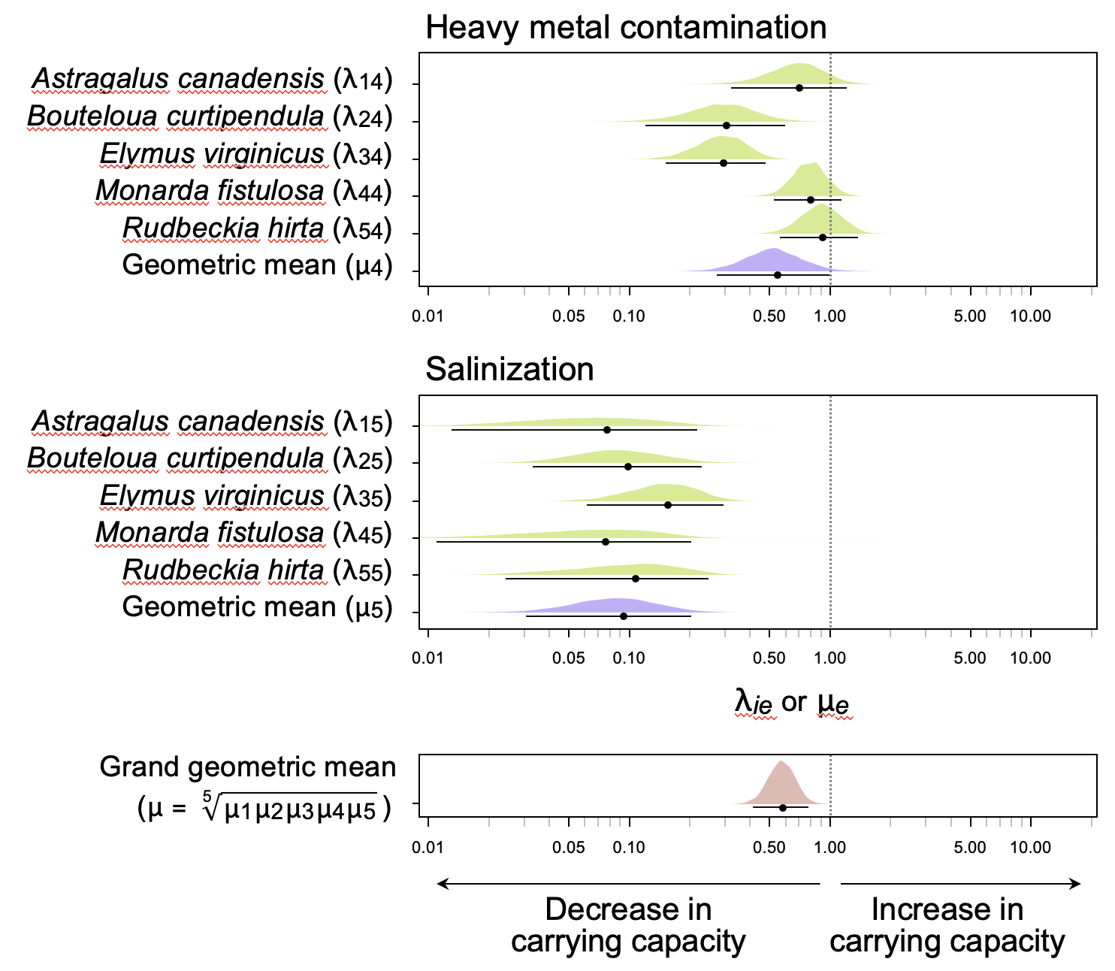
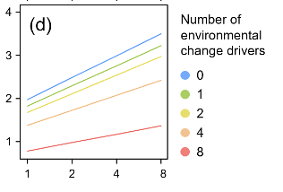
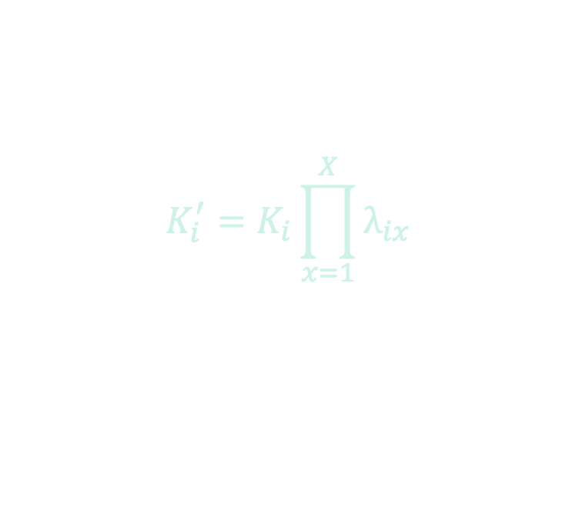
Results combining stressors
$$K_{i}^{′}=K_{i}\prod_{x=1}^{X}{λ_{ix}}$$

Slide 23


Results: sBEF relationships

Slide 24

Results: sBEF relationships
Selection effects dominate, but multiple stressors eliminate these effects

Slide 25
sBEF summary
Environmental drivers (stressors) can have differential effects on different species.
When stressors are combined, and their average effect is negative, can result in both a lower BEF slope and/or reduce overall functioning (lower intercept).
Translating BEF research to anthropogenic landscapes requires correction for the effect of the dominant stressors.

Slide 26






Biodiversity as a management tool for mitigating effects of anthropogenic stressors
Manipulating biodiversity has become a management option for increasing ecosystem function in anthropogenic landscapes
Degraded landscapes
Impacts of invasives
Green roof design

Slide 27





BEF on polluted soils
not easy to restore.
poor recovery.
loss of function.
Degraded landscapes
Jin-tian Li
Pu Jia

Slide 28



Understanding how biodiversity increases function on contaminated land.
102 2 x 2 m plots
Sown: 1, 4, 8 & 16 plant species
Seeds collected from around site
Measured: plant cover, biomass, soil microbes & soil chemistry
Repeated for 3 years
Jia et al. J. App. Ecol. 2020

Slide 29

Biodiversity increases ecosystem function on degraded land
No evidence nutrient limitation driving this
Jia et al. J. App. Ecol. 2020

Slide 30




Invasion decreases BEF relationships
Impacts of invasives
Stuart Livingstone
Marta Carboni
Darwin Sodhi
Sodhi et al. 2019. Ecol & Evol.
Livingstone et al. 2020 . Ecol. Mons.
Carboni et al. 2021 .J. Ecol
Cadotte. 2023. Ecol. App..
“Dog-strangling vine” (Vincetoxicum rossicum)

Slide 31


Invasion decreases BEF relationships
B
A
Ecosystem function
Plant Biodiversity
Pollinator richness
Functional diversity
Richness, evenness,
dispersion, divergence,
CWM: height, SLA, leaf C:N)
Pollinator abundance
Flower cover
Compositional diversity
Shannon’s H,
Simpson’s D,
Pielou’s J
Soil C
Relative DSV abundance
Soil N (total and Inorganic)
Decomposition rate
Species diversity
Richness
Phylogenetic (PD)
C
Aboveground biomass
Litter production

Slide 32



Invasion decreases BEF relationships
Biodiversity
DSV
Regression coefficient (± 95% C.I.)

Slide 33

Management lessons
Removal of dominant invaders needs to be quickly followed by restoration activities that increase species diversity.
These systems are depauperate and might have lower functioning, and much of the remaining function will depend on dominant invader.

Slide 34





Increasing green roof function with biodiversity
Scott MacIvor
Green infrastructure: green roofs

Slide 35















Maximizing green roof function using evolved differences

Slide 36



Evidence that evolutionary diversity influences green roof function.
Phylogenetic diversity
Phylogenetic diversity
MacIvor et al. 2018. Evol. App.

Slide 37

Final group assignment!
Think like a Structural Equation

Slide 38
Set up a testable hypothesis
Create structural hypothesis about the effect of multiple drivers/stressors on biodiversity and ecosystem function. Indicate paths of effect and covariation.
Identify the type of experiment you’d use and taxa/system
Can include:
Drivers
Temperature
Drought
Metal
contamination
Ozone
Salinity
Noise
Light
etc
Biodiversity
Richness
Evenness
Diversity
Phylogenetic
Functional
Beta
etc
Ecosystem functions
Biomass
Nutrient uptake
Decomposition
Pollination
Carbon storage
Food production
etc

