Slide 1
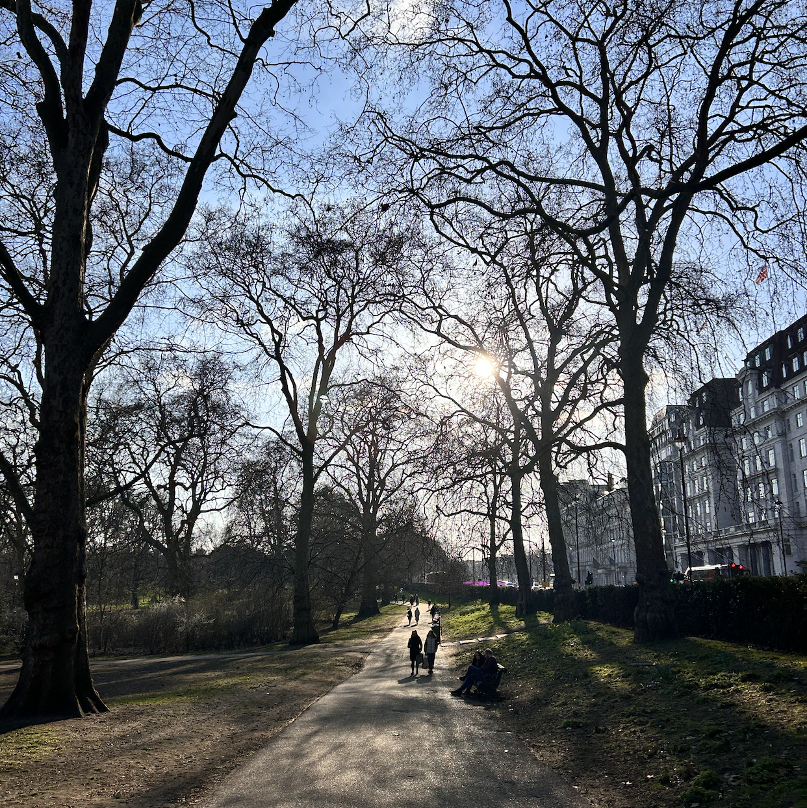
Integrating evidence into the conservation implementation pipeline
Marc W Cadotte, Bill Surtherland, Iroro Tanshi and Tsungai Zengeya

Slide 2

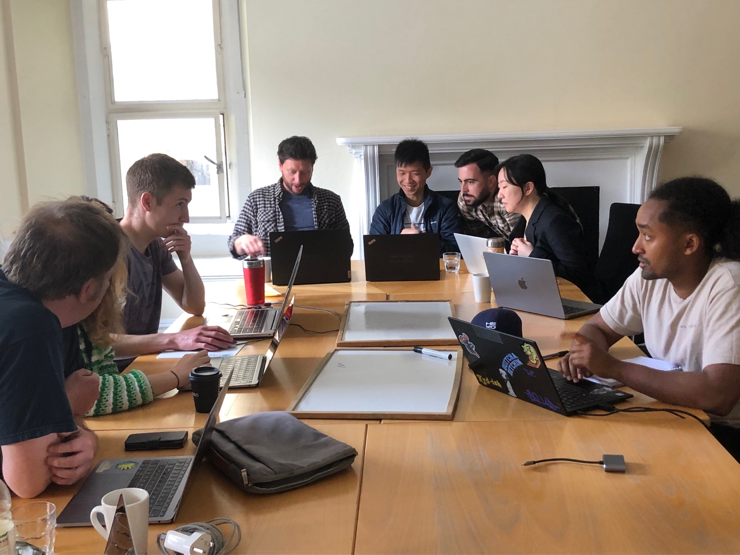
Introductions
Marc W Cadotte
Bill Surtherland
Iroro Tanshi
Tsungai Zengeya

Slide 3

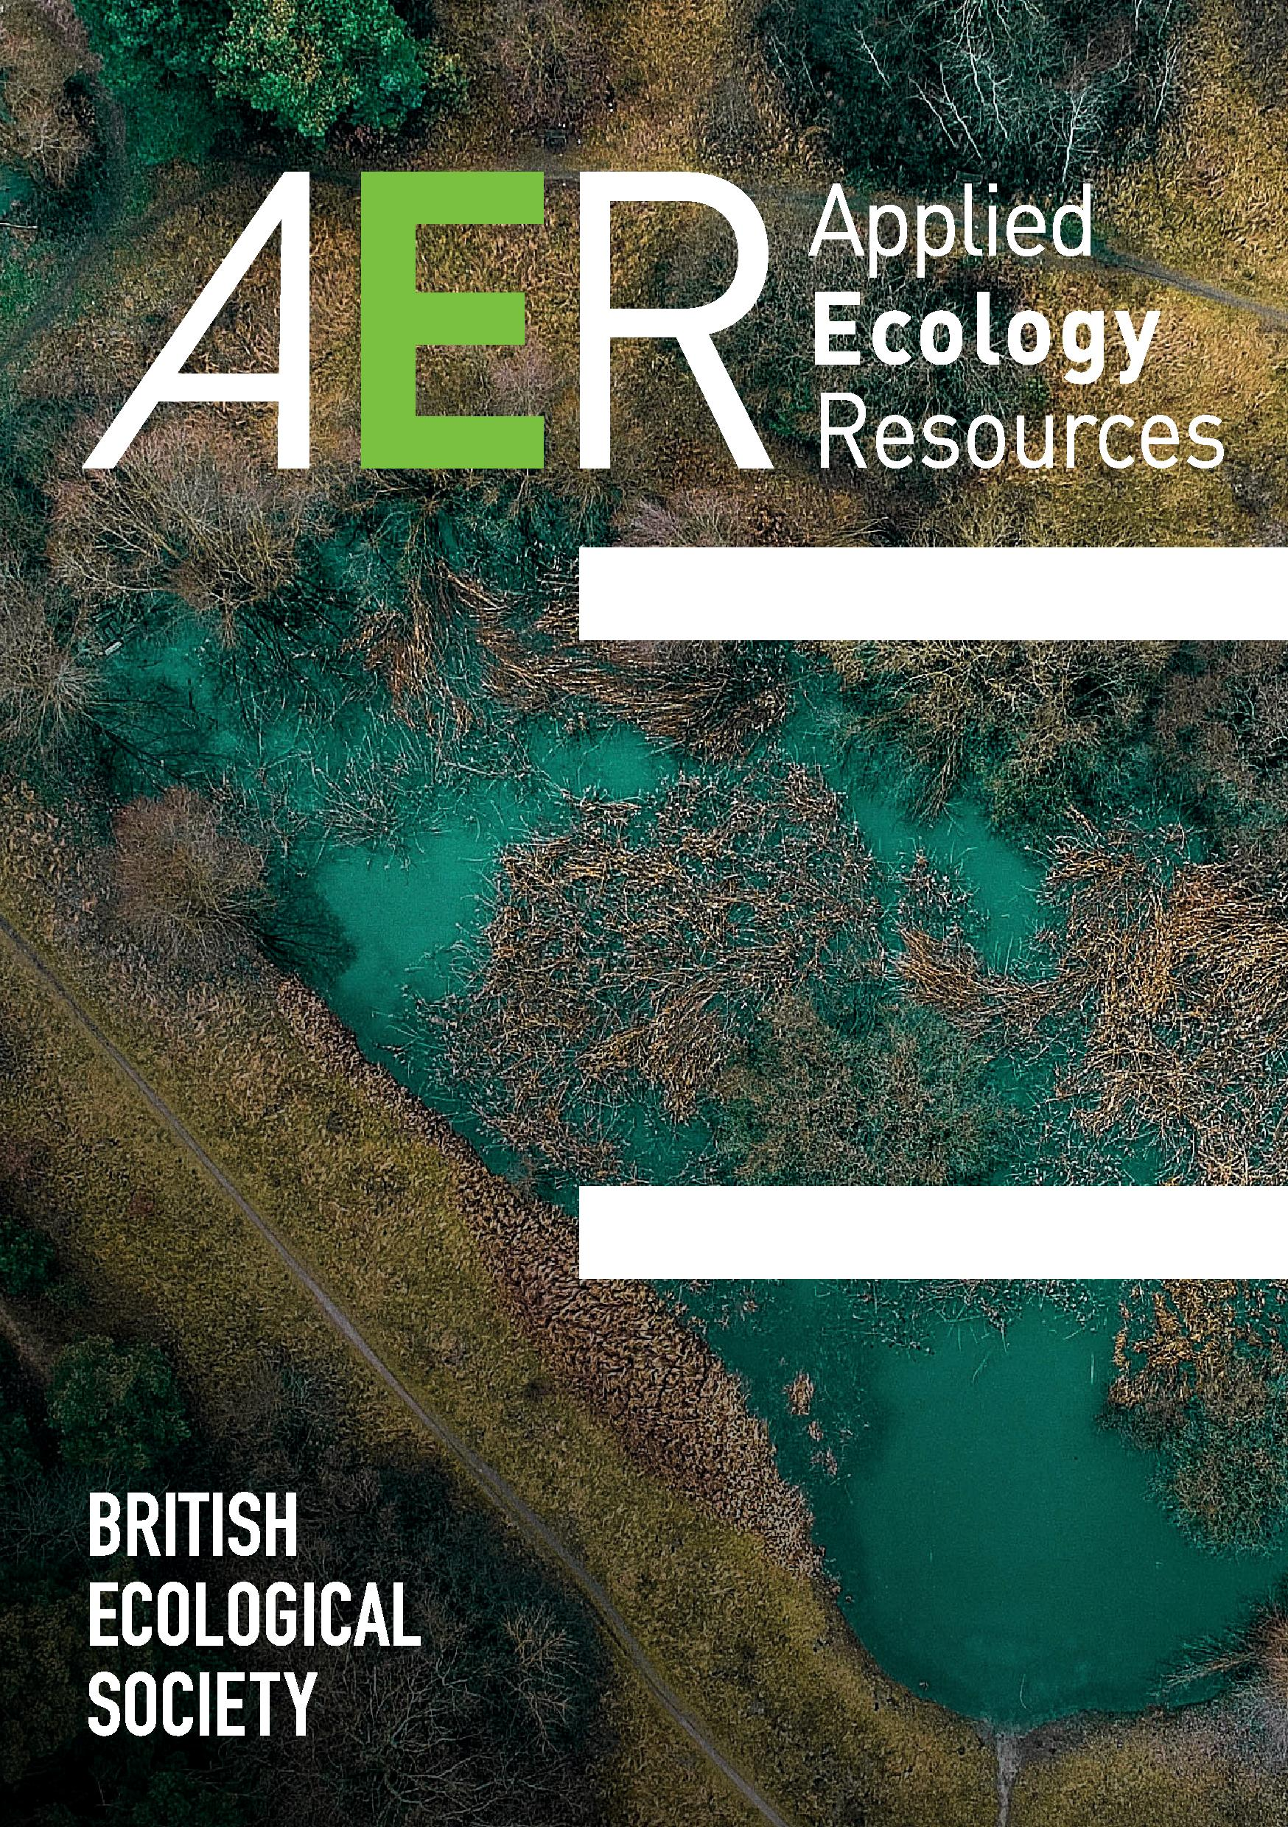
Ecology at your fingertips
A globally accessible open resource for the management of biodiversity and the environment.
Share work with a global community of ecologists and environmental consultants in academia and on-the-ground practice.
Discover the most up-to-date applied ecology research and summaries from leading organisations including the Woodland Trust and Defra (UK government).
www.appliedecologyresources.org
hello@appliedecologyresources.org

Slide 4


An open access journal from the British Ecological Society publishing articles with direct relevance for the management of biological resources and ecological systems.
Facilitates conversations between practitioners, researchers, and community.
www.EcologicalSolutionsandEvidence.org
editorial@ecologicalsolutionsandevidence.org

Slide 5

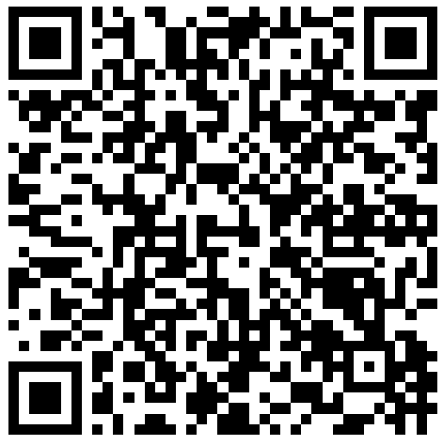
Read free conservation content:
FAR-sighted conservation
Thomas, C. D., Hill, J. K., Ward, C., & Hatfield, J. H. (2022)
Wildlife health outcomes and opportunities in conservation translocations
Beckmann, K. M., et al. (2022)
The impacts of management interventions on the sociality of African lions (Panthera leo): Implications for lion conservation
McEvoy, O. K., Ferreira, S. M., & Parker, D. M. (2022)
An introduction to evidence-based conservation (content tailored for research scientists)
Downey, H. & Amano, T. & Walsh, J. (2020)
Savanna woody plants responses to mammalian herbivory and implications for management of livestock–wildlife landscape
Kibet, S., Nyangito, M., MacOpiyo, L., & Kenfack, D. (2021)
www.EcologicalSolutionsandEvidence.org
www.appliedecologyresources.org

Slide 6
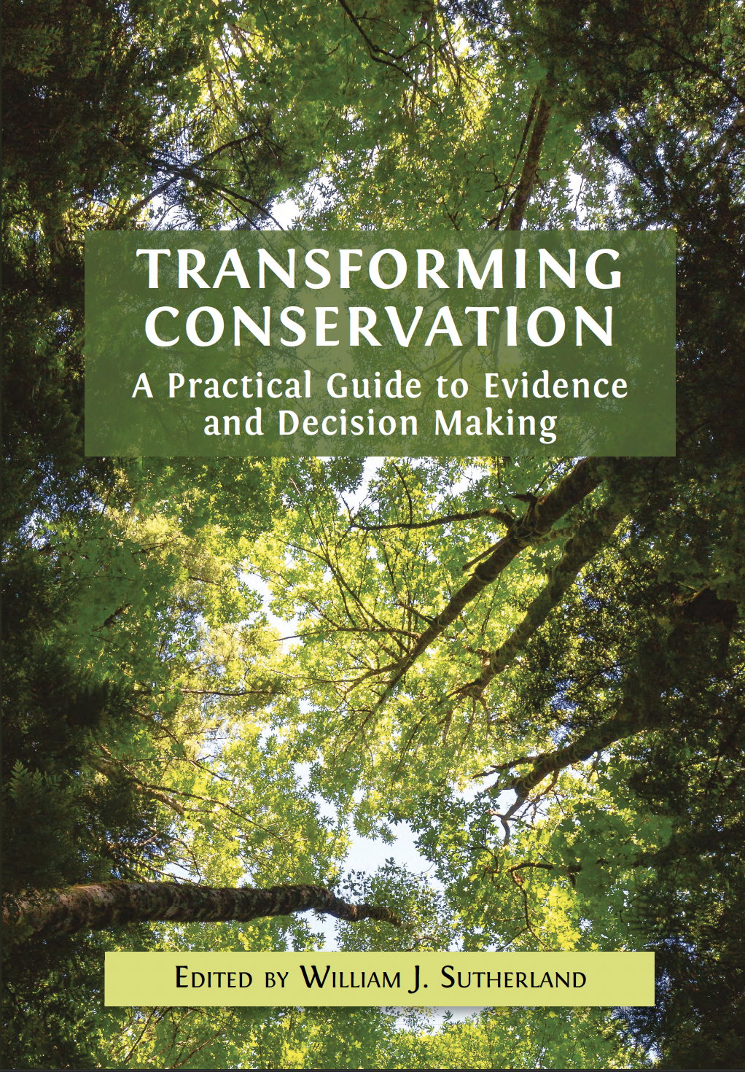
1. Introduction: The Evidence Crisis and the Evidence Revolution
2. Gathering and Assessing Pieces of Evidence
3. Assessing Collated and Synthesised Evidence
4. Presenting Conclusions from Assessed Evidence
5. Improving the Reliability of Judgements
6. Identifying Stakeholders and Collaborating with Communities
7. Framing the Problem and Identifying Potential Solutions
8 Making Decisions for Policy and Practice
9. Creating Evidence-Based Policy and Practice
10. How Conservation Practice Can Generate Evidence
11. Creating a Culture of Evidence Use
12. Transforming Practice: Checklists for Delivering Change

Slide 7
Ensuring best practice
Applied practice is best served by combining empirical knowledge with on-the-ground realities.
Yet, it is recognized that empirical evidence has had limited deployment in applied decision-making, and interventions and other applied projects are seldomly the sources of evidence that inform conservation projects and policies elsewhere.
Moreover, there is not a universally accepted/employed set of standards to evaluate the evidence that can improve applied conservation.

Slide 8
Accepted standards needed
There are several steps in conservation implementation where information is needed, and decisions required. These steps should be guided by best practice.
  Funding decisions
  Background information assessment
  Project planning
  Project assessment
  Analysis and conclusions
  Evidence integration and communication

Slide 9
Tried and true methods from other disciplines
As an example, meta-analyses and systematic reviews are the standard to assess conservation evidence (e.g., efficacy of a particular intervention). These come from the medical sciences where unbiased assessment is seen as necessary.
Other disciplines use checklists to ensure best practice is followed every time an action is performed.

Slide 10
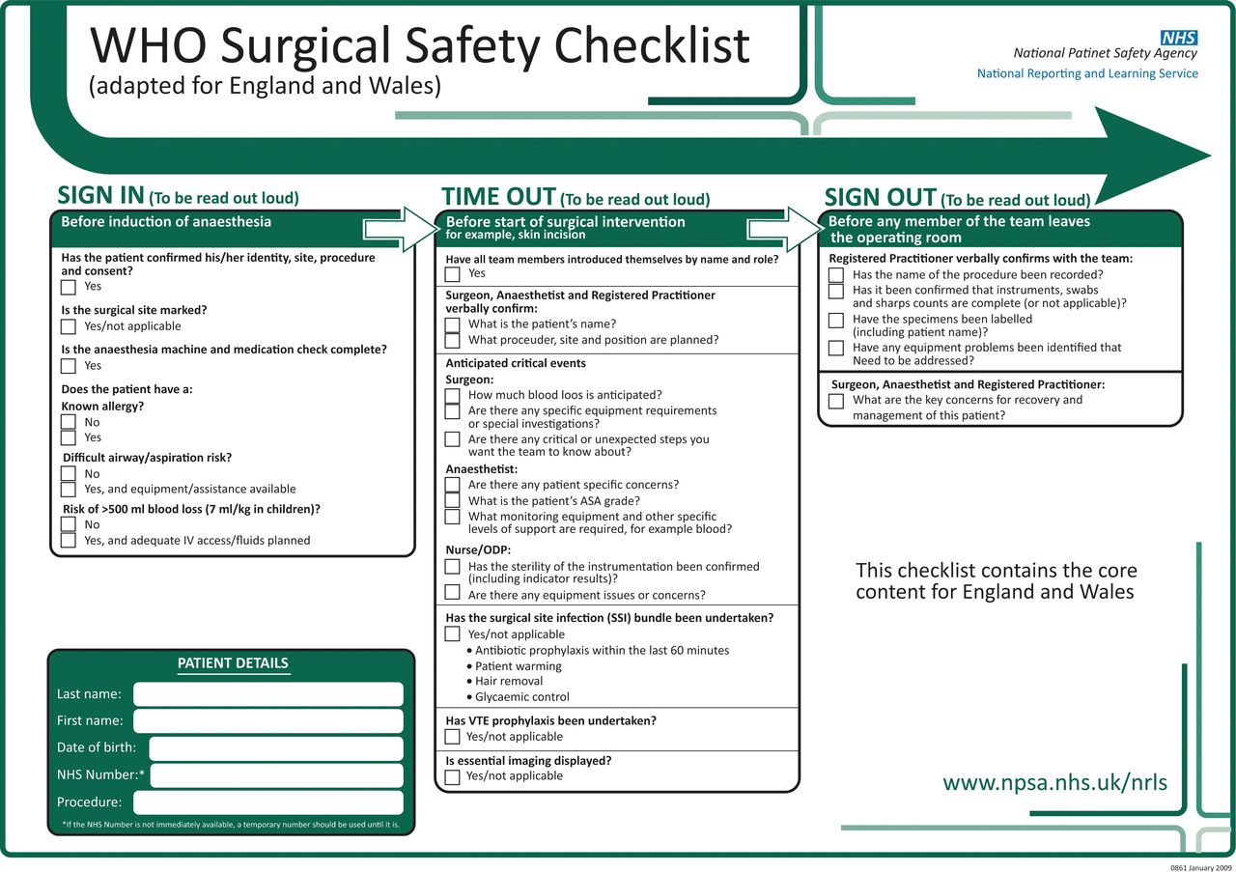
World Health Organization surgical safety checklist

Slide 11
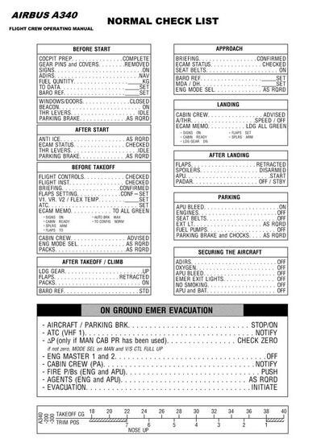
Flight checklist

Slide 12
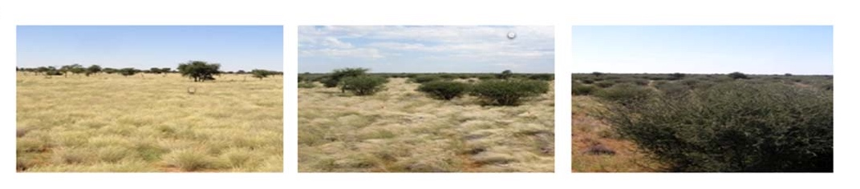
What’s needed for an effective conservation intervention.
Identifying problem/desired outcomes

Slide 13
What’s needed for an effective conservation intervention.
Identifying problem/desired outcomes
Identifying stakeholders/communities

Slide 14

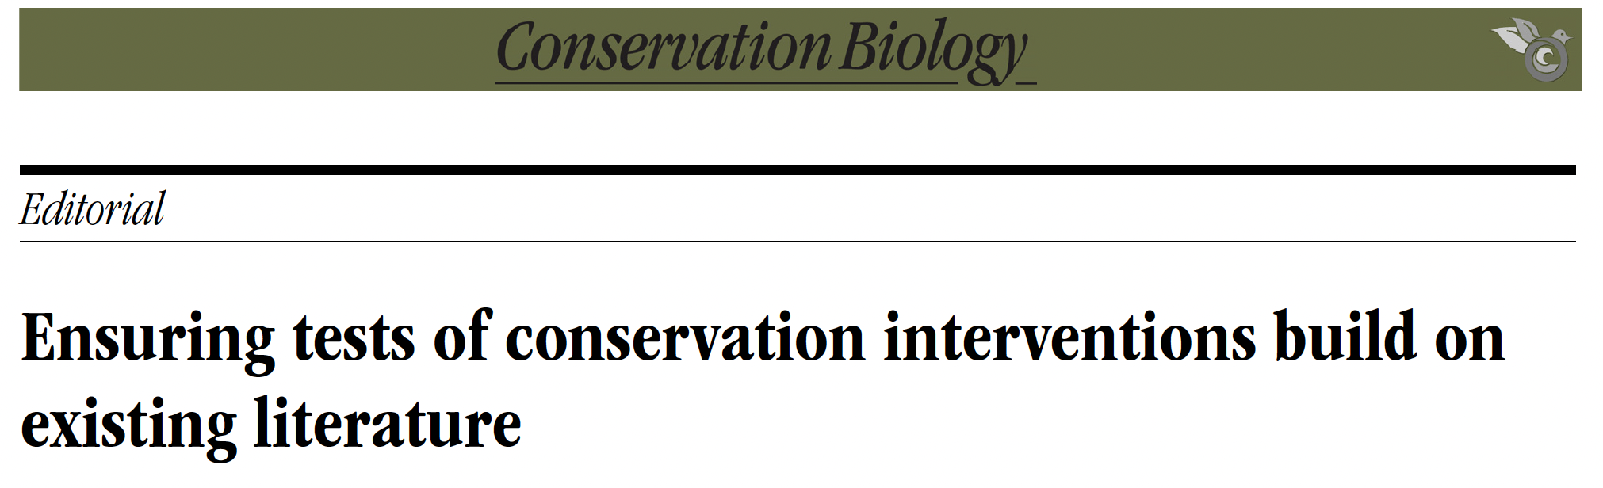
What’s needed for an effective conservation intervention.
Identifying problem/desired outcomes
Identifying stakeholders/communities
Assessing available evidence

Slide 15

What’s needed for an effective conservation intervention.
Identifying problem/desired outcomes
Identifying stakeholders/communities
Assessing available evidence
Designing project

Slide 16
What’s needed for an effective conservation intervention.
Identifying problem/desired outcomes
Identifying stakeholders/communities
Assessing available evidence
Designing project
Secure funding*
* Perhaps a separate checklist needed for funders!

Slide 17
What’s needed for an effective conservation intervention.
Identifying problem/desired outcomes
Identifying stakeholders/communities
Assessing available evidence
Designing project
Secure funding*
Carrying out project*
* Yes, this covers a lot

Slide 18
What’s needed for an effective conservation intervention.
Identifying problem/desired outcomes
Identifying stakeholders/communities
Assessing available evidence
Designing project
Secure funding*
Carrying out project*
Assessing outcomes
Replicated design
Statistics
Control/treatment
BACI (before-after control-impact)
Accounting for covariates
Using graphics to present findings

Slide 19
What’s needed for an effective conservation intervention.
Identifying problem/desired outcomes
Identifying stakeholders/communities
Assessing available evidence
Designing project
Secure funding*
Carrying out project*
Assessing outcomes
Communicating results

Slide 20
What’s needed for an effective conservation intervention.
Identifying problem/desired outcomes
Identifying stakeholders/communities
Assessing available evidence
Designing project
Secure funding*
Carrying out project*
Assessing outcomes
Communicating results
Connecting to management/policy

Slide 21
Flight checklist

Slide 22
Workshop goals
This workshop is part of a larger set of initiatives aimed at individual practitioners, conservation organizations, and funders to make applied practice more empirically robust, increase transparency, and promote adoption of best practice and repeatability.
By designing a set of checklists, much like other professions use (e.g., medical, engineering, flight industries), these best practice priorities can be better ingrained into how we carry out, evaluate, and communicate conservation interventions.

Slide 23
Workshop goals
Participants will then take part in structured activities that will build components of the Integrating Evidence into Practice checklist. The checklist will be subdivided into major components of the applied conservation pipeline: from funding to community engagement, evaluating success and recommending policy change.
Participants will be invited to continue participation in the design of the checklist.
The checklist will be the subject of an article, and it will be available in AER (in multiple languages).

Slide 24
Group activities
Groups will be formed to work on creating parts of the checklist
There will be four activities, each 15 minutes.
We will spend that last few minutes with general discussion and next steps.

Slide 25
Activities
The groups will undertake four activities, each includes a subset of the conservation intervention steps, going from initial to final steps.
The groups will discuss and record what they think should be the items in a checklist for each step.
At any time, the group could decide to change or create a new step for the check list.
Use the QR code to access additional materials and add your contact info to a spreadsheet for follow-up inclusion.
QR

Slide 26
Group activities
Identifying problem/desired outcomes
Identifying stakeholders/communities
Assessing available evidence
Designing project
Secure funding*
Carrying out project*
Assessing outcomes
Communicating results
Connecting to management/policy
Step 1
Step 2
Step 3
Step 4

Slide 27
Next steps
Participants wishing to remain involved please add your contact information to the spreadsheet.
We will collate all of the suggestions.
We will poll contributing participants with collated options, perhaps hold follow-up virtual meeting.
We will create draft checklist for comment.
We will draft a manuscript for comment.

